Slide 1
Psychological First Aid and Psychosocial Support in Complex Emergencies (PFA-CE)
Kick off meeting for selected projects
Brussels, 18 January 2017
Katarina Baničević

Slide 2
Agenda
1. Project overview
2. Project background
3. Main objectives
4. Project outputs
5. Major events
6. Follow-up

Slide 3
1. Project overview
Project title: Psychological First Aid and Psychosocial Support in Complex Emergencies (PFA-CE)
Grant agreement: ECHO/SUB2016/740032/PREP13
Total eligible costs: EUR 485 738,00
ECHO co-funding: EUR 364 303,00 EUR (75%)
Duration: 1 April 2017 – 31 March 2019 (24 months)
Coordinating beneficiary: Austrian Red Cross
Partners:
University of Innsbruck – Austria
Croatian Red Cross – Croatia
Italian Red Cross– Italy
Macedonian Red Cross – FYR of Macedonia
Red Cross of Serbia – Serbia
Slovenian Red Cross – Slovenia

Slide 4
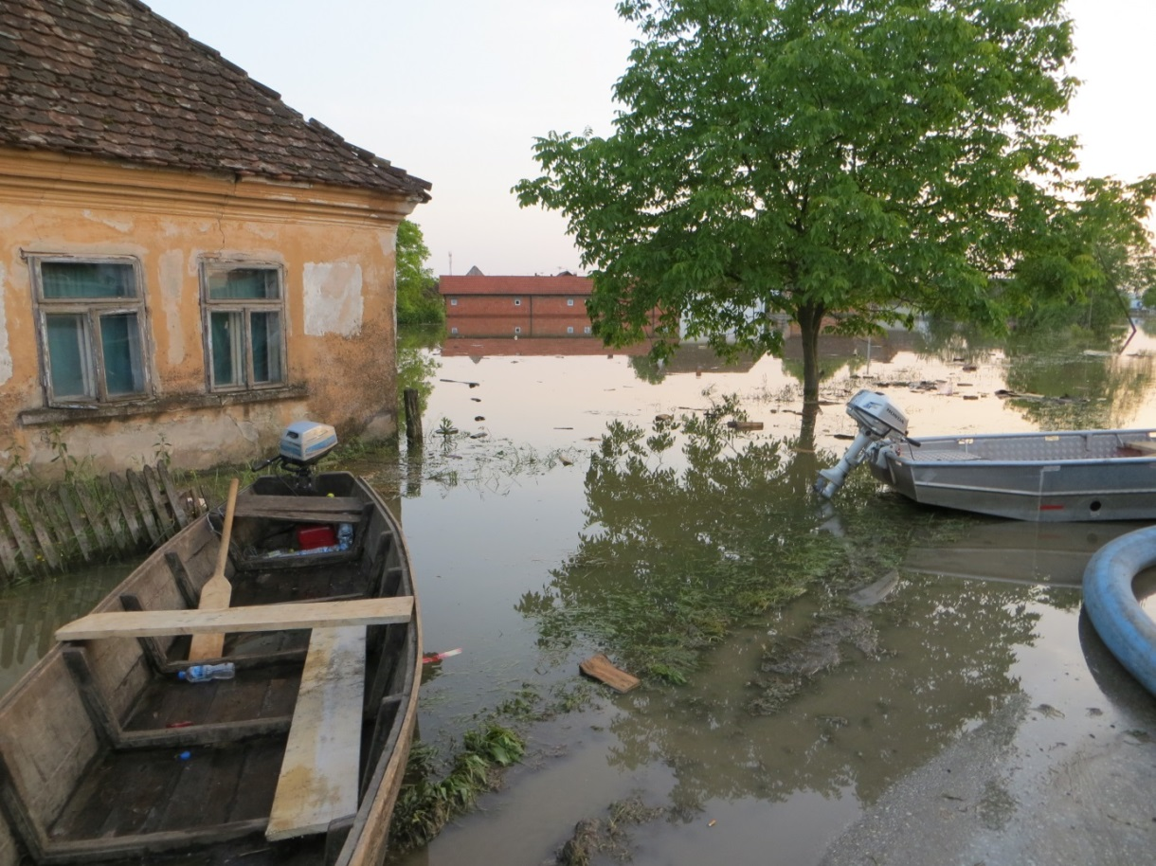
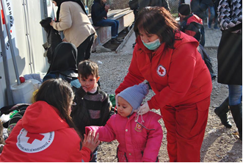
2. Project background
More frequent occurence of disasters, including new types of crisis (climate related natural disasters, such as floods or ongoing migration flows)

Slide 5
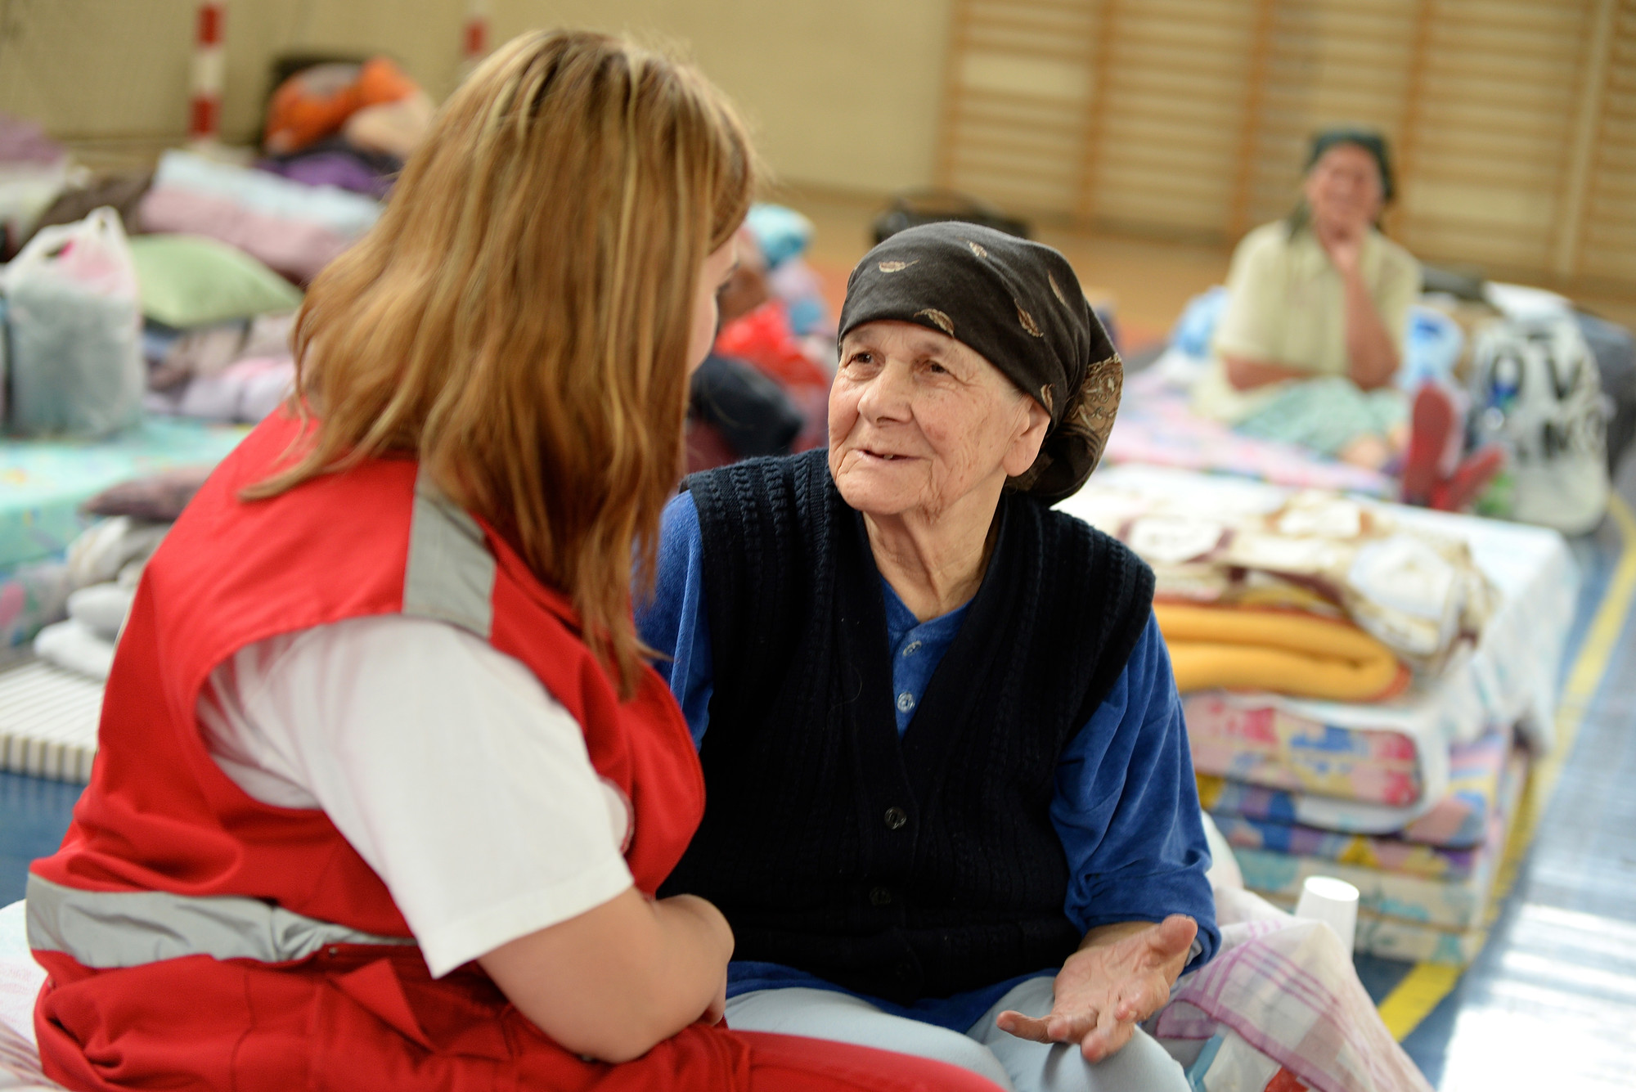
2. Project background
Need to provide Psychosocial Support (PSS) and to integrate currently missing short-term Psychological First Aid (PFA) into response on all levels through training DM staff and volunteers
Need to involve new forms of volunteers by enabling framework conditions and training in PSS

Slide 6
3. Project objectives
Improve disaster response capacities of emergency and volunteer organisations by strengthening PFA and PSS competencies of staff and volunteers
Improve active participation of affected communities in emergency response by training staff and volunteers and by developing new tools for community activation
Improve coordination and support for new volunteer types
Improve experience exchange and networking and share good practice

Slide 7
4. Project outputs
Desk research report on existing tools and recommendations applicable to the field of PFA and PSS for beneficiaries and helpers
TOT training package for multipliers and trainers in DM organisations, including:
PFA and PSS in basic services and security
Community and family activation (tools and best practice)
Tools for volunteer and staff support including guidance for coordination and support for convergent and spontaneous volunteers

Slide 8
5. Major events
Project kick off meeting (Vienna, April 2017)
Partner meeting on desk research (Rome, 2017)
Structured experience exchange through national workshops in each partner country (2017) and a transnational workshop in Croatia (2018)
Partner meeting on ToT development (Slovenia, 2018)
ToT trainings in Serbia and Slovenia (2018/2019)
Final partner meeting (Skopje, 2019)

Slide 9
6. Follow-up
Dissemination of project outputs by partners and their networks, as well as through the project website
Integration of developed training modules in partner organisations through the network of trained trainers
Search for funding follow-up activities and potential duplication in other countries and organisations

Slide 10
Further information and exchange
Austrian Red Cross
www.roteskreuz.at
Ms. Katarina Baničević
katarina.banicevic@redcross.at

