Slide 1


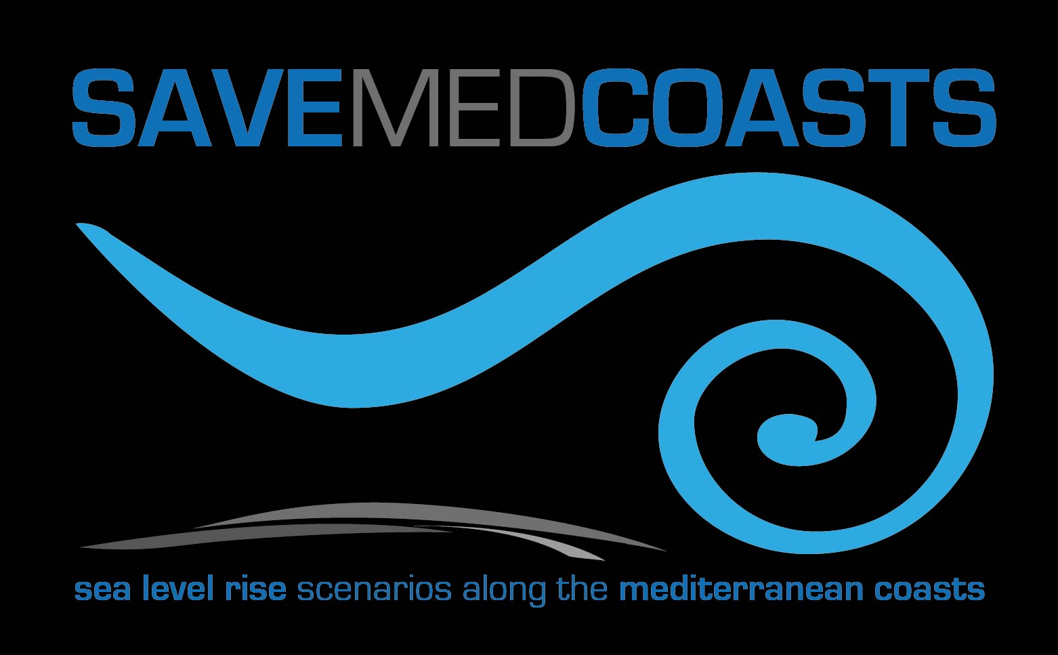
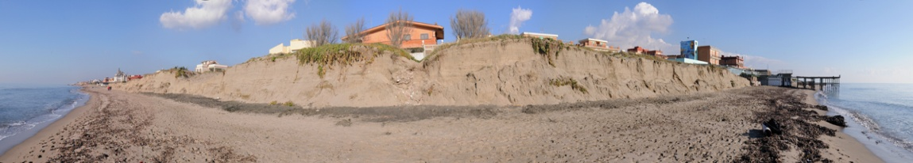

Sea level rise scenarios along the Mediterranean coasts
Kick-off meeting
Brussels, January, 18th 2016

Slide 2
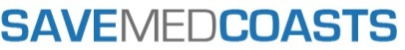

Total eligible cost: | 656.824,38 €
EC co-financing: | 492.618,28 €
Duration: | 24 months
INGV
Project coordinator
AUTH
CGIAM
FUNDINGS BY PARTNERS

Slide 3
Beneficiary and Partners
Project Coordinator - Istituto Nazionale di Geofisica e Vulcanologia (INGV, Italy)
INGV is the largest European body dealing with research in Geophysics and Volcanology involved in the Civil Protection sector. Its main mission is the monitoring of geophysical phenomena in both the solid and fluid components of the Earth.
Partner 1 - Aristotle University of Thessaloniki (AUTH, Greece)
Lab of Photogrammetry and Remote Sensing, School of Rural & Surveying Engineering
Partner 2 - Centro di Geomorfologia Integrata per l’Area del Mediterraneo (CGIAM, Italy) Scientific organization of Public Law involved in the Civil Protection sector.
Partner 3 - Fondazione Centro Euro-Mediterraneo sui Cambiamenti Climatici (CMCC, Italy) Non-profit research institution (www.cmcc.it)
Partner 4 - ISO TECH LIMITED (ISOTECH, Cyprus)
Private research SME on applied research in integrated coastal zone management
Partner 5 – Regional Union of Municipalities of Ionian Islands (PED-IN, Greece)
Organisation governed by public law established in Corfu with Presidential Decree (PD 75/2011)

Slide 4

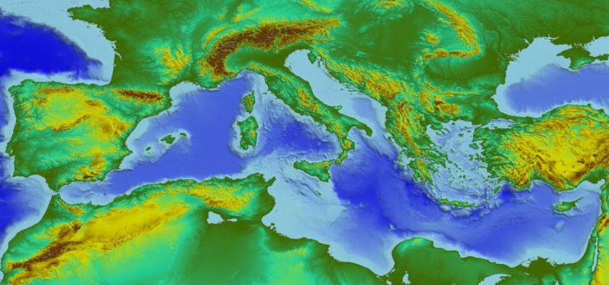



Area of activity
Italy
(Monterosso)
Italy
(Lipari)
Greece
(Lefkada)
Mediterranean Sea
Cyprus

Slide 5
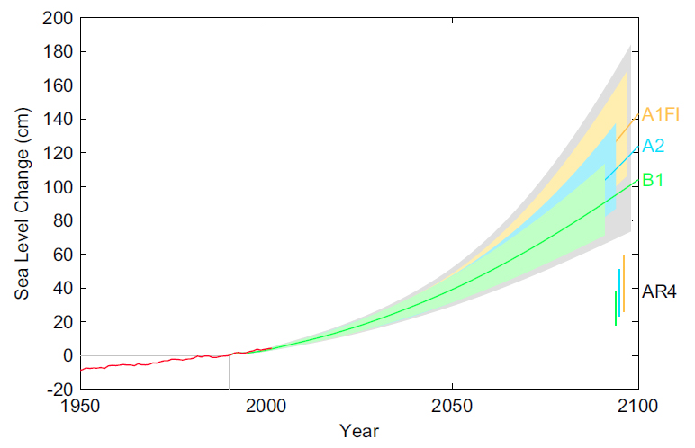
                Summary of the project
Global mean s.l. is expected to increase from 75 to 190 cm by 2100 (www.ipcc.ch; Veermer and Rahmstorf, PNAS 106, 51, 2009), thus leading to serious impacts of climate change to face in the next years.
The increase will be even larger in subsiding coasts, amplifying the impacts exerted by storm surges flooding, coastal erosion and tsunamis on infrastructure and building integrity, people safety, economic assets and cultural heritage, translating climate change impacts into socio-economic loss that will require civil protection measures.
aims to mitigate these risks by providing multi-temporal scenarios of expected inland extension of marine flooding in consequence of s.l. rise by preparing people to face the next changes.
Projection of global sea-level rise from 1990 to 2100, based on IPCC temperature projections for three different emission scenarios
(from Veermer and Rahmstorf, PNAS December 22, 2009 vol. 106 no. 51, 2009).
Marine flooding in Sardinia for 2100
(IPCC-AR5).
(Antonioli et al., QSR 2017)

Slide 6
Objective
focuses on the Prevention Priority. Aims to respond to the need for people and assets prevention from natural disasters in Mediterranean coasts undergoing to s.l. rise.
GENERAL OBJECTIVES
Support civil protection to produce exhaustive risk assessments for different periods;
Improving governance and raising community awareness towards the impacts of s.l. rise;
Fostering cooperation amongst science, affected communities and civil protection organizations within and between targeted Mediterranean areas.
SPECIFIC OBJECTIVES
Scan the current risk management capabilities and actions to identify best practices, existing prevention protocols, lacks and rooms for improvement.
Provide advanced methods to develop multi-hazard assessments and enhance existing databases for the Mediterranean basin and for areas at or below 1 m above s.l., characterized by high economic and environmental value.
Implement test sites to provide very high-resolution information for civil protection planning and prevention.
Assess s.l. effects using multi-temporal scenarios of the inland extension of marine flooding and coastline position up to 2100, based on the best available high resolution Digital Terrain Models (DTM), known rates of land subsidence and local s.l. rise estimates.
To transfer information to society, policy makers and stakeholders.

Slide 7
Task ID | Task Title | Start | End | Deliverables
A | Task Management and Reporting to the European Commission | 01.01.2017 | 31.12.2018 | - A1. Kick-off Meeting minutes (M1) - A1. Project Work Plan (M1) - A1. Project Work tools and Handbook(M2) | - A3. 3 Technical reports (M6, M12, M18) - A3. Final technical report (M24) - A1. Kick-out Meeting minutes (M24)
B | Building the Stakeholders’ and Decision-makers Capacity and awareness | 01.01.2017 | 31.11.2018 | - B1. Stakeholders ‘analysis (M4) - B2. Participatory decision making workshop report – Italy (M23) | - B2. Participatory decision making workshop report – Cyprus (M23) - B2. Participatory decision making workshop report – Greece (M23)
C | State of the art on sea level rise and land subsidence along the coasts of the Mediterranean | 01.02.2017 | 30.04.2018 | - C1: Report on collection of current sea level trend values from tide gauge and radar altimeters from available scientific studies (M4) - C1. Report on collection of sea level rise predictions up to 2100 from available IPCC reports and scientific studies (M4) - C1. Report on collection of current land subsidence rates from available geodetic and remote sensing scientific studies(M4) | - C2. Report on collection and validation of available high resolution DTM/DSM data for the coastlines belts and current coastline positions of the Mediterranean (M6) - C3. Database and WebGis (M8) - C3. Report on WebGis updating (M12) - C3. 2nd Report on WebGis updating (M18)
D | Development of multi-hazard and multi-temporal risk scenarios at regional scale (Mediterranean) | 01.09.2017 | 31.03.2018 | - D1. General criteria on the contribution of storms and coastal erosion to increase the extension of marine land flooding (M11) - D2. Regional maps of flooding scenarios up to 2100 (M13) | - D3. Report on expeditive assessment of coastal flooding extension (M14) - D4. General criteria for risk and vulnerability mapping related to sea level rise and storm surge flooding in the Mediterranean region (M15)
E | Implementation of Pilot and Training Activities | 01.04.2018 | 31.12.2018 | - E1. Data and report of local scale aerial photogrammetry by UAV in TS1 (M18) - E1. Data and report of local scale aerial photogrammetry by UAV in TS2 (M18) - E2. Data and report of local scale aerial photogrammetry by UAV in TS3 (M18) - E3. Digital maps of risk erosion, wave storm climate for different return time and flooding risk (M20) | - E1. Local scale maps (test sites) of flooding scenarios up to 2100 risk (M20) - E4. Assessment Report of economic impacts of coastal flood risk and sea level rise scenarios (M20) - E5. Guidelines on risk management: application to TSs risk (M24) - E6. Report on Workshops and training activities (M24)
F | Information, Dissemination and Capitalization Actions | 01.01.2017 | 31.12.2018 | - F.1 Communication and Capitalization Handbook (M2) - F.1 Project web site and social networks (M3) - F.1 Informative Leaflets in English, Italian, Greek (M12) - F.1 Newsletters (Month 6,12,18,24) - F.1 Press releases (Month 12, 24) | - F.1 Booklet of the project achievements (M24) - F.1 Layman’s Report (M24) - F.1 SAVEMEDCOASTS final conference / F2. Capitalization session (M24) - F.2. Memorandum of Understanding (M24)

Slide 8
Milestones
Event | Location | Date | Epoch
Kick-off meeting | Brussels | January, 18, 2017 | M0
Starting conference | Rome | January, 31, 2017 | M1
Final conference and brokerage session | Rome | December 2018 | M24
Action no. | Epoch | Name of the Action
Action B.1 | M 2-4 | Identification of key Stakeholders and Decision-makers by questionnaires, interviews and small groups meetings.
Action B.2 | M 5-23 | Key Stakeholders and Decision-makers involvement and commitment by implementing the DeCyDe-4 method (gaps and needs identification, build consensus in implementing agreed solution).
Action E | M 23 | Workshop and training activities of pilot cases carried out in Italy and Greece. E1,E2 - Training activities of pilot cases carried out in Italy and Greece (M20) E6 - 2 workshops and 2 training sessions to be carried out (respectively 2 in Lefkada and 2 in Rome).
Action F.2 | M 24 | Capitalization Action (Final conference and brokerage session in Rome-INGV).

Slide 9
Follow up
has the potential to establish new partnerships and networks by the exchange of good practices in upcoming EU transnational initiatives:
INTERREG Adrion,
ENI CBC Med 2014-2020
Horizon 2020
Eranet – Med
Partners cover the whole Mediterranean area, highly prone to marine flooding in consequence of s.l. rise, land subsidence, tsunamis and storms. Similar hazards are also met in other parts of Europe (Nile delta, Gulf of Gabes, Turkey, northern Europe).
will serve as a pilot case: resulting knowledge/experience can be transferred to other EU cases and reflect topics of current EU interest, mainly with reference to the socio-economic impacts and relative cost-effective prevention measures.
Being a stakeholders-based project, proposes a DSS adaptable to different scenarios, turning the decision-making into a more inclusive and risk-informed process while using a multi-hazard approach.

Slide 10
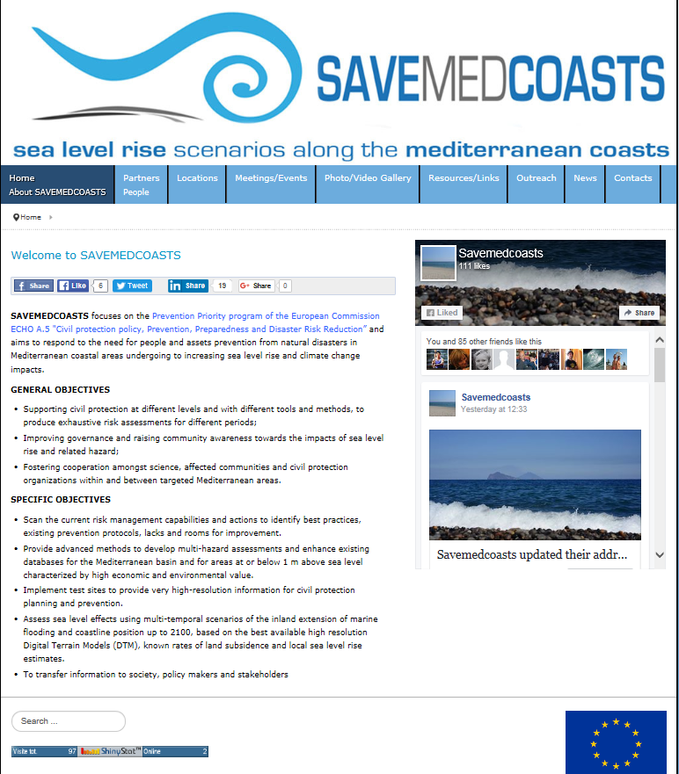
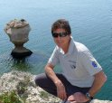
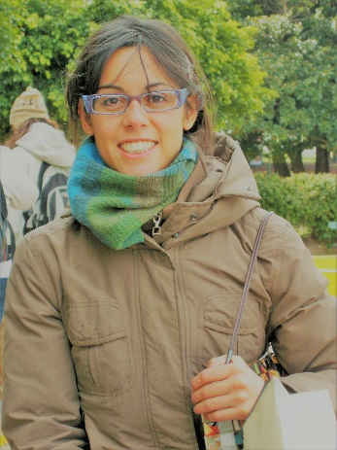
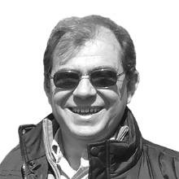
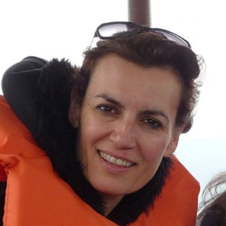

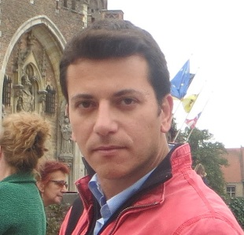
People
Contacts
Marco Anzidei, PhD
Email: marco.anzidei@ingv.it
Senior Scientists
Istituto Nazionale di Geofisica e Vulcanologia
National Earthquake Center - www.ingv.it
Via di Vigna Murata 605, 00143 Rome, Italy
Office +390651860214
Mobile +393356528812
Skype: marco.anzidei2
website: www savemedcoasts.eu
Key persons
Melania Michetti
CMCC
Petros Patias
AUTH
Xenia Loizidou
ISOTECH
Giovanna Forlenza
CGIAM
Thanos Petousis
PED-IN

