Slide 1





OPEN
RISK
Hermanni Backer, Professional Secretary
Valtteri Laine, Project Manager
HELCOM (Lead Partner)
KICK OFF MEETING 2016 18 January 2017, ERCC, Rue Jozef-II 79, BE-1049 Brussels.
OPENRISK 2016/PREV/26 is Co-financed by the EU – Civil Protection Financial Instrument.

Slide 2
“OPEN -Source tools
for regional
RISK assessments
for improved European
preparedness and response
at sea” (2016/PREV/26)
2 years (2017-2018)
0.53 Meur
HELCOM (www.helcom.fi) Lead
WMU (www.wmu.se )
MARIN (www.marin.nl )
SYKE (www.syke.fi )

Slide 3
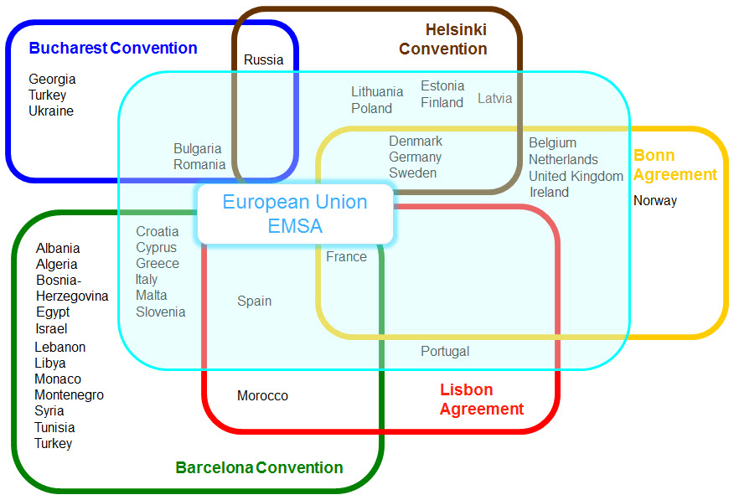
Regional Intergovernmental Cooperation on PPR at sea
Copenhagen Agreement
Sweden
Finland
Norway
Denmark
Iceland
HELCOM
Black Sea Commission
IMO
REMPEC

Slide 4
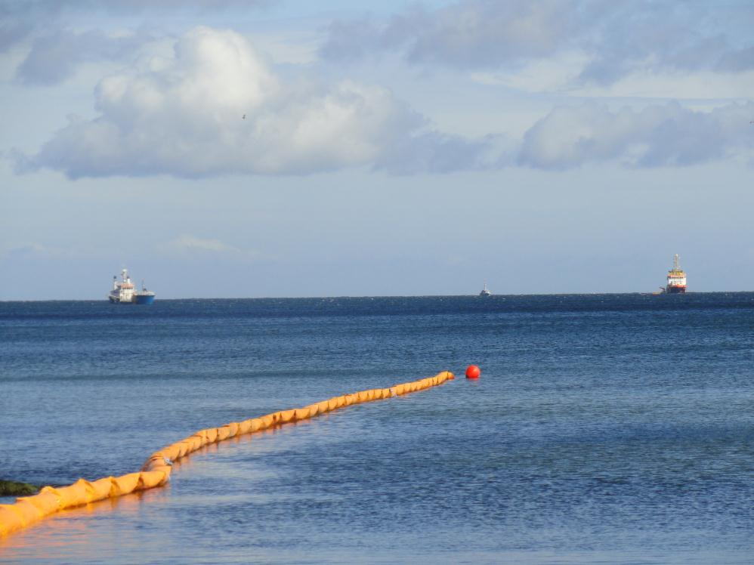
The fruits of regional response cooperation:
Well equipped regional fleet (-s)
Agreed response procedures
Regular operational exercises
Traffic safety measures in place
Notes:
But around the 1950s a shadow creeped into the Baltic summer paradise: POLLUTION!
Fertilizers from agriculture, toilet discharges from cities and industrial pollution were all over the place.
Something needed to be done!

Slide 5
…but can we do more? Are we up to date?
from Status reports (re-active)…
…to Risk Assessments (pro-active)
Notes:
But around the 1950s a shadow creeped into the Baltic summer paradise: POLLUTION!
Fertilizers from agriculture, toilet discharges from cities and industrial pollution were all over the place.
Something needed to be done!

Slide 6
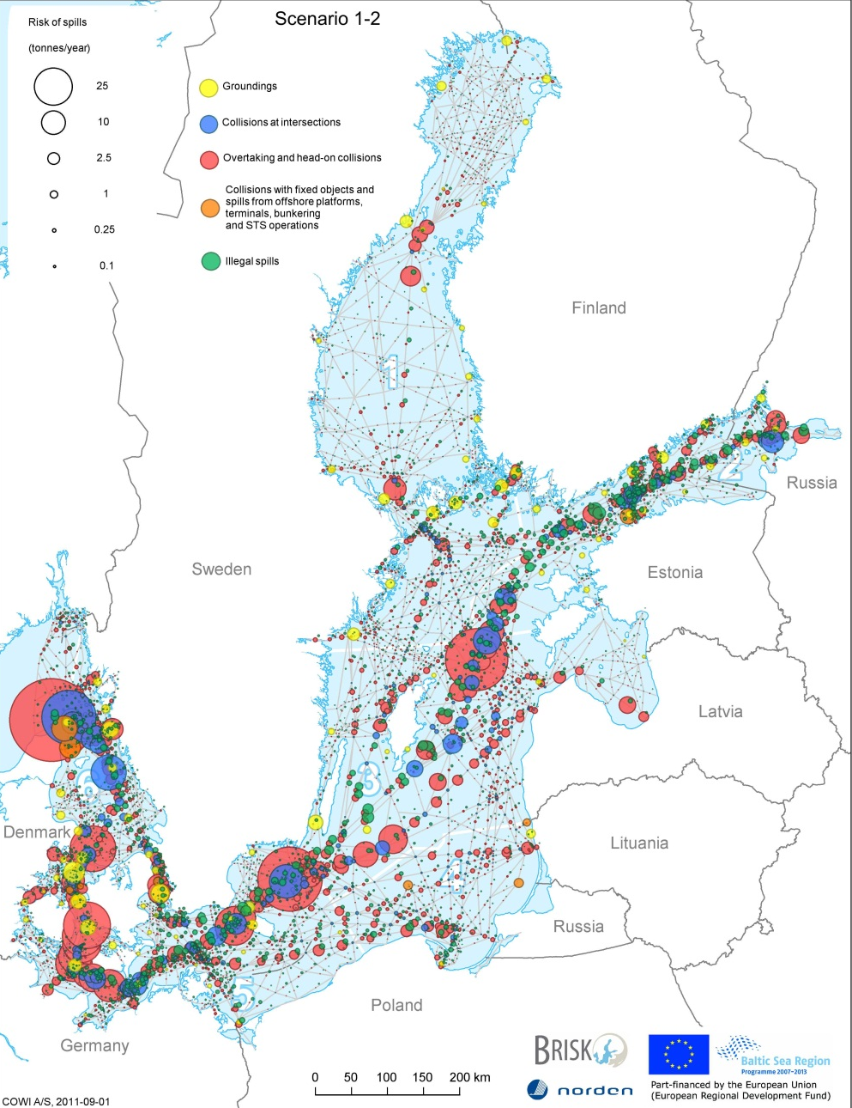
Regional Spill Risk Assessments
HELCOM BRISK/BRISK-RU (2009-12)
BONN BE-AWARE I&II (2012-2015)
Spill risks-> sensitivity mapping -> recommended risk reducting measures
Big projects –> long intervals
-> Could we have jointly agreed & transparent tools enabling more frequent RAs?

Slide 7
Our vision of Risk Assessment Tools
Relatively quick to use but robust
Open source
Maximal transparency (know what it does)
Cheap (possible without external expertise)
Jointly agreed by countries
Based on earlier work if available
Possible to develop further
Feeding into further EU and global work

Slide 8
OPENRISK takes the first step
A proposal for a joint and transparent METHOD
Concretely best available tools for:
  Locating high risk areas using VTS reports/interviews/accident reports
  Locating high risk areas using AIS (dynamic modelling) c.f. Norwegian project
  Risk reducing measures
For use EU wide regionally or nationally
Focus is on prevention –a follow up project on tools for optimised measures would be natural

Slide 9
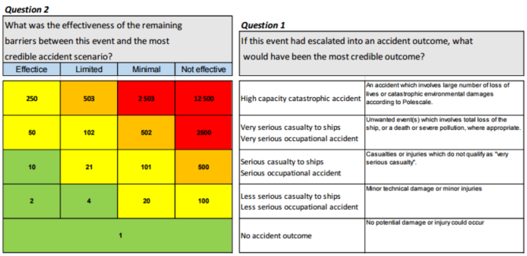
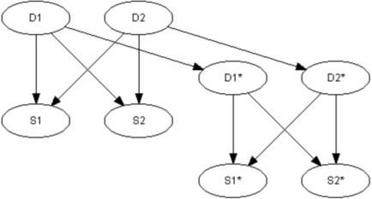
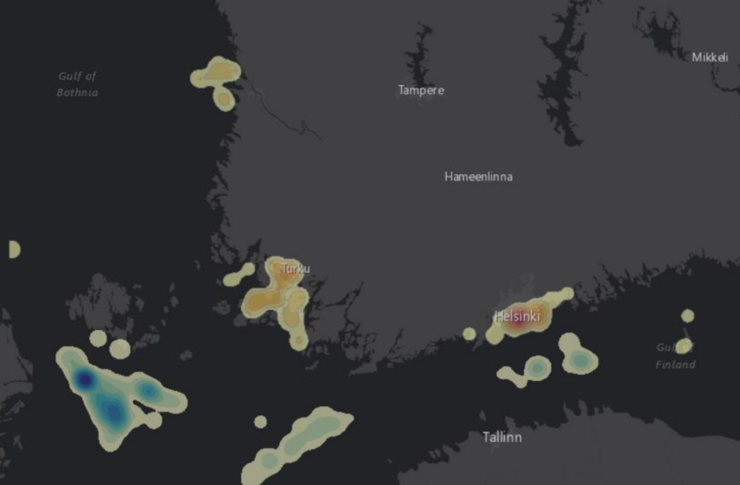
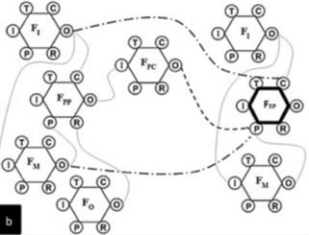

Examples of tools provided

Slide 10
We want to change the world!
Support and interest:
BONN Agreement (North Sea)
Copenhagen Agreement (Nordic)
REMPEC (Mediterranean)
Norwegian Coastal Administration (similar tools underway as part of the havbase.no service)
-> A series of 4 inter regional OPENRISK workshops

Slide 11
Work Packages
Task I Methods for Maritime Event Risk Assessment and Validation
Task II Dynamic risk indicators for AIS applications
Task III Tools for optimising safety improvement measures
Task IV Regional Risk Assessments for preparedness and response -Lessons learned
Task V Test run of tools in the Baltic Sea
Task VI Administration/ Project Management
Task VII Dissemination

Slide 12
Timeline first 6 months
January 26 Partner Kickoff (Helsinki):
  Detailed timeplanning
  Partnership agreements & Reporting
  Website/brochure
February 16 Inter-Sec meeting
by May (internal deliverables)
  Delivering RA method first drafts
June 12-13 1st Inter-regional WS. (Helsinki)
  Exchanging PPR RA lessons learned
  Considering RA method first drafts

Slide 13
OPEN
RISK
Hermanni Backer, Professional Secretary
Valtteri Laine, Project Manager
HELCOM (Lead Partner)
KICK OFF MEETING 2016 18 January 2017, ERCC, Rue Jozef-II 79, BE-1049 Brussels.
OPENRISK 2016/PREV/26 is Co-financed by the EU – Civil Protection Financial Instrument.

