Slide 1
UD-RASP - Urban Disaster Resilience through
Risk Assessment and Sustainable Planning
Coordinated by
IABG mbH Germany
and
Project Partners
United Nations University, Institute for Environment and Human Security (UNU-EHS)
Municipality of Monastir (Tunisia)
ECHO/SUB/2016/740186/PREV19

Slide 2
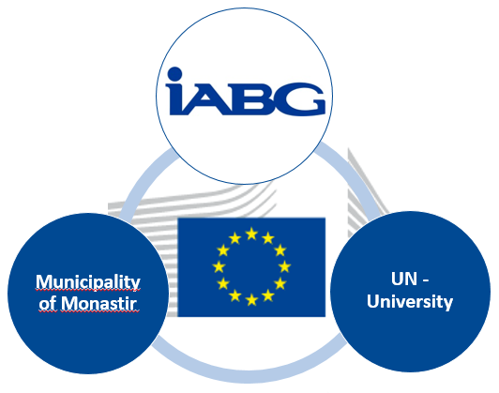
UD-RASP – Consortium and Budget
Partners
IABG mbH, Germany
UNU-EHS - Institute for Environment and Human Security, Germany
Municipality of Monastir, Tunisia
Selection of Contributors
National Office of the Civil Protection (ONPC), Tunisia
Ministère de l’Équipment de l’Habitat et de l’Aménagement du Territoire, Tunisia
Centre National de la Cartographie et de la Télédétection (CNCT)
Office de la topographie et de la cartographie (OTC)
External budget - Prevention priority: pilot and demonstration project focusing on urban resilience to disasters
Total eligible costs: EUR 539.890
EC co-financing: EUR 365.483 (67,7%)
Project duration: 18 months – 01.01.2017 – 30.06.2018

Slide 3
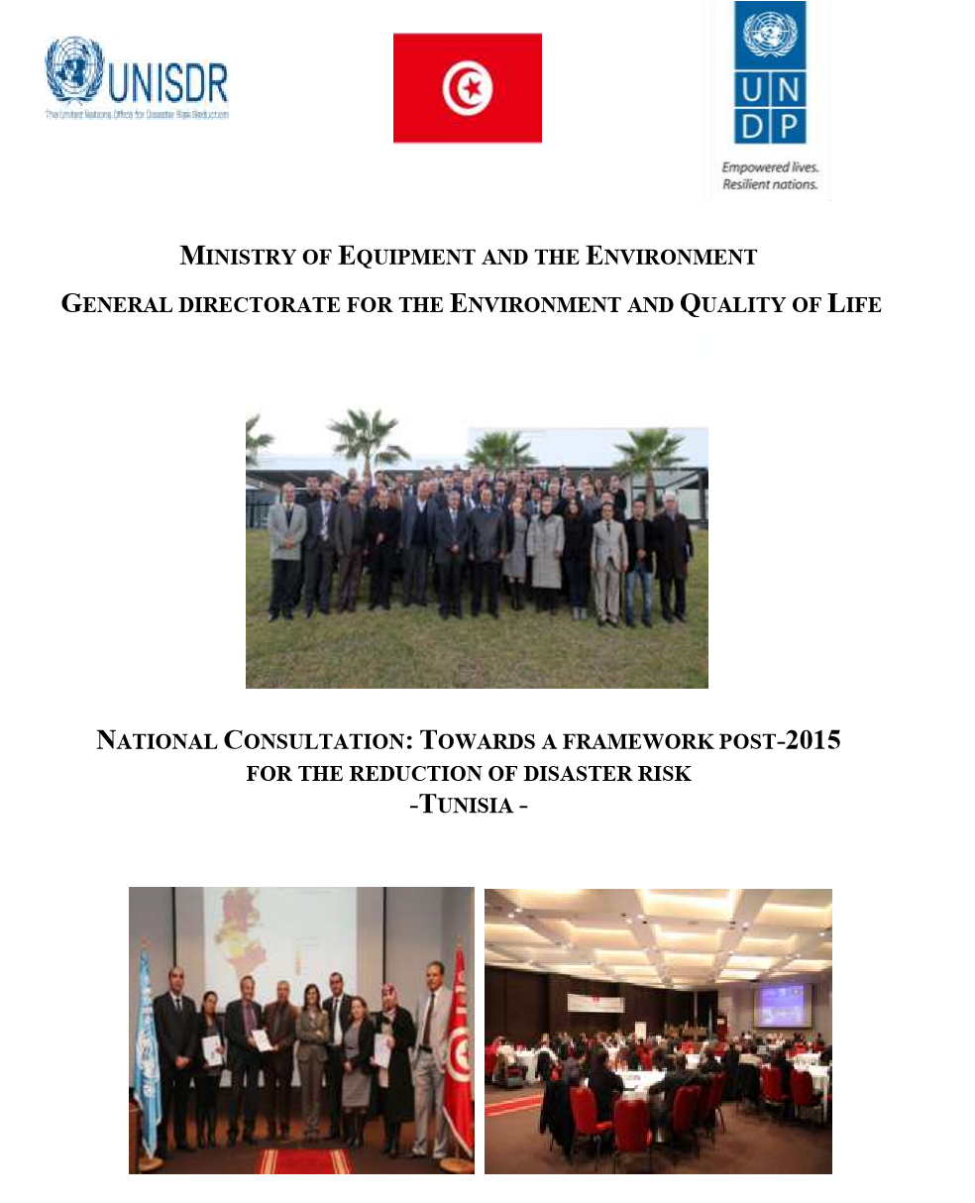
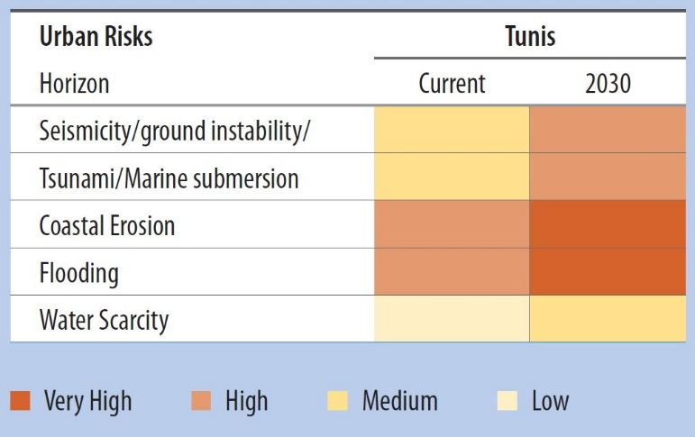
Objectives of the project
Enhance urban multi-hazard disaster prevention and resilience in Tunisia, using the city of Monastir as a pilot study
Availability of up-to-date data and information on urban disaster risk (present day, future scenarios) for the pilot city (including its dimensions of hazard, exposure and vulnerability) as well as its underlying drivers will enable local decision makers to identify potential hot spots for short and medium term disaster risk reduction measures
By proposing a standardized, transferable and transparent approach, the project lays the foundation for future urban disaster risk assessments in Tunisia and further North African countries
(source: regional study 2011 World Bank)

Slide 4
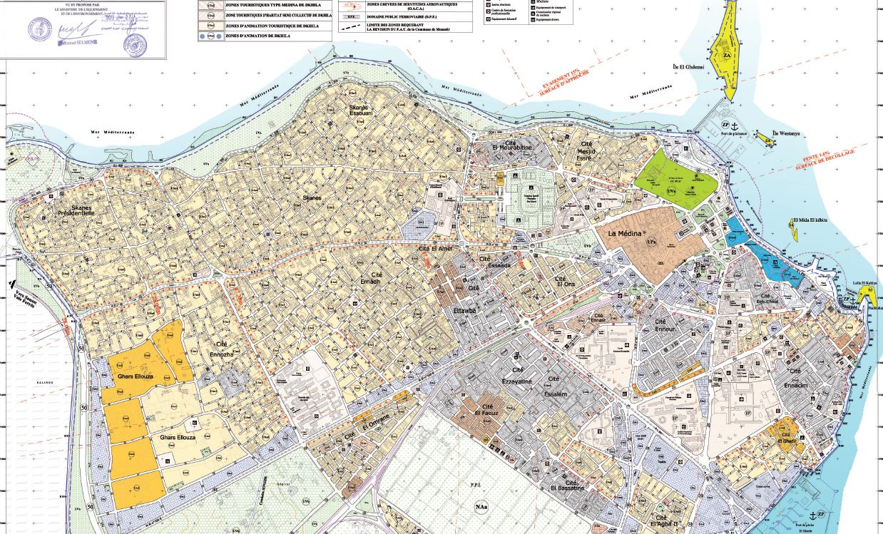
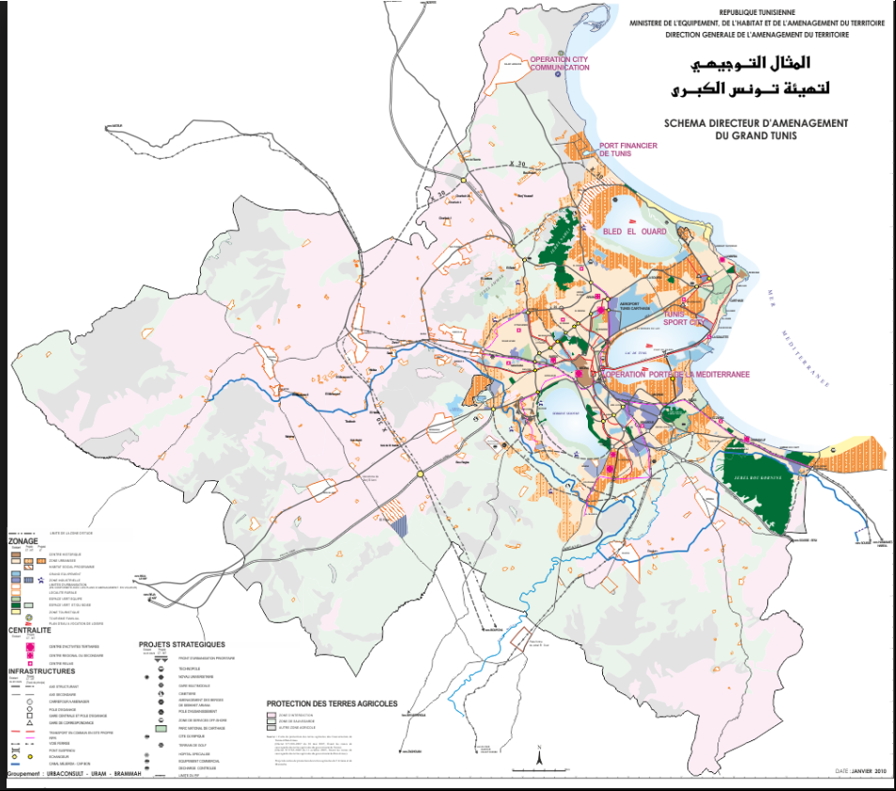
Objectives of the project
Strengthen the capacity of urban stakeholders to mainstream disaster risk reduction into sustainable urban planning processes

Slide 5
What will the project do: expected results
Development and implementation of a standardized digital GIS-based dataset as a basis for the analysis and monitoring of urban development and urban disaster risk
Update Spatial Planning Plan based on the GIS database and retrospective view of the urban growth
Improve understanding and empirical knowledge of past, current and future exposure, vulnerability and risk dynamics and their respective drivers
Develop scientific methods and standardized approach to assess hot spots and dynamics of vulnerability and risk in data scarce environments at sub-city scale
Create a web-based tool for the interactive visualization of hot spots of urban disaster risk and hazard characteristics, exposure and societal vulnerability
Standardized workflow and chain of actions to be provided for decision-making in case of an overall urban planning and disaster events, applicable to other municipalities in Tunisia and beyond

Slide 6
What will the project do: main benefits for sustainability
The switch from paper documents and maps to digital database supports the stakeholder in their daily work and decision making process
The proposed approach for urban disaster risk assessments in data scarce environments can serve as a blueprint for future studies in Tunisia / northern Africa
The capacity building by training on the job ensures the development of know-how and a sustainable use of the information system
A better understanding of the interaction of processes enables the Municipality to implement an urban planning process to be better prepared for future hazards
Support of the urban management process

Slide 7
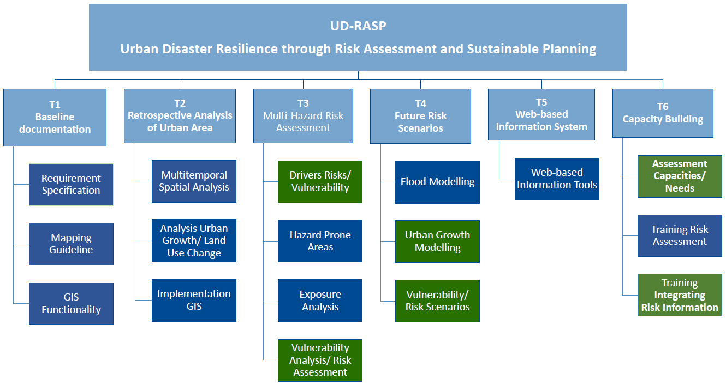
Breakdown of core activities
IABG
UNU
✗
✗
✗
✗
✗
✗
Continous contribution and participation of the municipality and stakeholders

Slide 8
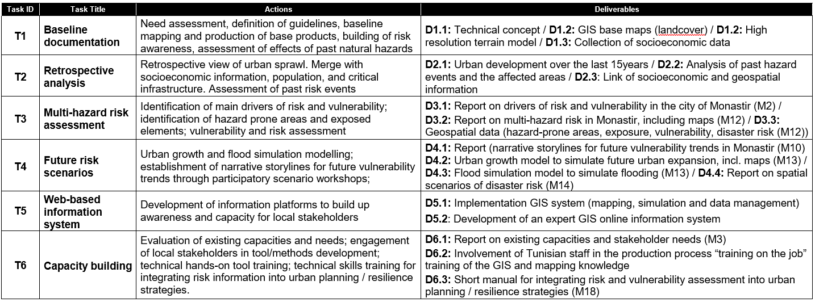
Milestones - Deliverables and calendar

Slide 9
UD-RASP – Next steps
Workshop in Monastir (February 2017)
Stakeholder engagement
Starting with interviews to define the requirements and processes for the technical concept with main stakeholder
Collection and review of available information and data
Start of communication/ dissemination actions
Website of the project, Social Media
Dissemination (Space Conference January 2017, World Bank Conference March 2017, publications etc.)
On-site visit of Monastir

Slide 10
Your contact
IABG mbH
Felicitas Bellert
Dr. Rainer Malmberg
Einsteinstrasse 20
85521 Ottobrunn
Germany
Phone +49 89 6088-3299
bellert@iabg.de
malmberg@iabg.de
www.iabg.de
United Nations University
Dr. Michael Hagenlocher
Dr. Matthias Garschagen
UN Campus
Platz der Vereinten Nationen 1
53113 Bonn
Germany
Phone +49-228-815-0250
hagenlocher@ehs.unu.edu
garschagen@ehs.unu.edu
www.ehs.unu.edu
Monastir Municipality
Neila Kalboussi
Sonia Ayed
Municipalité de Monastir
Avenue Habib Bourguiba
5019 Monastir
Tunisia
Phone +216-98 407 114
neilarokbani@yahoo.fr
soniaayed_urbaniste@yahoo.fr

