Slide 1
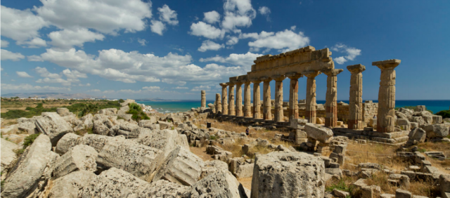

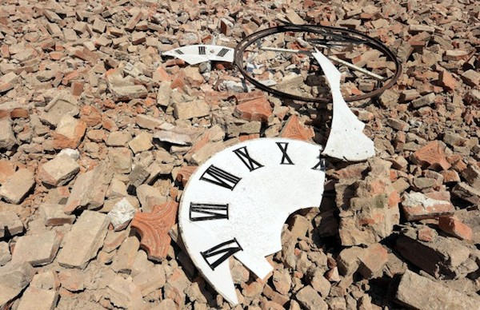



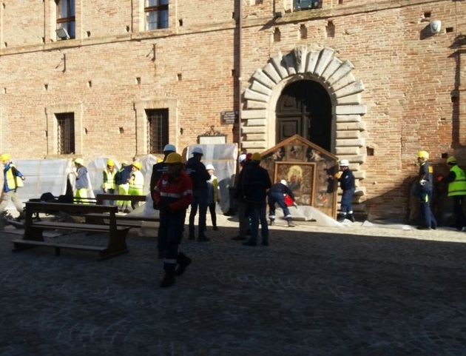



(Increasing Resilience of Cultural heritage: a supporting decision tool for the safeguarding of cultural assets)
18 January 2017
1

Slide 2
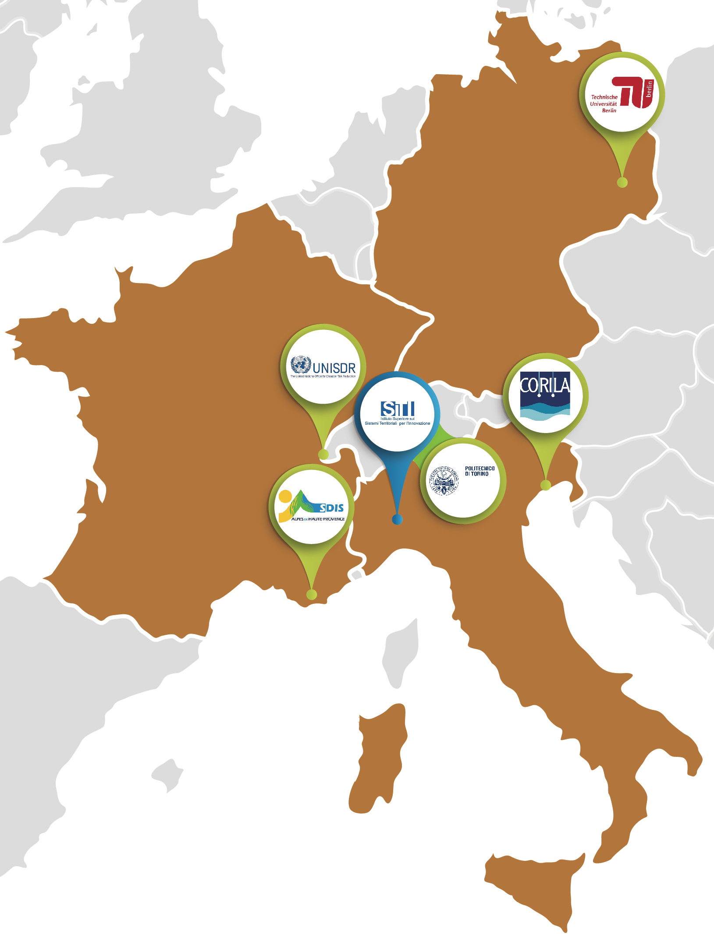

SiTI - Istituto Superiore sui Sistemi Territoriali per l'Innovazione (coordinator)
PARTNERS and
AREA OF ACTIVITY
UNISDR – The United Nations Office for Disaster Risk Reduction
BENEFICIARIES,
COST and DURATION
WHY THE PROJECT IS
NECESSARY
TUB – Technische Universität Berlin
OBJECTIVES
POLITO – Politecnico di Torino
WORK PLAN
CORILA – Consortium for managing research activities in the Venice Lagoon system
DELIVERABLES and DEADLINES
MAJOR EVENTS
(hypothesis)
SDIS 04 – Service Départemental d’Incendie et de Secours des Alpes de Haute-Provence
FOLLOW UP
18 January 2017
2

Slide 3





PARTNERS and
AREA OF ACTIVITY
CH protection and management entities
BENEFICIARIES,
COST and DURATION
Emergency operators
Citizens & local communities
WHY THE PROJECT IS
NECESSARY
OBJECTIVES
PROJECT’S DURATION: 18 months
WORK PLAN
DELIVERABLES and DEADLINES
TOTAL COST:
791,893 €
Governmental Authorities
Research
centres
MAJOR EVENTS
(hypothesis)
EC co-financing: 593.913,83 €
FOLLOW UP
18 January 2017
3

Slide 4




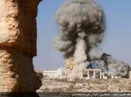

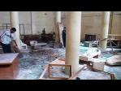



“Historia testis temporum, lux veritatis, vita memoriae, magistra vitae, nuntia vetustatis.”
“History is the witness that testifies to the passing of time; it illumines reality, vitalizes memory, provides guidance in daily life and brings us tidings of antiquity.”
Cicerone
PARTNERS and
AREA OF ACTIVITY
A growing need for security in cultural heritage domain, which are constantly threatened
BENEFICIARIES,
COST and DURATION
Floodings
Earthquakes
Natural Disasters
WHY THE PROJECT IS
NECESSARY
Art pieces as:
Witnesses of people’s history
Religious symbols
Material catalysts of culture
Universal value and heritage of Mankind
High market value
Investment assets
Fires
Extreme conditions
OBJECTIVES
WORK PLAN
Terrorism
Counterfeit
DELIVERABLES and DEADLINES
Manmade Threats
MAJOR EVENTS
(hypothesis)
Theft / Looting
Illegal trade
FOLLOW UP
Armed Conflicts
Vandalism
18 January 2017
4

Slide 5
Pilot and demonstration project with replication capacity focusing on urban resilience to disasters.
PARTNERS and
AREA OF ACTIVITY
European Interoperable Database (EID) for CH, a unique framework.
BENEFICIARIES,
COST and DURATION
European Heritage Map
Cadaster
Risk scenarios monitoring platform
Advice-seeking interface
Crowd-data acquiring from citizens and stakeholders
3D and virtual reality models
Base for training, education and research
Tool to understand the risk of CH to be damaged.
WHY THE PROJECT IS
NECESSARY
OBJECTIVES
Aiming at enhancing the capability of Civil Protection (CP) to prevent/mitigate disasters impacts on Cultural Heritage (CH).
WORK PLAN
DELIVERABLES and DEADLINES
Disaster risk reduction strategy (for prevention and resilience).
MAJOR EVENTS
(hypothesis)
FOLLOW UP
OUTPUT
18 January 2017
5

Slide 6
TASK
0
PARTNERS and
AREA OF ACTIVITY
BENEFICIARIES,
COST and DURATION
MANAGEMENT
WHY THE PROJECT IS
NECESSARY
OBJECTIVES
TASK
1
TASK
2
TASK
3
TASK
4
WORK PLAN
DELIVERABLES and DEADLINES
DATABASE DESIGN & IMPLEMENTATION
EID TESTING AND PILOT CASES
COMMUNICATION AND DISSEMINATION
ANALYSIS OF REQUIREMENTSTASK
MAJOR EVENTS
(hypothesis)
FOLLOW UP
18 January 2017
6

Slide 7
0. MANAGEMENT
A 0.1 D 0.1
A 0.3 D 0.3
A 0.3 D 0.4
A 0.3 D 0.4
Partner Leader
PARTNERS and
AREA OF ACTIVITY
A.0.2 D.0.2
SITI
1. ANALYSIS OF REQUIREMENTS
SDIS 04
BENEFICIARIES,
COST and DURATION
A 1.4
A 1.5 D.1.2
A 1.6 D.1.3
POLITO
A 1.1
A 1.2 D.1.1
A 1.3
WHY THE PROJECT IS
NECESSARY
CORILA
2. DATABASE DESIGN & IMPLEMENTATION
TUB
OBJECTIVES
A 2.1
A 2.2 D.2.1
A 2.3
A 2.5
D 2.2
A 2.6 D 2.3
A 27 D 2.4
A 2.8
A 2.9 D 2.5
WORK PLAN
3. EID TESTING AND PILOT CASES
DELIVERABLES and DEADLINES (1/1)
A 3.1
A 3.2 D.3.1
A 3.3
A 3.4
D 3.2
A 3.5
A 3.6 D 3.3
MAJOR EVENTS
(hypothesis)
4. COMMUNICATION AND DISSEMINATION
A 4.2 D 4.2
A 4.3 D 4.3
A 4.4 D 4.4
A 4.5 D 4.5
FOLLOW UP
A 4.1 D 4.1
A 4.2 D 4.2
18 January 2017
7

Slide 8
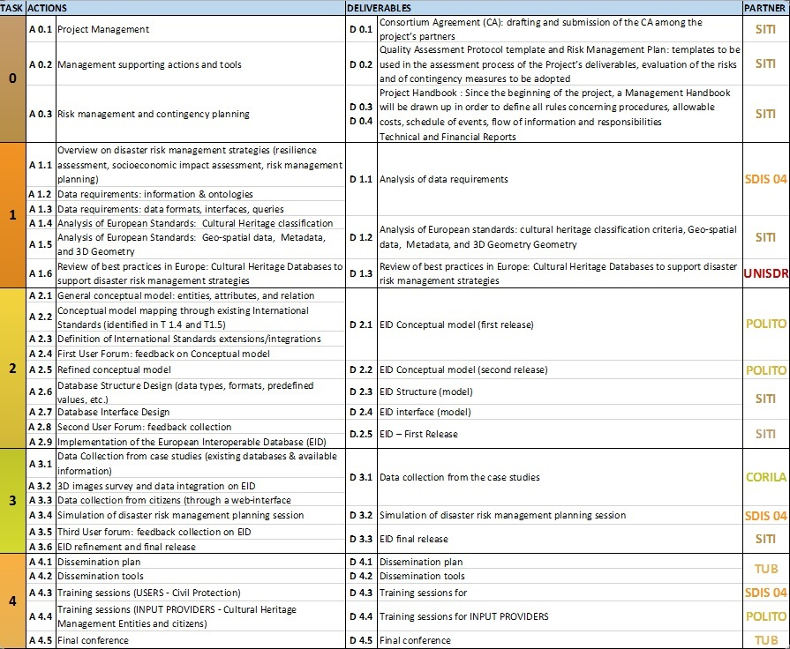
PARTNERS and
AREA OF ACTIVITY
BENEFICIARIES,
COST and DURATION
WHY THE PROJECT IS
NECESSARY
OBJECTIVES
WORK PLAN
DELIVERABLES and DEADLINES (1/2)
MAJOR EVENTS
(hypothesis)
FOLLOW UP
18 January 2017
8

Slide 9
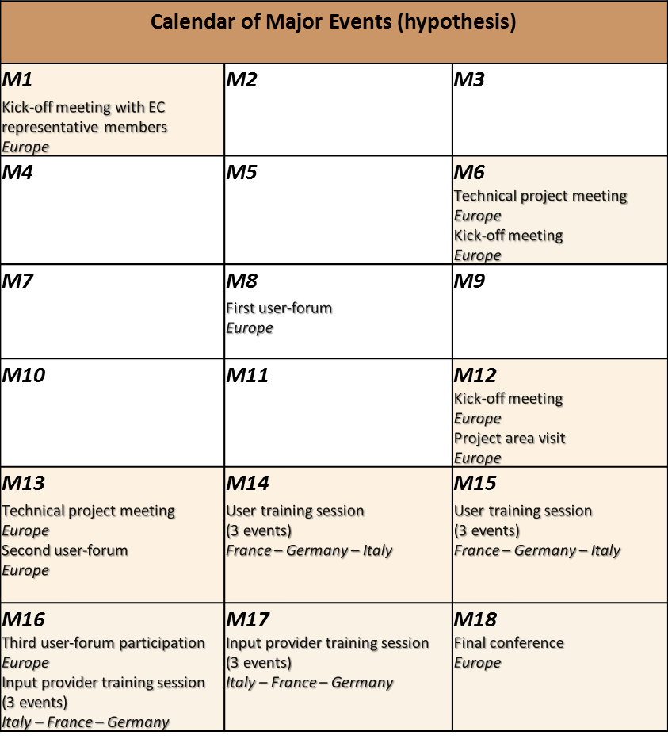
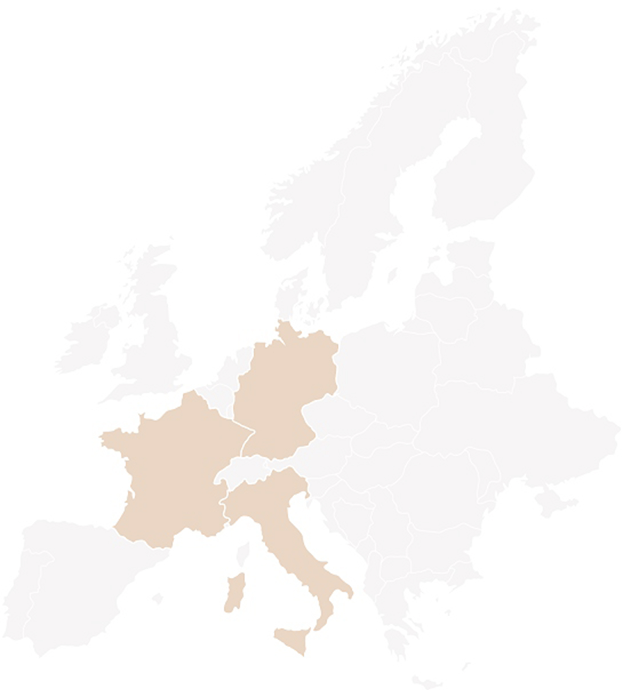
PARTNERS and
AREA OF ACTIVITY
BENEFICIARIES,
COST and DURATION
WHY THE PROJECT IS
NECESSARY
OBJECTIVES
WORK PLAN
DELIVERABLES and DEADLINES
MAJOR EVENTS
(hypothesis)
FOLLOW UP
18 January 2017
9

Slide 10
PARTNERS and
AREA OF ACTIVITY
the translation of the system to Linked Open Data (LOD)
the inclusion of the management of further kinds of disasters in the database and risk analysis algorithms
BENEFICIARIES,
COST and DURATION
other kinds of modelling and analysis algorithms
WHY THE PROJECT IS
NECESSARY
OBJECTIVES
highlight further requirements from disaster risk management planning stakeholders
WORK PLAN
DELIVERABLES and DEADLINES
the automatic translation of existing cultural heritage inventories and databases
the project
will raise awareness
on CH protection needs in Europe, fostering investments and interests by private/public stakeholders.
MAJOR EVENTS
(hypothesis)
FOLLOW UP
18 January 2017
10

Slide 11
Thank you
Sergio Olivero
Head of Security and Business Models for Energy Networks and Infrastructures
SiTI – Higher Institute on Territorial Systems for Innovation
Via Pier Carlo Boggio 61
10138 Torino
Italy
Tel +39 011 1975 1111
Mobile: +39 335 12 73 521
Email: olivero@siti.polito.it
Massimo Migliorini
Email: migliorini@siti.polito.it
www.siti.polito.it
18 January 2017
11

