Slide 1
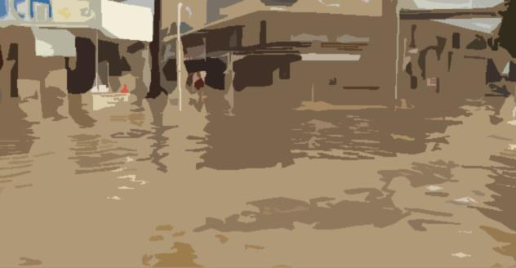
TRIBUTE – TRigger BUffer zones for inundaTion Events
ECHO/SUB/2016/742480/PREV08
Prof. Chris T. Kiranoudis
Coordinator
National Technical University of Athens, Greece
Associated Beneficiaries:
NATIONAL OBSERVATORY OF ATHENS (EL)
ARATOS-SYSTEMS (NL)
INFORMATION TECHNOLOGY FOR HUMANITARIAN ASSISTANCE, COOPERATION AND ACTION (IT)
ANYSOLUTION (ES)
UNIVERSITAT DE LES ILLES BALEARS
UNIVERSITY OF ARCHITECTURE, CIVIL ENGINEERING AND GEODESY IN SOFIA (BG)
KOM Brussels 18 January 2017

Slide 2
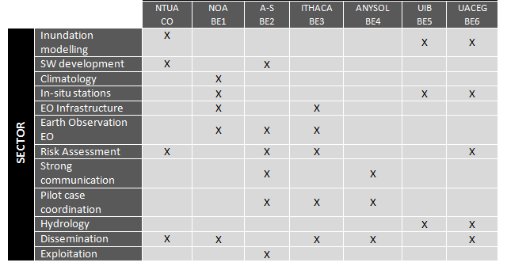
Project Budget & Duration
Total eligible costs: 753 317 Euros
EC contribution: 564 987 Euros (75%)
Duration: 2 years, starting 1/1/2017

Slide 3
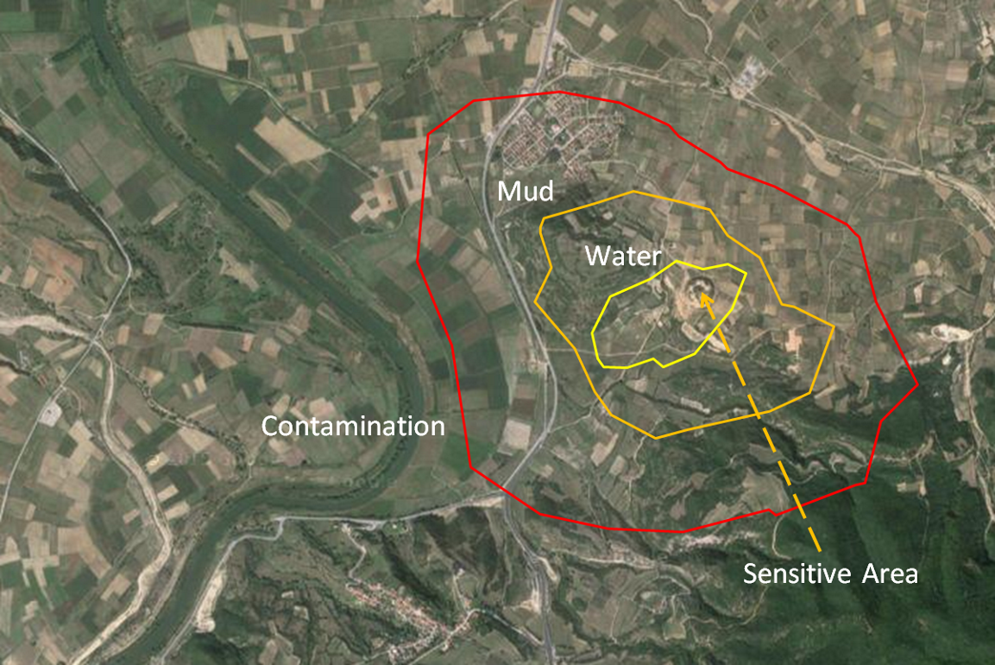
TRIBUTE
TRIBUTE aims to help Europe-wide national, regional and local CP authorities answer the following vital question in case of flooding: “Should I initiate an evacuation and how long do I have to evacuate safely?”.
The answer to the above question is unique per selected area, as not all sites are equally prone to flooding.
An evacuation trigger buffer is a boundary that circumscribes an area in such a way that when floodwaters (incl. waters, sediment, contaminated waters and pollution) coming from any direction cross the buffer, an evacuation is recommended.

Slide 4
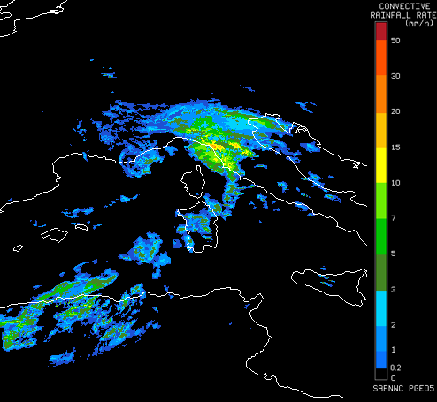
Current meteo hazard
TRIBUTE software tool that will be delivered as a web service and as a mobile application, will be fed with current estimates of downpour hazards from satellites and information on the vulnerability and coping capacity for the threatened site. The service will have pan-European coverage and will be tested extensively in three pilot areas with different characteristics, including cross-border and multi-threat. TRIBUTE has rich training, dissemination and exploitation activities to promote the concept to the stakeholders.

Slide 5
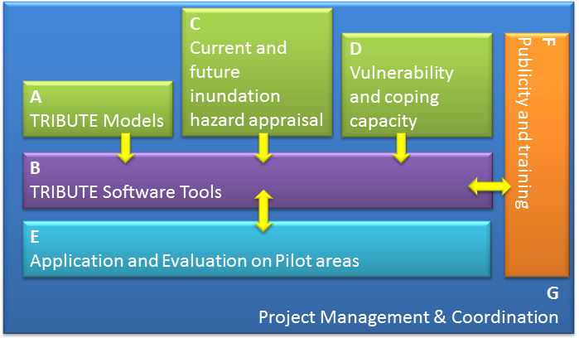
Tasks and logical flow

Slide 6
Deliverables
Tasks | Deliverables
A. TRIBUTE Models (NTUA/CO) | D.A1 Report on Model development for Inundation simulation, M6 D.A2 Report on Model development for trigger buffers for the evacuation of sensitive areas due to inundation, M12
B. TRIBUTE Software Tools (NTUA/CO) | D.B1 TRIBUTE Software tool, M15 D.B2 TRIBUTE Software Tool Users’ Manual, M15 D.B3 TRIBUTE Mobile Application, M16
C. Current and future floods hazard appraisal (NOA/BE1) | D.C1 Report on satellite-derived parameters related to the estimation of inundation risk (static and dynamic), M6 D.C2 Report on satellite-derived parameters related to the estimation of extreme rainfall detection, M6 D.C3 Web portal to provide maps with the current satellite-derived Convective Rainfall Rate in Europe, M12 D.C4 Report with maps on future climatic trends for extreme precipitation events that lead to inundation in urban and rural areas , M15
D. Integration of vulnerability and coping capacity (ITHACA/BE3) | D.D1 Report on State-of-the-art on flood vulnerability and risk models, M6 D.D2 Report on Vulnerability and coping capacity assessment, M16

Slide 7
Deliverables
Tasks | Deliverables
E. Application and Evaluation at Pilot Cases (A-S/BE2) | D.E1 User needs and requirements, M5 D.E2 TRIBUTE Performance evaluation, M23
F. Publicity and Training (ANYSOL/BE4) | D.F1 Project Web-site, M4 D.F2 Report on Workshop 1 in Turin Province, M18 D.F3 Report on Workshop 2 in Palma de Mallorca, M19 D.F4 Report on Workshop 3 in Sofia during EU Presidency, M23 D.F5 Report on of European TRIBUTE Exploitation workshop 4 in the Hague, M23 D.F6 Conference Papers or Abstracts after Participation in Conferences, M24 D.F7 Report on the Communication Activities & Dissemination and training material, M24 D.F8 Layman’s report, M24
G. Project Management & Coordination (NTUA/CO) | D.G1 First Reporting to EC, M8 D.G2 Second Reporting to EC, M16 D.G3 Final Reporting to EC, M24 D.G4 Agendas and minutes of Internal meetings, M24

Slide 8
Major Events
KOM Meeting, Athens, 8 Feb. 2017
workshop 1 in Turin Province, 1st Semester (S1) 2018
workshop 2 in Palma de Mallorca, S2 2018
workshop 3 in Sofia during EU Presidency, S2 2018
exploitation workshop 4 in the Hague, S2 2018

Slide 9
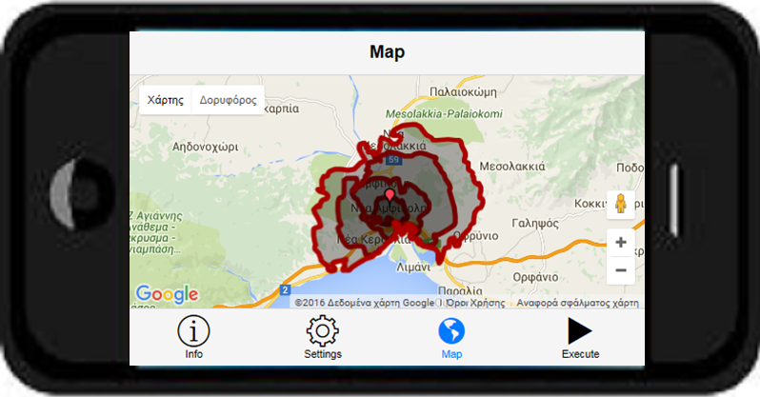
Conceptual diagram of proposed smart phone app
Users and stakeholders will be able to run TRIBUTE from their mobile devices. A native mobile application to provide trigger buffer zones in inundation events as well as relevant information in the area, like meteorological hazard and population vulnerability will be provided. The app will be able to run with current meteorological data from satellites or with data entered by the user. The app will run for the user current position or any other location entered.

Slide 10
Follow up
Although the tools will be validated in the selected three case studies, the tool will be developed for the whole Europe.
TRIBUTE concept is unique and will be clearly recognisable; any actions related to hazard assessment due to rainfall are complementary and by no means overlapping with other funded efforts.
Designed to have technical and financial sustainability
Strong dissemination and exploitation activities

