Slide 1
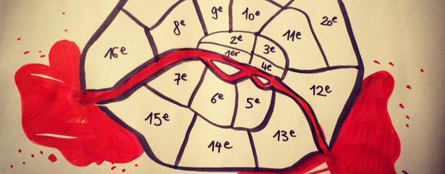
MERCI - Multi-site Events Response and Coordinated Intervention
Hripsime Torossian, Lucie Leblond, Lorenzo Massucchielli

Slide 2
MERCI
Who’s who? Duration and cost of the project.
French Red Cross
Italian Red Cross
Spanish Red Cross
Bulgarian Red Cross
Portuguese Red Cross
Red Cross EU Office
From 1st of January 2017 to 31 December 2018
Total cost of the projet : 531 035 €
EC co-financing : 398 276€
Area of activity : Preparedness of volunteering civil protection organisations to face multi-risk and multi-site incidents

Slide 3
MERCI
Why do we need this project?
Support EU large urban areas' resilience in multi-site incidents for which the new complexity of coordination requires new kind of responses.
Main objective:
Contributing towards the strengthening of civil society and volunteering civil protection organisations’ capacities and to enable them to act in coordination with public authorities before, during and after such events.
Specific objectives:
Development of a replicable transnational response planning tool based on policies, guidelines and shared operating protocols.
Strengthening responders’ capability and increase their effectiveness in the field of multi-sites or multi-risks simultaneous events management.

Slide 4
merci
Deliverables and deadlines
State of the art of Urban resilience and multi-site events management (05.2017)
Assessment tool and report study on responders’ needs in EU countries (08.2017)
Development of Scenarios (09.2017)
Guidelines and standard operational protocols (12.2017)
Development of training material for first responders and operation managers (12.2017)

Slide 5
Merci
Important dates and events
Kick off meeting in Paris 03/2017
Project steering committee meetings in partners’ countries 01/01/2017 – 31/12/2018
Training of trainers sessions 03/2018
Exercises 01/04/2018 – 01/09/2018
Dissemination conference in Brussels 11/12/2018
Follow up: rolling out of tools and results within the network of the Red Cross and relevant partners

Slide 6
Merci
MERCI !!!
hripsime.torossian@croix-rouge.fr
lorenzo.massucchielli@cri.it
lucie.leblond@redcross.eu

