Slide 1
AlpDIRIS - Alpine DISASTER RELIEF for Slovenia and Italy

Slide 2
AlpDIRIS in A NUTSHELL
Short name: ALPDIRIS
Title: Alpine Disaster Relief for Slovenia and Italy
Project Budget: € 615 141,40
EC Contribution: € 461 356,00 (75%)
Duration: 24 Months
Theme: Preparedness
Benficiaries
HITEC Luxembourg S.A. - Coordinating beneficiary
Intelligence for Environment & Security - IES Solutions
Administration of the Republic of Slovenia for Civil Protection and Disaster Relief (URSZR)
Protezione civile della Regione Autonoma Friuli Venezia Giulia (PCRAFVG)
Supporting:
Vigili del Fuoco della Regione Autonoma Friuli Venezia Giulia

Slide 3
Objectives
Share different expertise and techniques used in case of emergencies, particularly in case of forest fires fighting and mountain rescue operations in field training joint activities
Ensure the exchange of the information between field operators and their headquarters in case of emergencies
Improve communication capabilities on disaster sites by introducing satellite communication and mobile 4G LTE base stations
Improve information exchange between the disaster response teams from Italy and Slovenia by introducing a common information space

Slide 4
Common Information Space (CIS)
Goal: information systems from different disaster management stakeholders, domains and vendors shall exchange information.
CIS: central place where services get in touch to exchange data (connects data service providers with consumers)
Adaptors reduce complexity (one CIS adaptor instead of N interfaces per legacy systems)
Adaptors transform proprietary data to standard messages adopted in CIS (CAP, EMSI, MLP; EDXL DE message envelope)

Slide 5
CIS architecture syntactic interoperability
SOAP
REST
standard message formats EDXL DE <CAP, EMSI, MLP …>
Adaptor
Adaptor
Peer-to-peer communication or Enterprise Service Bus
Admin
WorkStation
CIS Directory Agent configuration of CIS participants
Adaptor
RSS
Adaptor
JAVA integration

Slide 6
Common Information Space CIS Secure and understandable information
Goal: secure exchange of meaningful information.
to protect information from unauthorised access
to limit shared information to trusted partners involved in a joint mission – “need to know” principle.
Secure interoperability
to understand information from other organisation, using different language, terms and encodings
semantic annotations, not translation of free text
Semantic interoperability

Slide 7
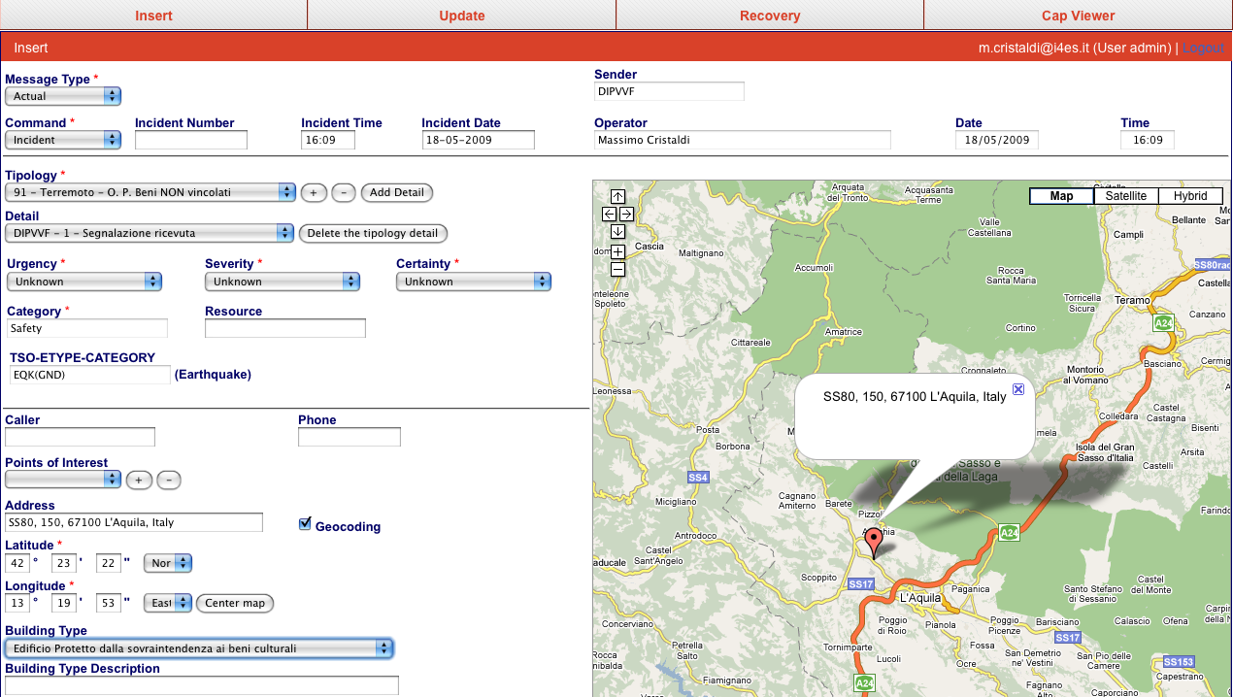
Reason for semantic interoperability
OK!
Italian Fire Brigades
Incident Code: 2
(incendio dovuto a scoppio)
Italian Fire Brigades
OK!
Resource Code:
APS FIAT OM 160

Slide 8
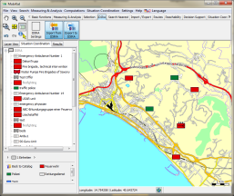
Reason for semantic interoperability
?!?
Italian Fire Brigades
Greek Fire Brigades
?!?
Incident Code: 2
(incendio dovuto a scoppio)
Incident Code:
ΔΑΣΙΚΗ ΠΥΡΚΑΓΙΑ
Resource Code:
APS FIAT OM 160
German Red Cross
Resource Code: RTW-1
(Medical Vehicle)
Slovenian Fire Brigades
?!?
?!?
Resource Code:
REŠEVALNO VOZILO

Slide 9
Phases
1. Common Cooperative Procedure Definition
2. Adaptation and Integration of the solution
3. Field Trial
Definition of common cooperative procedures and the requirements for the disaster relief solution
Adaptation, Implementation and Integration of the Common Information Space Adaptor for URSZR, PCRAFVG and Vigili del Fuoco FVG
The Common Information Space solution will be installed on servers in Slovenia and Italy
4. Start the productive use
Several real trials will be organised and concluded by a workshop
Final adaptation of the procedures and tool set will be realised
The deployed equipments and services will be used in day to day operations
Trainings for selected Search and Rescue teams will be organised

Slide 10
Planning
Task A
Standard Operative Procedures (SOP)
Task B
Implementation, adaptation and integration of the tool set
Task C
Field Trial
Task D
Start productive use
01 January
2017
31 May
2017
01 October
2017
30 December
2017
30 June
2018
30 December
2018

Slide 11
Project Follow-UP
After the successful end of the project the solution is ready for full deployment in FVG and Slovenia.
What is needed to be done is the full deployment of the collaboration solution to all first responders. The remaining team members have to be trained in the procedures and the solution.
New trainings activities will be organised to extend the use of the solution
Deployment to other European Countries, i.e. Germany, Austria…
The goal of the public international demonstration is to create awareness in other countries.
Notes:
We should mention here the exiting protocol

Slide 12
Next Important Dates
First Workshop:
Date: February 2017
Location: Slovenia
Purpose: First part of the cooperative procedure definition and requirements
Second Workshop:
Date: Mid May 2017
Location: Italia
Purpose: Approve cooperative procedures and requirements

Slide 13
Katja Banovec Juros
Administration for Civil Protection
and Disaster Relief - Slovenia
katja.banovec.juros@urszr.si
Nadia di Narda
Civil Protection of the Region
Friuli Venezia Giulia - Italia
Nadia.DiNarda@protezionecivile.fvg.it
Harold Linke (Project Coordinator)
HITEC Luxembourg
harold.linke@hitec.lu
Uberto Delprato
IES Solutions
u.delprato@i4es.it

