Slide 1
Ready 2 Respond
Modernised Preparedness and Response Capacity in South Caucasus

Slide 2
Consortium, Stakeholders & Partners
Consortium
Danish Red Cross (grant holder)
Austrian Red Cross
Icelandic Red Cross
Armenian Red Cross Society
Georgia Red Cross Society
International Federation of Red Cross and Red Crescent Societies (IFRC)
Observing partners
Azerbaijan Red Crescent
Swiss Red Cross
International Committee of the Red Cross (ICRC)
Stakeholders
Emergency Management Service (EMS) in Georgia
Ministry of Emergency Situations (MES) in Armenia

Slide 3
Project Data
Duration: January 2019 – December 2020
Budget: Total eligible costs: € 567.536 EC contribution: € 425.652
Geography: South Caucasus
Needs Adressed:
- Area prone to natural and manmade disasters
- Diversify preparedness and response capacities and aid at scale
- Core Humanitarian Standards
- Current developments in the Civil Protection Mechanism locally

Slide 4
Project Objectives & Outputs
Specific objective 1:
ARCS and GRCS have effective disaster response capacities (DRTs) at national and community level.
ARCS and GRCS have improved emergency preparedness through a network of national and regional DRTs.
ARCS and GRCS have improved capacity to supervise, lead, manage and deploy volunteers in emergency situations through established Emergency Operation Centres (EOC).
Testing the response capacity of ARCS and GRCS assessing the effectiveness of SOPs, cooperation and command structures together with Civil Protection (CP) stakeholders and local authorities
Preparation of Disaster Response Teams (DRTs) for deployment and improved border cooperation
Specific objective 2:
CTP is routinely considered as a response option in GRCS and ARCS enabling timely, effective and efficient responses to emergencies.
To integrate CTP as a response option in GRCS and ARCS’ emergency response
Reinforcing of the capacity development and training activities in cash preparedness and emergency response

Slide 5
Project Objectives & Outputs
Specific objective 3:
Mental health and psychosocial needs of disaster-affected people are met in a timely, efficient and effective manner.
Increased capacity of the ARCS and the GRCS to respond timely and effectively to mental health and psychosocial needs of disaster effected people in the region
Strengthened regional cooperation and coordination in the field of disaster related MHPSS
Specific objective 4:
Enhanced cooperation between CP actors through effective dissemination of results and learnings
Support the effective dissemination, outreach and coordination for impact of the planned Work Packages
Close coordination, exchange and collaboration with CP authorities
To collect data that will help measure the process, outcome and impact of the activities to ensure sustainability and further development.

Slide 6
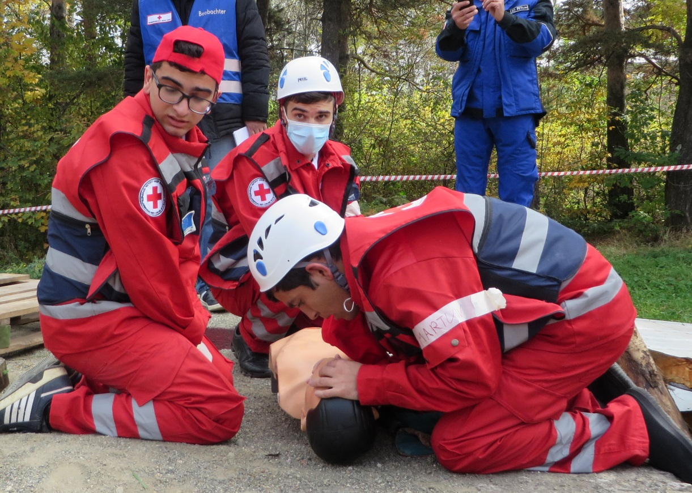
Main Events
Simulation exercises are planned for year 2
- National exercise in Armenia (summer 2020)
- National exercise in Georgia (summer 2020)
- Cross-border exercise (autumn 2020)

