Slide 1
Aid to Prioritize Fire Prevention Efforts
Fire probability maps for decision support
2020-11-13
Center for Knowledge and Analysis | DEMA

Slide 2
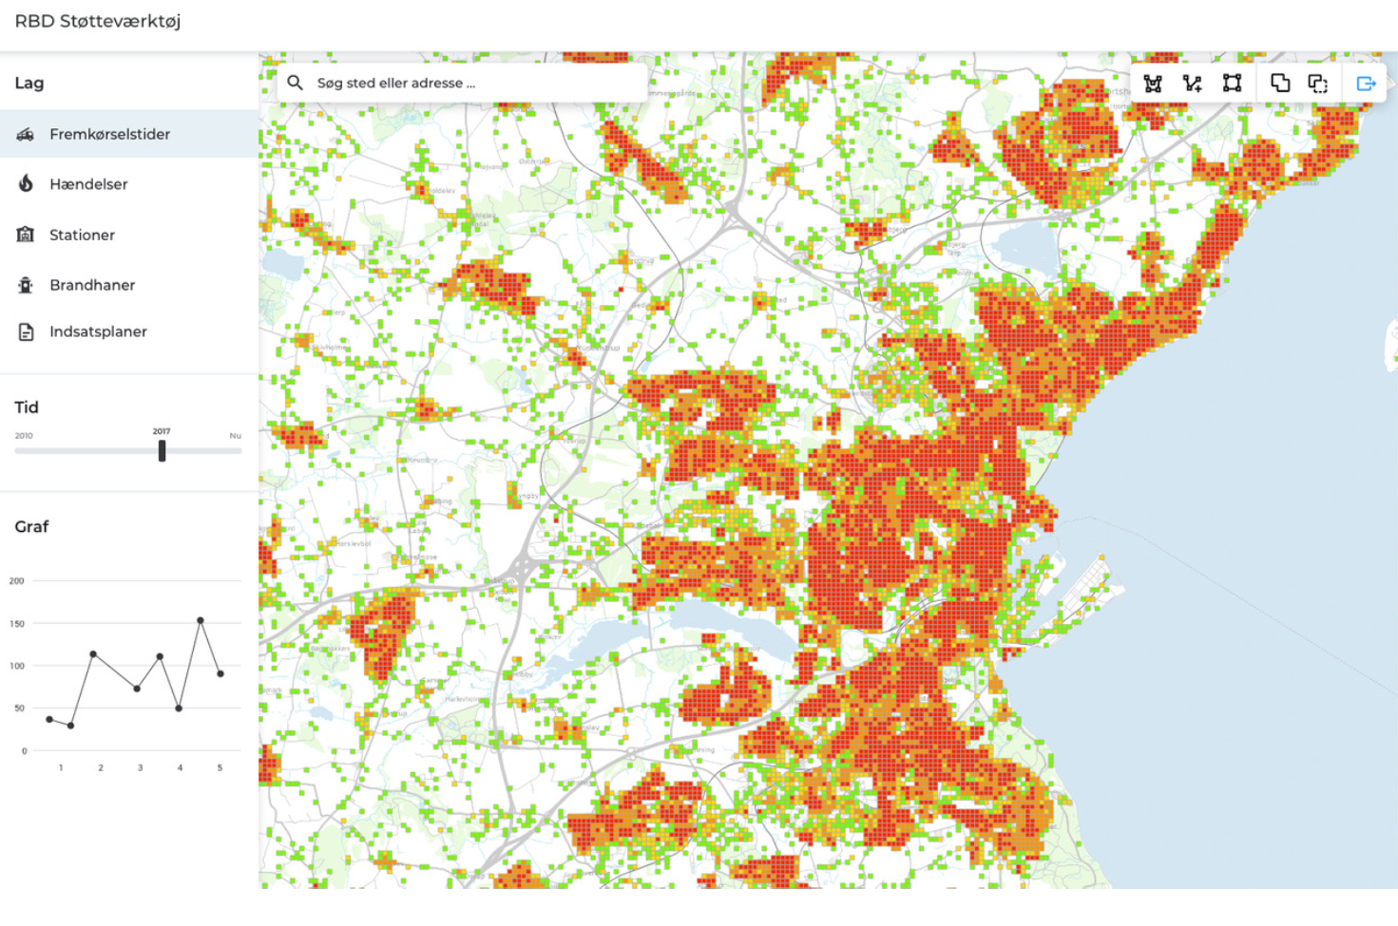
Output:
Tool
Publications
Objectives:
Fewer building fires
Smarter spending
Stakeholders:
DEMA
University of CPH
Municipal firebrigades
Data supplier
Software supplier
Center for Knowledge and Analysis | DEMA

Slide 3
Approaches
Machine learning, UCPH Dept. of Computer Science
Maximizes accuracy
Black box
Logistic regression, DEMA and UCPH Dept. of Geoscience
Provides explanation
White box
Center for Knowledge and Analysis | DEMA

Slide 4
2020
2021
Activity
Q4
Q1
Q2
Q3
DEMA | WP1: Management
UCPH | WP2: Data collection
UCPH | WP3: Mapping
DEMA | WP4: Dissemination
Data set ready
01-01-2021
User workshop
01-04-2021
Model complete
01-07-2021
Launch
30-09-2021
Center for Knowledge and Analysis | DEMA

