Slide 1
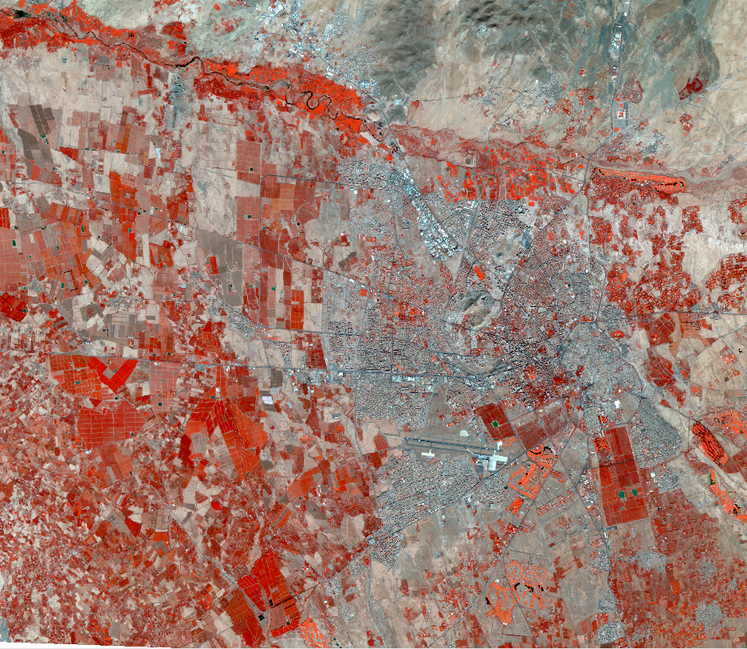
ARiMA - Assessment and Simulation of Present and Future Multi-hazard Risk in the Marrakech-Safi Region
Project presentation by IABG
Felicitas Bellert
Brussels, January 2019

Slide 2
Consortium & Budget
Coordinator:
IABG mbH (Germany)
Project Partners:
UNITED NATIONS UNIVERSITY Institute for Environment and Human Security (UNU-EHS) • Germany
CIMA • Italy
RESING • Morocco
University Cadi Ayyad • Morocco
Beneficiaries:
Hydraulic agency, Urban agency, Agriculture agency, Civil protection, Forest and Water Agency, local authorities • Morocco
External budget - Prevention priority Pilot and demonstration project focusing on regional resilience to disasters
Total eligible costs: EUR 929,409.49
EC co-financing: EUR 697,057 (75 %)
Project duration: 24 months 01.01.2019 – 31.12.2020
Area of activity:
Marrakech-Safi Region – Morocco

Slide 3
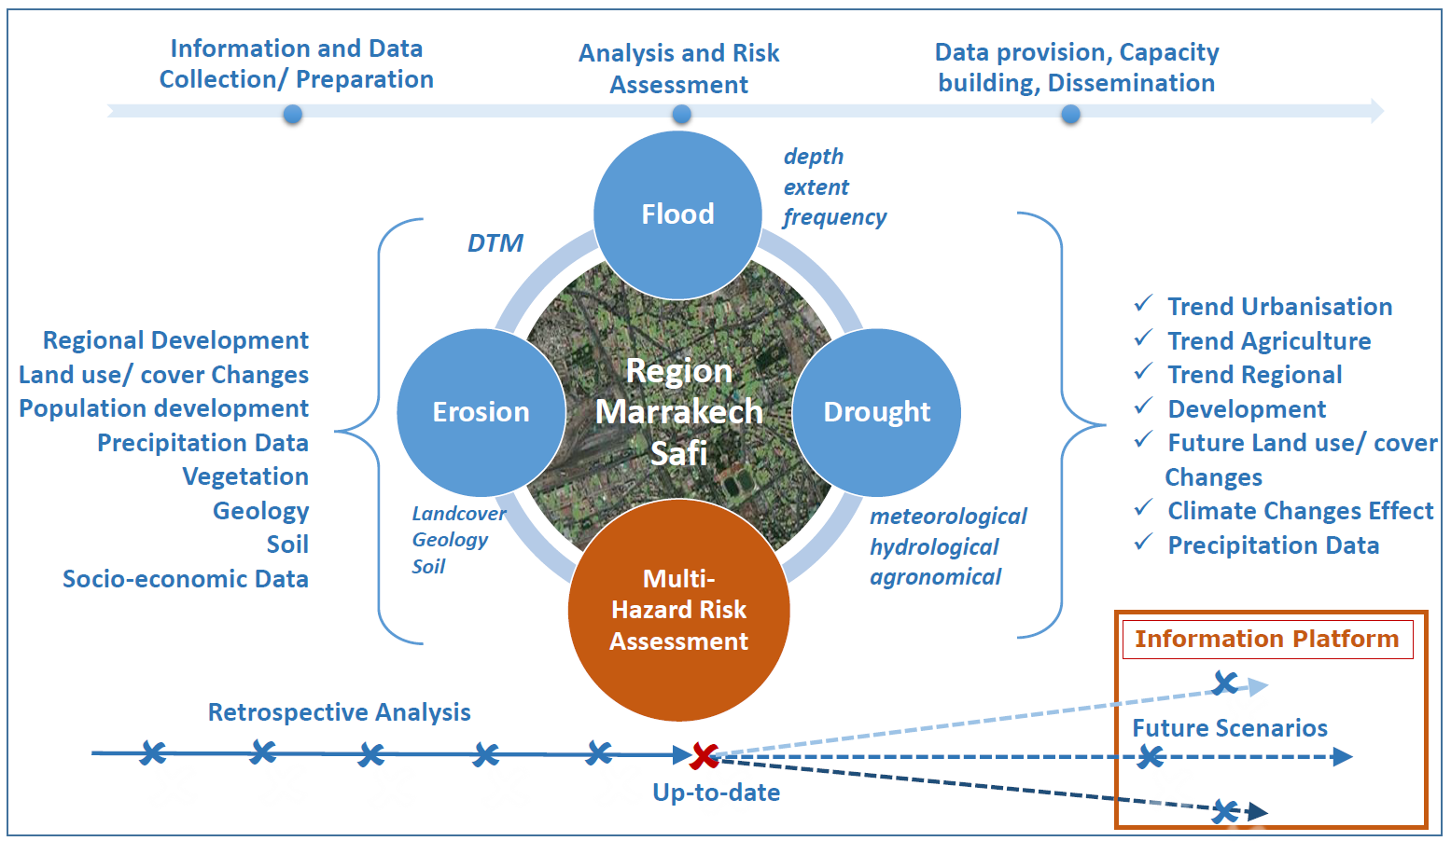
Core Activities & Work packages
WP 1: Management & coordination
Phase I - 2019
WP 2: User needs & stakeholder engagement
WP 3: Development & production geo-spatial database for multi-hazard risk assessment
Phase II – 2019/2020
WP 4: Multi-hazard risk assessment
WP 5: Future scenarios of multi-hazard risk
Phase III - 2020
WP 6: Development of a spatial multi-hazard risk information platform
WP 7: Analysis of prevention strategies
WP 8: Capacity building & knowledge transfer

Slide 4
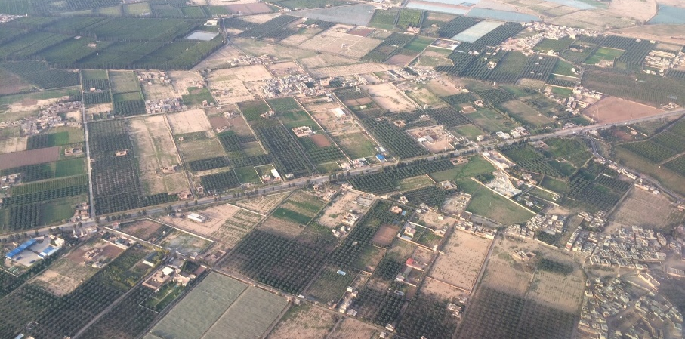
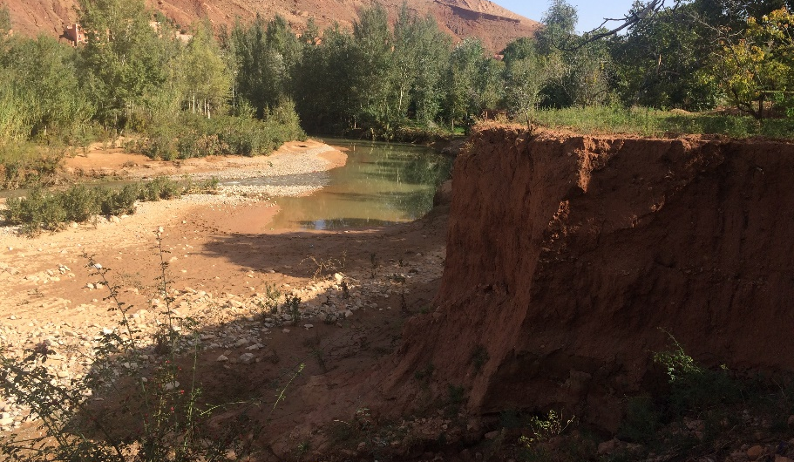
Objectives of the Project
Development of a spatial multi-hazard risk information system (floods, drought, erosion) for Marrakech-Safi Region – Morocco
Support disaster risk decision making by improving risk-informed rural and urban planning
Evaluate the drivers, delineate the hotspots and understand the dynamics of current and future single and multi-hazard disaster risk
Mainstream the acquired knowledge into the regional prevention actions.
Vulnerability
Hazard
Risk
Exposure

Slide 5
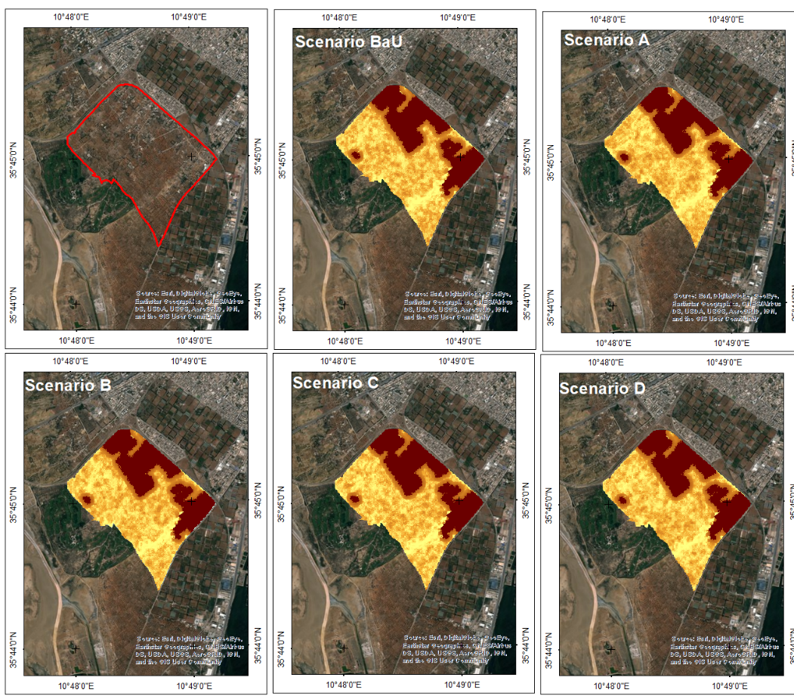
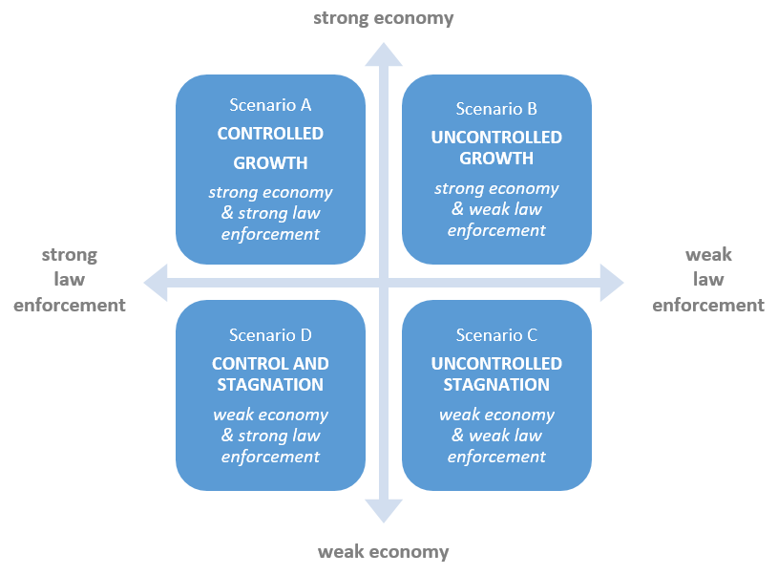
Main Benefits for Sustainability
Implementation of a system based on accessible data (f.e. Copernicus) and local or national data.
Intensive trainings for Moroccan public authorities
to maintain the risk assessment process
to operate the system on their own
Set of a governance system (implementation/ monitoring) for the sustainability of its use.
Improved awareness for sustainable planning and the use of natural resources.
Contribution to increase capacity for preventing or reducing the impacts of future hazardous events

Slide 6
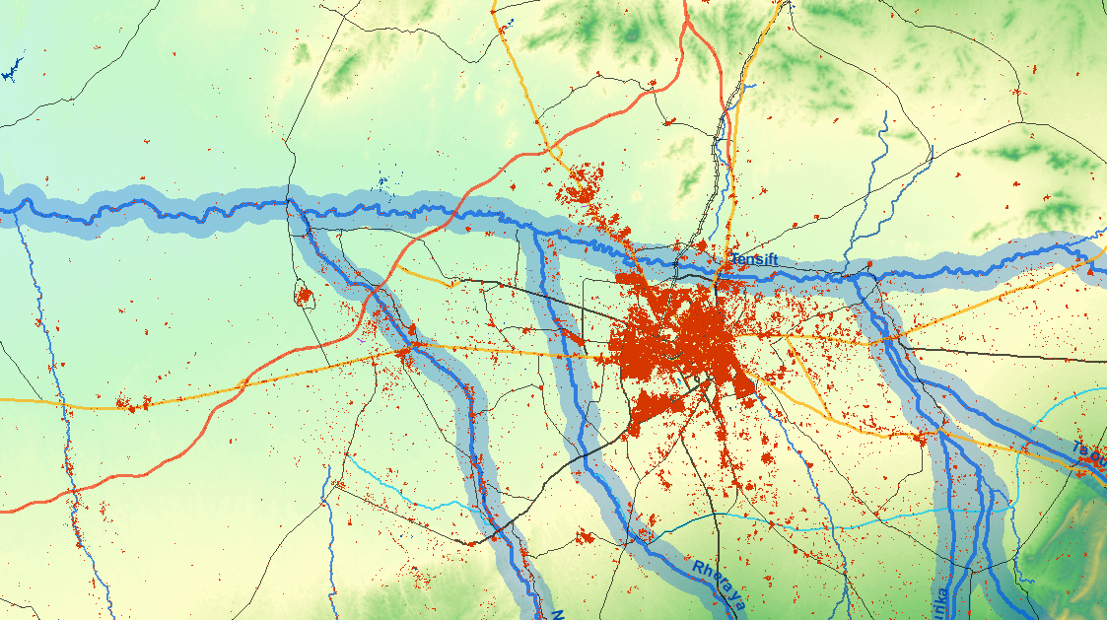
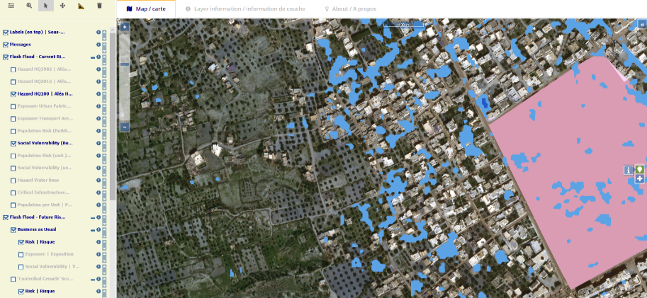
Expected Results & Next Steps
Regional risk information system to identify current and future multi-hazard risk zones in its geospatial context.
Decision making and planning tool for better management and prevention activities facing potential future risks within the Region.
Involvement of Moroccan regional and national partners in all processes during the project lifetime to ensure acceptance and usability of outputs.
Complement local and national activities and fit into the national plan for disaster risk prevention.
KO and 1st Workshop in Marrakech (Jan/March 2019)
Stakeholder engagement, data collection, interviews, field visits (Jan/March 2019 ff)
Launch communication/ dissemination actions (Feb 2019 ff)

Slide 7
Contacts
Thank you for your attention!
IABG mbH
Felicitas Bellert
Sandra Mezzadri
Geodata/Geoinfirmatics
Einsteinstrasse 20
85521 Ottobrunn
Germany
Phone +49 89 6088-3299
Bellert@iabg.de
Mezzadri@partner.iabg.de
www.iabg.de
United Nations University - EHS
Michael Hagenlocher
Mostapha Harb
Institute for Environment and Human Security
Platz der Vereinten Nationen 1
53113 Bonn
Germany
Phone +49-228-815-0250
hagenlocher@ehs.unu.edu
harb@ehs.unu.edu
www.ehs.unu.edu
CIMA
Roberto Rudari
Eva Trasforini
Disaster Risk Reduction and Climate Change Adaption
Via A.Magliotto, 2
17100 Savona
Italy
Phone +39 019230271
roberto.rudari@cimafoundation.org
eva.trasforini@cimafoundation.org
www.cimafoundation.org
RESING
Mohamed Aboufirass
Aurélie Chancel
435 Rue Annanhda Annakhil
40016 , Marrakech
Morocco
Phone +212524329817
+212524329818
m.aboufirass@resing.ma
a.chancel@resing.ma
www.resing.ma
University Cadi Ayyad
Khalid Rkha Chaham
Faculté des Sciences-Semlalia, Laboratoire 3geo-lab
Boulevard Prince Moulay Abdellah
40000, Marrakech
Morocco
Phone +212-524434885
rkha@uca.ac.ma
www.ucam.ma
Arima.iabg.de

Slide 8
Activities and Milestones
Phase I
Phase II
Phase III
Stakeholder engagement and participation

