Slide 1
European Modular Field Hospital
Kick – Off meeting European Commission

Slide 2
European Modular Field Hospital
Coordinator:
Italian Civil Protection Department
Partners:
Belgian Federal Public Service of Health
Danish Emergency Management Agency
Estonian Health Board
French DG for Civil Protection and Crisis Management
Johanniter-Unfall-Hilfe Germany
Leipzig University
Romanian Department for Emergency Situations / Ministry of Internal Affairs
Association Of Slovak Samaritans

Slide 3
European Modular Field Hospital
Total eligible cost: 1.045.875 Euro
EC co-financing: 784.406 (75%)
Duration of the project: 2 years (start 1/1/2017)

Slide 4
Necessity of the project:
A clear lack of active deployable level 3 Emergency Medical Teams i.e. referral hospitals in the field.
A need for a high level medical module, deployable for a longer term mission without putting the burden on one single Member State or organisation.

Slide 5
Area of activity and description
“To explore how to improve the medical capacity of the UCPM while meeting high standards of quality, rapid deployment and accountability and sustainability for the deployment of a common European medical capacity to deliver healthcare in accordance with, or above, the minimum standards drafted by the WHO EMT Working Group”
The project has the permanent support of the WHO-EMT working group, Handicap International, and the Greek National Centre of Emergency Care.

Slide 6
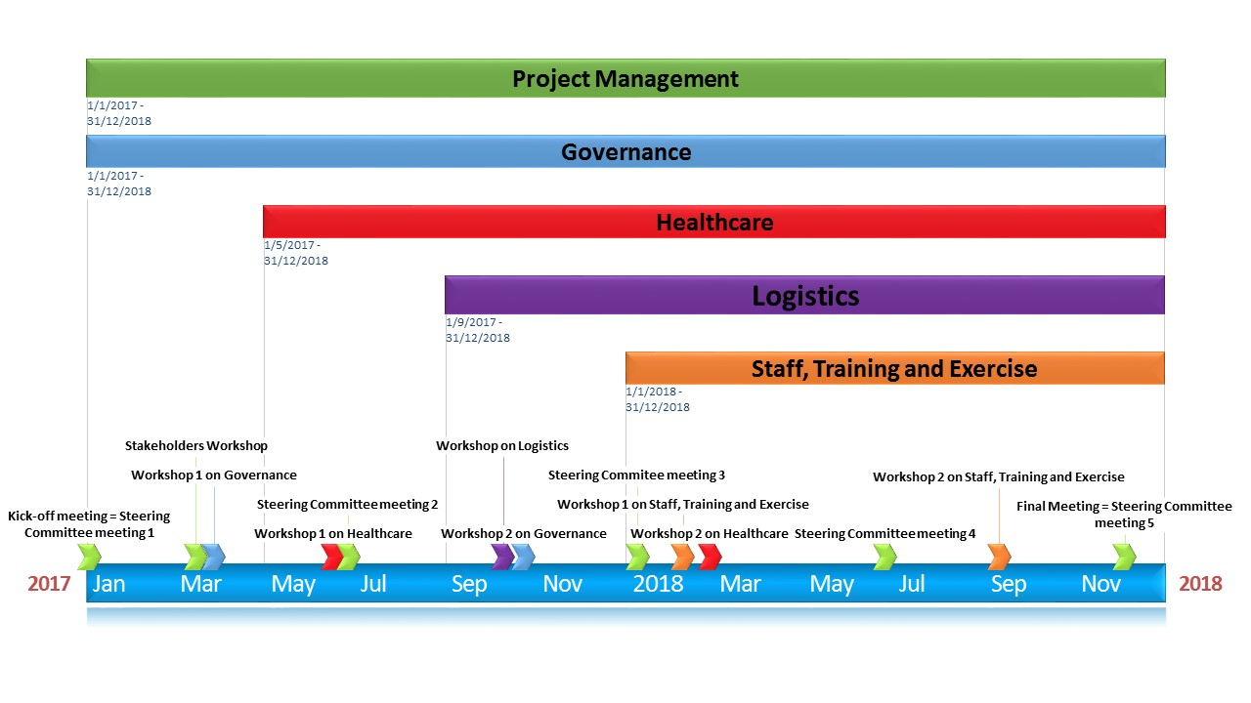
Deliverables and timeline

Slide 7
Tentative dates and locations for major events
Activity | Start |  |  | End |  |  | Location | Duration
Kick-off meeting with EC | 18 | 1 | 2017 |  |  |  | Brussels | 1 day
Kick-off meeting = Steering Committee meeting 1 | 13 | 2 | 2017 | 14 | 2 | 2017 | Rome | 2 days
Stakeholders Workshop | 6 | 3 | 2017 | 8 | 3 | 2017 | Antwerp | 2 days
Workshop 1 on Governance | 28 | 3 | 2017 | 29 | 3 | 2017 | Paris | 2 days
Workshop 1 on healthcare | 23 | 5 | 2017 | 24 | 5 | 2017 | Tallinn | 2 days
Steering Committee meeting 2 | 22 | 6 | 2017 | 23 | 6 | 2017 | Berlin | 2 days
Workshop op logistics | 26 | 9 | 2017 | 28 | 9 | 2017 | Denmark | 3 days
Workshop 2 on Governance | 19 | 10 | 2017 | 20 | 10 | 2017 | Paris | 2 days
Steering Committee meeting 3 + sustainability | 9 | 1 | 2018 | 11 | 1 | 2018 | Bratislava | 3 days
Workshop 1 on Staff, Training and Exercise | 15 | 2 | 2018 | 16 | 2 | 2018 | Timisoara | 2 days
Workshop 2 on Healthcare | 20 | 2 | 2018 | 21 | 2 | 2018 | Tallinn | 2 days
EUMFH training course 1 | 9 | 4 | 2018 | 13 | 4 | 2018 | Antwerp | 5 days
EUMFH training course 2 | 18 | 6 | 2018 | 22 | 6 | 2018 | Antwerp | 5 days
Workshop 2 on Staff, Training and Exercise + pre-exercise meeting | 25 | 6 | 2018 | 27 | 6 | 2018 | Aix en Provence? | 3 days
Steering Committee meeting 4 | 10 | 7 | 2018 | 11 | 7 | 2018 | Leipzig | 2 days
conduct EUMFH exercise | 18 | 9 | 2018 | 21 | 9 | 2018 | Aix en Provence | 4 days
Final Meeting = Steering Committee meeting 5 | 10 | 12 | 2018 | 11 | 12 | 2018 | Rome | 2 days
HPNW |  | 2 | 2018 |  | 2 | 2018 | Geneva | 5 days
Civil Protection Forum |  |  | 2017 |  |  |  | Brussels | 2 days

Slide 8
Follow-up
The project can be the source of a group of following activities and projects, leading to the growth of the UCPM’s medical response to be a worldwide example

