Slide 1
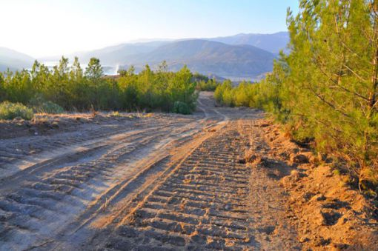
Development of a Long-Term Wildfire Prevention Framework for Istanbul
ECHO/SUB/2020/TRACK1/833085
01/10/2020 – 31/09/2021

Slide 2
Project Info
Project Title : Development of a Long-Term Wildfire Prevention Framework for Istanbul Forest
Region
Project Duration : 1 October 2020 – 30 September 2021
Total Budget : 393.700 Euro
EU ECHO Contribution : 374.015 Eur. (95%)
Legal Representative of the Project: Director of the Istanbul Forest Region
Affiliated Entity: Istanbul Regional Directorate of Forestry
Contact Person: Ikram Çelik – Head of Forest Fire Unit

Slide 3
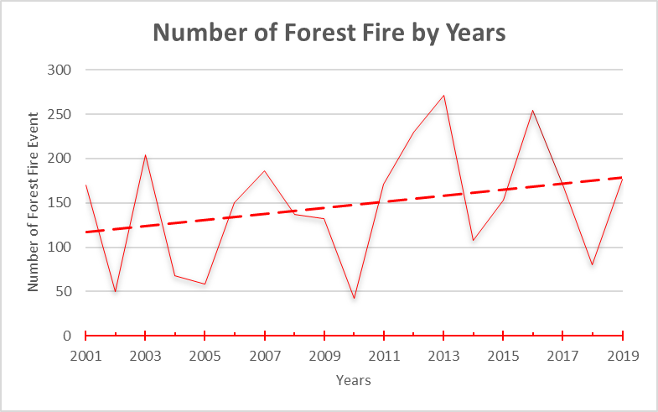
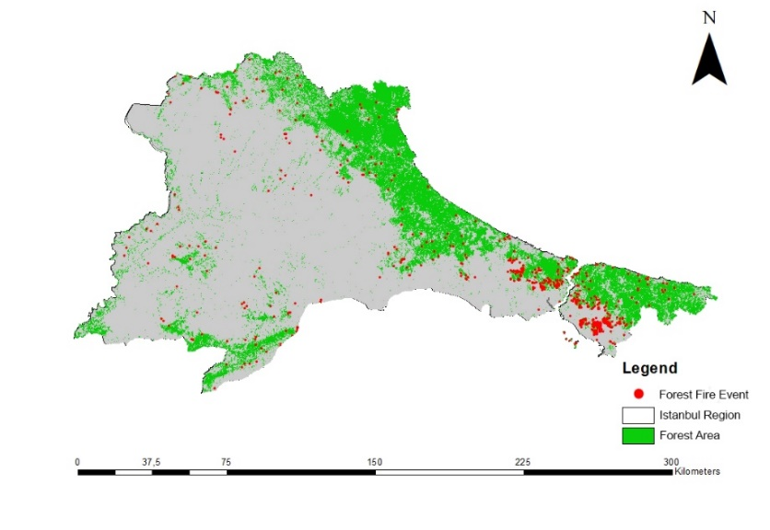
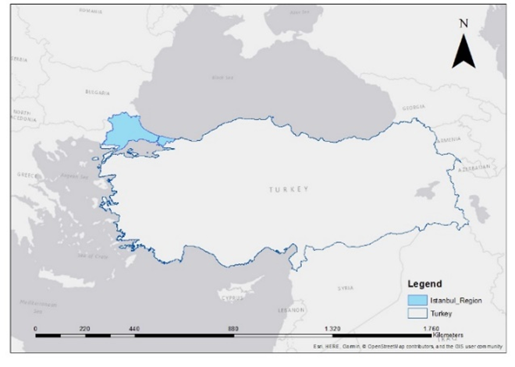
Project Background and Rationale
Istanbul Region Forested Areas and Forest Fire Events from 2001 to 2018
Istanbul Region's Forest Areas and Forest Fire Events (2001-2018)

Slide 4
Project Time Frame
 | O | N | D | J | F | M | A | M | J | J | A | E
Component 1- Development of a long-term fire prevention strategy for 2021-2030
Activity 1.1. Stakeholder feedback on the structure of the strategy report
Activity 1.2. Preparation of the strategy document
Component 2- Capacity building in wildfire prevention and investigation
Activity 2.1 Training program (TP) Report
Activity 2.2 Training workshops (TW)
Activity 2.3 Study Visits
Component 3- Technical analysis of wildfire risks in relation with env. change
Activity 3.1 Report on Influence of Climate Change and Urban Sprawl on Fire Risk
Activity 3.2 Report on Research Gaps on Fire Prevention and CC Interaction
Component 4- Development of a fire action plan for Prince Islands
Activity 4.1. Stakeholder feedback on the str.of the fire action plan for Prince Islands
Activity 4.2. Stakeholder feedback on the draft fire action plan for Prince Islands
Visibility and Dissemination

Slide 5
OUTPUTS
The proposed action is expected to produce the following outputs; Strategic plan of Long Term (2021-2030) Wildfire Prevention for Istanbul Forest Region (Component1) Report on Capacity Building and Training Needs (Component 2) Report on Influence of Climate Change and Urban Sprawl on Fire Risk (Component 3) Report on Research Gaps on Fire Prevention and Climate Change Interaction (Component 3) Fire Prevention and Suppression Report for Prince Islands (Component 4)

Slide 6
SUCCESS INDICATORS
The indicators to assess the project’s achievements are; For Component 1; contribution of at least 5 stakeholders in Istanbul Regions. These stakeholders are district mayors or high-level officials of district municipalities, representatives of NGO’s and academicians. For Component 2; at least 10 people are trained for fire prevention and fire investigation. For Component 3; all reports are delivered. For Component 4; a collaborative process has been conducted with at least 5 stakeholders representing various agencies related to the Prince Islands and a Fire Prevention and Suppression report has been delivered.

Slide 7
THANK YOU Project Technical Team

