Slide 1
PREDICATE: PREventing DIsasters by CApitalizing on unmanned aerial systems TEchnology
Dr. Christos Panayiotou Deputy Director
KIOS Research Center for Intelligent Systems and Networks,
University of Cyprus
Email: christosp@ucy.ac.cy
KEMEA, Ministry of Interior and Administrative Reconstruction, Hellenic Republic
Cyprus Civil Defence, Ministry of Interior, Republic of Cyprus

Slide 2
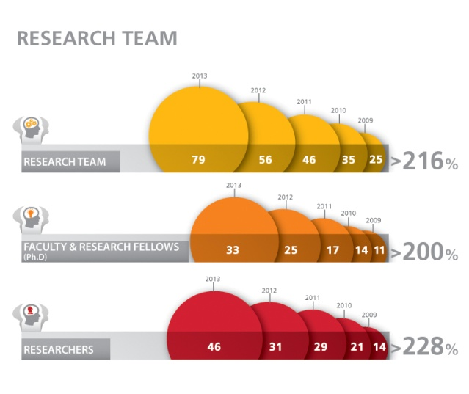
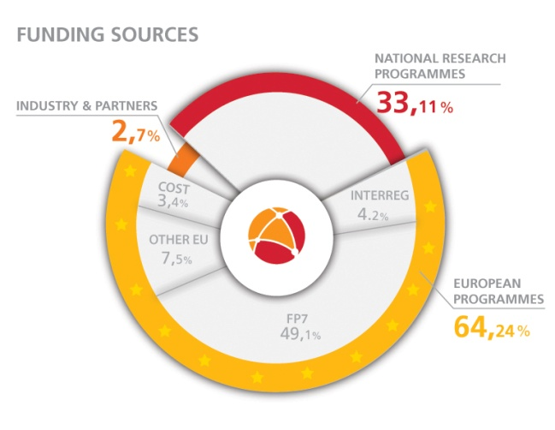
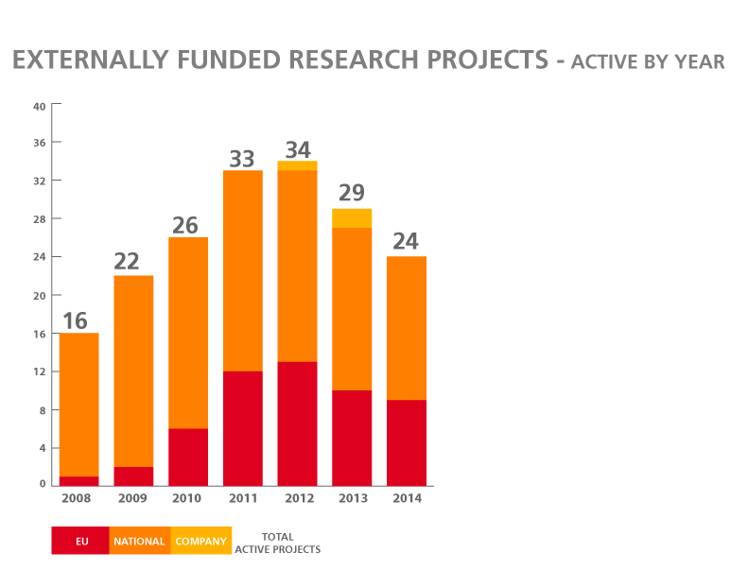
Beneficiary
KIOS Research Center - University of Cyprus
Focus on Intelligent Management and Security of Critical Infrastructure Systems
70+ researchers
20+ research projects (including ERC Advanced Grant & Proof of Concept, a number of FP7 Projects, Marie Curie, ESF Cost Action, Eurostars, etc)
21 Honors & Awards
Active

Slide 3
Partners
KEMEA (the advisory, research and consulting body of the Ministry of Interior and Administrative Reconstruction)
Implements research on Homeland security relating to the Ministry of Interior and Administrative Reconstruction, and its associated agencies as well as other foreign organisations
Coordinates and participates in many EU funded projects (including, INSPEC2T, EU-CIRCLE, VASCO, EWISA, ect)
Staffed by active officers of the Hellenic Police, Fire Corps, Civil Protection, and security experts with high academic profile in security research
Cyprus Civil Defence
The Civil Defence Force is an organised service under the Ministry of Interior and covers the whole free areas of the Republic of Cyprus.
Participates in many EU funded projects (3 of which have been accepted in this call for proposals)
Small number of permanent staff and large volunteer base

Slide 4
Total eligible cost, EC co-financing and duration
Eligible cost categories | Rate % | € | Financing Plan | € | % of eligible costs
Personnel |  | 257,816 | Requested EC contribution | 255,650 | 75.00%
Travel and subsistence |  | 28,580 | Contribution of the Coordinator | 41,521 | 12.18%
Equipment |  | 27,831 | Contribution of the Beneficiary (ies) | 43,695 | 12.82%
Sub-contracting / External assistance |  | 0 | Other sources of funding | 0 | 0.00%
Other direct costs |  | 4,340 | Expected direct revenues | 0 | 0.00%
Indirect costs / overheads | 7.00% | 22,300
TOTAL ELIGIBLE COSTS |  | 340,866 | TOTAL | 340,866
Project duration of 24 months

Slide 5
Area of Activity
Traditional surveillance infrastructure and reconnaissance personnel entail a high capital and operational expenditure, and as a result their availability is only limited. In many cases, access to areas where disaster management needs to take place might be too dangerous for humans; with remote coastal areas, steep mountainous areas and hostile territories being prominent examples.
The project partners do operate in such spatial regions in both Greece and Cyprus (with increasingly very limited resources).

Slide 6
Short description, background information and why the project is necessary,
Monitoring disaster-prone regions for the purpose of prevention and risk reduction
Using Unmanned Aerial Systems (UASs)
Affordable and highly capable platforms
Easily adaptable (to different situations), flexible and reconfigurable
Guide the selection and use of UAS in watch-keeping and patrolling of different regions of interest
Needs assessment and technology review procedures
Intelligent path planning toolkit for efficient UAS operation
Implement prototypes and facilitate cooperation and coordination of end-user partners

Slide 7
Deliverables and deadlines
Management and Reporting
Needs Assessment Methodology
Date (Month) | Task ID | Description
1 | A | Kick-off meeting minutes that will initiate the project tasks
6 | A | 2nd project meeting minutes
10 | A | 3rd project meeting minutes
20 | A | 4th project meeting minutes
24 | A | Final project meeting minutes
10 | A | First progress report
20 | A | Second progress report
3 | B | End-user needs prescription
6 | B | Report on needs assessment methodological procedure
4 | C | Review of current UAS technologies and future trends
12 | C | Report on technology review methodological procedure
5 | D | Functional Features report
18 | D | Report on developed path planning algorithm
Technology Review Methodology
Path planning Methodology

Slide 8
Deliverables and deadlines
Prototyping, Testing and Demonstrations
Date (Month) | Task ID | Description
18 | E | Path planning toolkit software and user manual
20 | E | Simulations, testing and demo report
23 | E | Feedback report on path planning use by end-user
2 | F | Website creation
13 | F | Infographic on UAS technology potentials
18 | F | Technical conference paper on developed path planning algorithm
19 | F | Training material for Community Mechanism Introduction Course
21 | F | Video clip on path planning toolkit
22 | F | Seminar on UAS platforms for disaster prevention and management
22 | F | Technical journal paper on developed path planning algorithm
22 | F | Training material
23 | F | Video clip of path planning demonstrations
23 | F | Infographic on efficiency and robustness gains
24 | F | Layman’s Project Report
Publicity: Dissemination and Exploitation

Slide 9
Tentative dates and places for Major Events
Demonstrate the results in the following major events:
European Civil Protection Training Programme
Community Mechanism Introduction Course
Technical Experts Course
The annual drills conducted in the Republic of Cyprus
“Lelapa” fire drill and the “Eggelados” earthquake drill for safe evacuation of citizens (planned for April 2017)
Disseminate to key collaborators:
CIPRNet Network of Excellence
IntelliCIS Cost Action participants
Raise awareness of other ongoing FP7-H2020 project meetings (including COncORDE, IMPRESS)

Slide 10
Follow Up
The developed methodological procedures will need to be updated to address future needs that arise and include state-of-the-art technology that becomes available.
The needs assessment procedure should be revised less frequently (once every two years)
The technology review procedures should be revised more frequently due to rapid advancements in technology (every six months).
Due to the dependency of the path planning toolkit on the available technology, both tasks D and E should be frequently revised (every six months).

