Slide 1
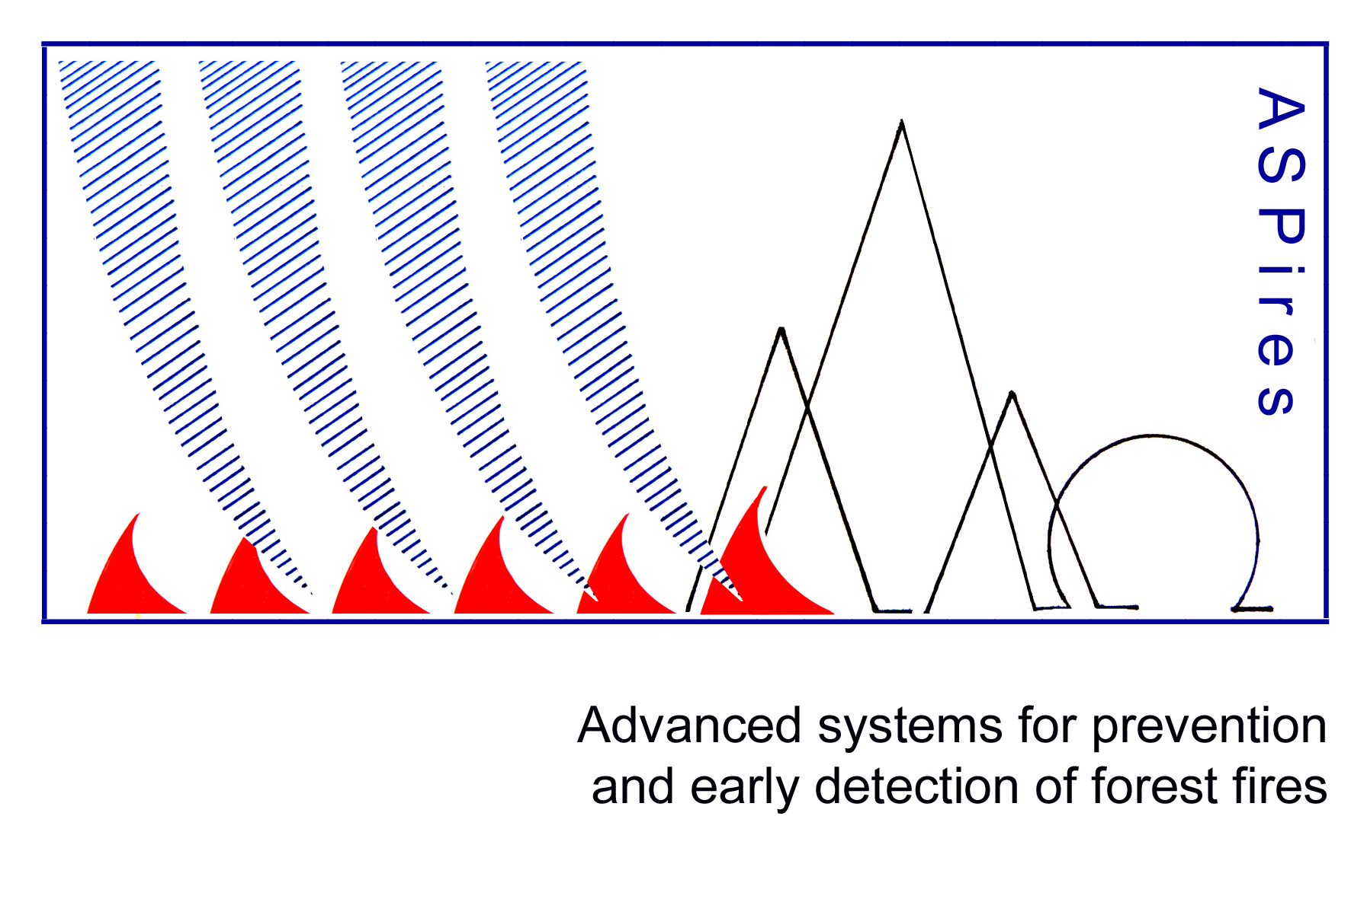
Advanced systems for prevention & early detection of forest fires (ASPires)
KICK OFF MEETING
Call for proposals for prevention and preparedness project 2016
Brussels, 18 January 2017
ECHO/SUB/2016/742906/PREV03
Coordinator: Prof. Dr. Rumen Stainov, Fulda University of Applied Sciences (DE)

Slide 2
Partners
Fulda University of Applied Sciences (DE)
Military Academy Skopje (MK)
Comicon Ltd (BG)
InterConsult Bulgaria Ltd (BG)
Cluster NCITES (BG)

Slide 3
End Users
FYR of Macedonia:
Ministry of Environment and Physical planning
Ministry of Agriculture, Forestry and Water
Crisis Management Center
National Park Mavrovo and National Park Pelister
Bulgaria:
Fire Safety and Civil Protection Directorate, Ministry of Interior
Germany: Bundesministerium des Innern

Slide 4
Costs
Total eligible cost € 829.523,00
EC co-financing € 622.142,00
Duration: two years
WEB Page: www.ASPires.eu

Slide 5
Area of activity
Early detection of Forest fires
Priority
Our system will help all Crisis Management Information Systems in Europe to develop and to implement different methodologies for initial stage warning, localization and organization of the firefighting teams and tactics to suppress the disaster.

Slide 6
Summary
Early detection systems of forest fires that integrates sensor networks and mobile (drone) technologies for data collection and acquisition of those data at existing Crisis Management Information Systems (CMIS).
The mobile (drone) technologies will allow covering much larger areas in order to raise the percentage of forest fires detections in area of particular importance, to monitor area with high fire weather index, and to monitor areas already affected by forest fires.
Although initially implemented in our test bed in fYR of Macedonia and in our end-users, e.g. Bulgarian Ministry of Interior, our system will be open to all European countries.

Slide 7
Deliverables and deadlines
A. MANAGEMENT AND REPORTING TO THE COMMISSION, M1 - M24
A.1. Management and Coordination
A.2. Financial Management
A.3. Evaluation and feedbacks
B. PUBLICITY, M1 - M24
B.1. Preparation of publicity material, establishing a web-site
B.2. Dissemination events and workshops
B.3. Advocating and Networking - at both bilateral and regional levels

Slide 8
Deliverables and deadlines
C. SYSTEM DEFINITION, M1 - M20
C.1. Conduct comparative analysis with other models of information systems for detection and monitoring forest fires
C.2. Conduct comparative analyzes of occurred forest fires in fYR of Macedonia in period of 2006-2015
C.3. System design of advanced systems for prevention and early detection of forest fires
C.4. Research of existing interfaces for forest fires (prediction and behaviour)
C.5. MOCK-UP development for existing MKFFIS
C.6. Creating data-bases, needed to support the upgraded and extended MKFIS
C.7. Specification and experimental prototype development of the gateway using standard interfaces
C.8. Networks and data model simulation

Slide 9
Deliverables and deadlines
D. COMMUNICATION PROTOCOLS AND INTERFACES BETWEEN DIFFERENT ACTORS OF THE CRISIS MANAGEMENT SYSTEM, M6 – M18
D.1. Analysis and description of proper standards for communication with the goal of overcoming the challenges of dependence of the information systems on known and already used technology and creating and partially implementing an information system, based on Structure-oriented Architecture
D.2. Creating communication protocols between the users that form the Crisis Management System
D.3. Definition of standard interfaces and protocols at sensor network and cloud level
E. SYSTEM IMPLEMENTATION AND INTEGRATION, M9 – M21
E.1. Algorithms development and connecting market available sensors for detecting forest fires.
E.2 Model selection for transferring data to a central database.
E.3 Data-bases experimentally development for supporting the upgraded and extended MKFIS
E.4. Installing set of cameras detectors and mobile device (like drone) available on the market with a large optical range of monitoring forest fires in areas of particular importance and transfer data to a central database of existing MKFFS
E.5 Conceptual implementation and partial proof of man-machine platform integration (connecting API and machine learning algorithms)

Slide 10
Deliverables and deadlines
F. SYSTEM TESTING, VERFICATION AND VALIDATION, M10-M23
F.1. Testing, of the system through simulation.
F.2. Verification and validation of the system through simulation
F.3. Perform research and measurements to see the degree of efficiency, effectiveness of cameras detectors and mobile device (like drone) in detecting and monitoring of forest fires in areas of particular importance and transfer data to a central database of existing MKFFS
G. OPERATIVE USE OF UPGRADED AND EXTENDED CMIS, M15-M24
G.1. Connecting the system with the existing systems used in the Crisis Management System and the EU CIWIN (Critical Infrastructure Warning Information Network.
G.2. Familiarization of end users with system
G.3. Trial Period (Putting part of the system in operative use)

Slide 11
Tentative dates
Start Date 1 May 2017
End Date 30 April 2019
Kick off meeting Sofia March 2017
Virtual steering committee May 2017, September 2017, January 2018, March 2018, June 2018, November 2018
Reporting Periods Months 1-8, Months 9 – 16
Final Peport for Months 1-24
Workshop with final beneficiaries and partners Skopje, September 2018
Final conference Brussels, April 2019

