Slide 1
CASCADE
Community Safety Action for Supporting Climate Adaptation and Development

Slide 2
Background
The concept and partnership for the CASCADE project was developed in the Swedish Institute Seed Funding project CRCC – Making Communities Resilient to Climate Change: Cross-Sectoral Cooperation in Capacity Building.

Slide 3
Structure, duration & funding
Work package 1 management & coordination
City of Turku/Southwest Finland Emergency Services
Work package 2 : Development of Guidelines on Integrated Climate Change and Disaster Risk Response Management
The Main School of Fire Service, Poland
Work package 3 Capacity building on integrated climate change and disaster risk reduction (DRR) management
Hamburg Fire and Rescue Service
Work package 4 Initiating Policy Dialogue
Council of Baltic Sea States
Work package 5 Communication and Dissemination of project processes and results
Union of the Baltic Cities, Turku
Project is funded by DG ECHO
Duration two years, start 1.1.2019
Total budget 850871€, co funding 638153€

Slide 4
Objectives
To develop an innovative macro-regional approach for climate change related risks, encompassing both risk assessment and treatment, of the BSR’s specific conditions tailorable to the needs and challenges of cities.
To increase the practical knowledge of climate change effects and how to manage them.
To create a framework for better coordination between different in climate change urban risk management.

Slide 5
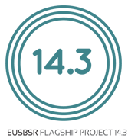
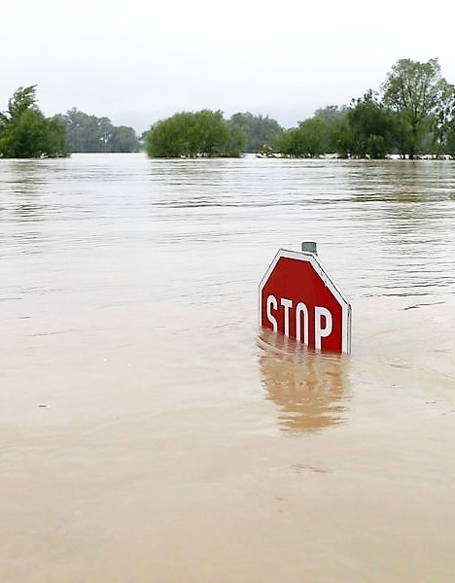
Climate specialists
Civil protection experts
Assessment of climate
change risks
Risk assessment
Capability
assessment

Slide 6
Platform for cooperation
All member states in the BSR have committed to implement the Sendai Framework, therefore, it makes sense to address implementation challenges together.
National level expertise
Making knowledge available
On the national level there is a lot of knowledge on risk assessment methodologies, however, this know-how can be made available for the regional and local levels as well.
Civil Protection
Methods for risks assessment
The civil protection experts are used to working with assessment of risks typically related to the field of civil security, however, climate change is presenting new security risks in need of consideration.
Climate change
adaptation
New dimension of risks
Building on previous knowledge and methods from the field of civil protection on the national level, the dimension of risks induced by climate change will be added, and a new broader methodology will be developed.
Local level
Tailor-made for end-users
A brand new methodology, taking current and future climate change risks into account, tailor-made for the end-users at the local level, will be developed.

Slide 7
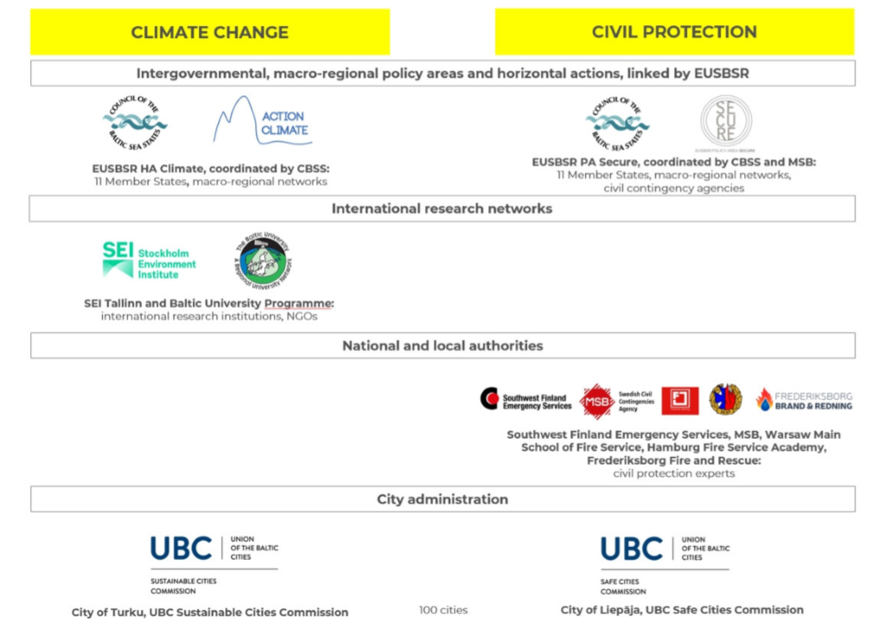
The consortium

Slide 8
Miikka Toivonen
Fire Officer
Southwest Finland Emergency Services
miikka.toivonen@turku.fi
+358 40 620 5473
www.vspelastus.fi

