Slide 1
Wildland-Urban-Interface VIrtual Essays Workbench
WUIVIEW
Kick-off Meeting 28 Jan 2019 at DG ECHO / ERCC

Slide 2
The WUIVIEW Consortium
Universitat Politècnica de Catalunya – UPC (Coord.) - Spain
Associaçao para o Desenvolvimento da Aerodinamica Industrial – ADAI – Portugal
Fundació d'Ecologia del Foc i Gestió d'Incendis Pau Costa Alcubierre – PCF – Spain
Association pour la Recherche et le Developpement des Methodes et Processus Industriels – ARMINES – France
Alma Mater Studiorum Università di Bologna – UBO – Italy
Rise Research Institutes of Sweden Ab – RISE – Sweden

Slide 3
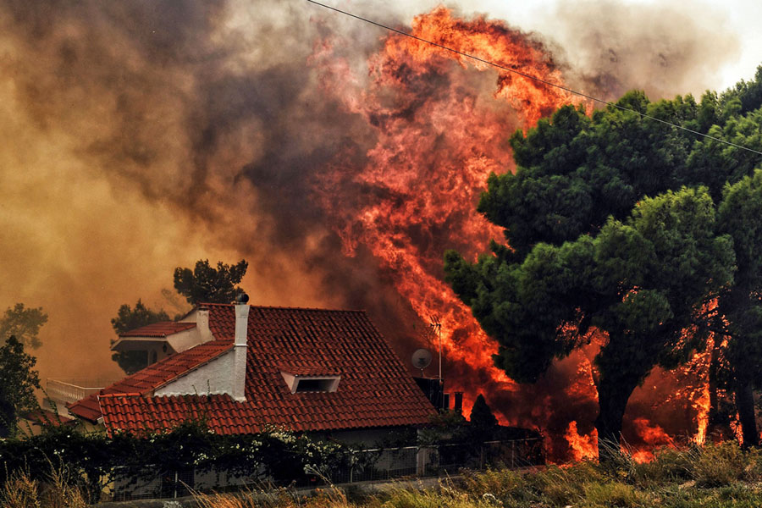
Basic Project Data
Project duration: 24 months (01/02/2019 – 31/01/2020)
Total project eligible cost: 762,687.44 €
EC financial contribution: 572,015.58 € (75% total eligible cost)
Area of activity: Prevention
Priority: Development of disaster risk reduction strategies, taking into account climate change adaptation
Wildland-Urban-Interface (WUI) Fires
Source: The Guardian (AFP/Getty Images)

Slide 4
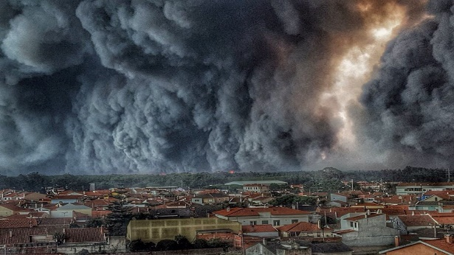
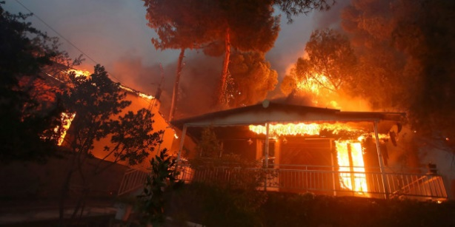
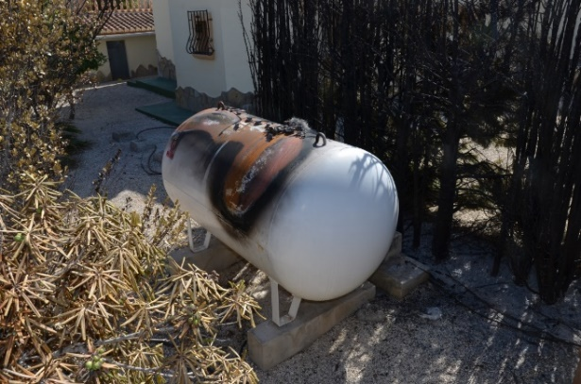
Background & Needs
Vieira de Leiria, Portugal (2017)
Source: H. Madeiras
Climate change is worsening the WUI fire problem throughout Europe
More intense wildfires
Emergent WUI-fire prone zones in northern latitudes
WUI fires quite often exceed fire-fighters capacities
Self protection is a growing need
Mati, Greece (2018)
Source: G. Chrisochoidis
Observations from WUIWATCH project:
Fuels at home-owner scale whose hazard is poorly characterized and disregarded
Vulnerable elements in houses whose response to and interaction with fire is unknown
Lack of scientific-based standards to deal with the WUI problem at the microscale
Benitatxell, Spain (2016)
Source: D. Caballero

Slide 5
Objectives & Activities
WUIVIEW aims at reinforcing WUI fires risk reduction strategies by…
Designing, testing and operating a virtual workbench service for the analysis of fire hazards and buildings vulnerabilities at different European WUI realities
Platform to perform essays and simulation studies dealing with structures survivability and sheltering capability
Workbench set-up
Real fire experiments
Modelling and simulation
Demonstration in real WUI settlements
(Spain & Sweden)
Mell et al., 2009
Pastor et al., 2016

Slide 6
Outputs, Follow up & Major Events
EXPECTED OUTPUTS
EXPECTED RESULTS
Data on fuels hazard and buildings vulnerabilities
Modelling codes and guidelines
Recommendations for regulations improvement
Education material
Scientific papers and conference communications
Improved knowledge and awareness to all fire actors
New capability to assist fire safety design
EXPECTED FOLLOW-UP
Consultancy service to manage WUI fire risk in vulnerable communities
Major Events:
Two international workshops: I Coimbra - (~ M12)- on hazards at the WUI microscale. II Barcelona – (~ M23)– on modelling for fire safe designs. WS coupled with project meetings.
Kick-off meeting in Barcelona (11/02-12/02). Other technical meetings (some partners): Barcelona (~ M9), Borås (~ M13).
Fire experiments in Coimbra and Alès (M7-M8).

Slide 7
Thanks for your attention!
More information:
Elsa Pastor
elsa.pastor@upc.edu
www.wuiview.org

