Slide 1
Portada
e-URready4OS
expanded
Underwater Robotics Ready for Oil Spill
(e-URready4OS)
Co-financed by
EU / DG-ECHO
2016 CALL FOR PROPOSAL PREVENTION AND PREPAREDNESS
Agreement Number – ECHO/SUB/2016/740129/PREP/21
Brussels, January 18th 2017
Javier Gilabert Ph.D. - Universidad Politécnica de Cartagena – UPCT (SPAIN)
Notes:
Portada

Slide 2
Project resume
● 24 months duration (01/01/2017 – 01/01/2018)
● Total cost: 798.106 € [EC financial contribution: 598.574 € (75 %)]
● 11 partners, 8 countries participating
Technical University of Cartagena (Spain)
SASEMAR (Spain)
Irish Coast Guard IRCG
(Ireland)
University of Porto (Portugal)
Tallinn University
of Technology (Estonia)
University of Zagreb (Croatia)
The Scottish Association
for Marine Science (UK)
Oceanographic Center
University of Cyprus (Cyprus)
University of Girona (Spain)
University of
Balearic Islands (Spain)
Norwegian University of
Science and Technology
(Norway)

Slide 3
Objectives
● General
Expand the already existing URready40S fleet (from 5 to 12 assets)
Provide training to new vehicles teams joining the fleet
Improve the current URready40S system
Transfer the know-how to Maritime Safety Agencies
● Specific
Prepare a NEPTUS version fully adapted to all kind of fleet vehicles independently of their manufacturers.
Increase the capability of the MEDSLIK model to track small scale spills
Perform training exercises with new and currently vehicles
prepare and give short practical courses and demos to maritime safety agencies.

Slide 4
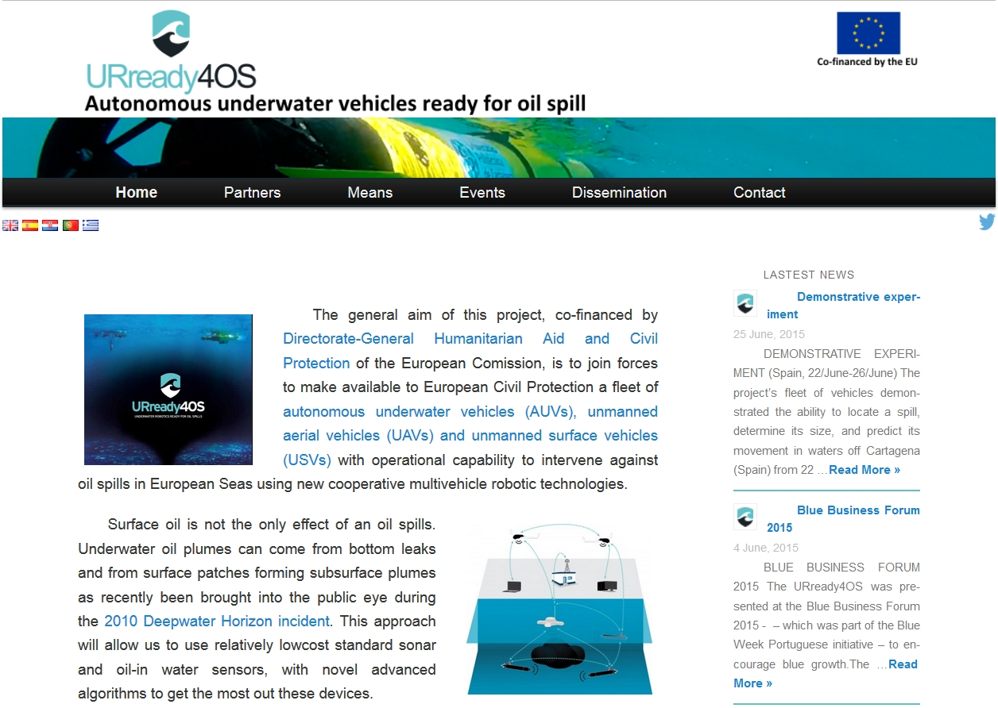
Motivation
Motivation
● A fleet of autonomous vehicle will provide earlier detection and tracking of in-water oil plumes to feed numerical models and increase the preparednes to reduce the consequences of the oil spill on the coast.
● This Project is an extensión of the URready4OS funded in the 2013 call to increase a fleet of training vehicles.
www.upct.es/urready4os

Slide 5
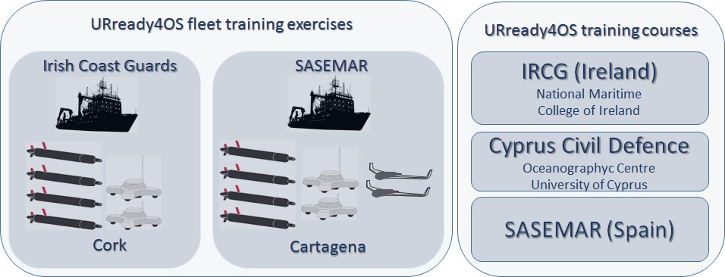
Mean involved
 | AUV | USV | UAV | Exercise IRCG Cork | Exercise SASEMAR Cartagena | Training Courses | IT Support
UPCT – ES | 1 IVER2 | 1Buscamos |  | √ | √ | √ | Coordination
UP – PT | 1 LAUV | 1 Necsave | 2-X8 | √ | √ | √ | NEPTUS
UZ – HZ | 1 LAUV | 1 PlaDyPos |  | √ | √ | √
UC – CY |  |  |  | √ | √ | Host | MEDSLIK
SAMS – UK | 1 Remus 600 |  |  |  | √ | √
NTNU – NO | 1 Remus 100 |  |  |  | √ | √
TUT – EE | 1 IVER2 |  |  |  | √ | √
UG – ES | 1 Sparus |  |  | √ |  | √
UIB – ES | 1 Sparus |  |  | √ |  | √
SASEMAR - ES |  |  |  |  | Clara Campoamor Vessel | Host
IRCG – EI |  |  |  | Celtic Explorer vessel |  | Host

Slide 6
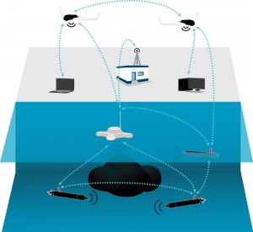
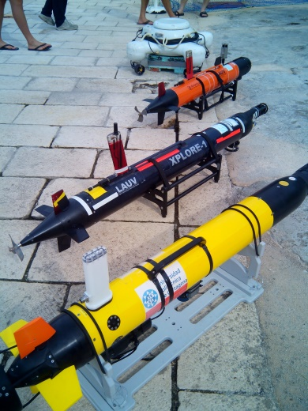
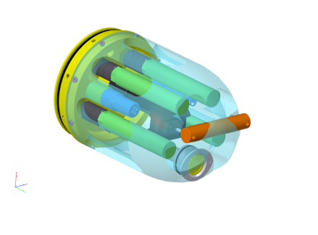
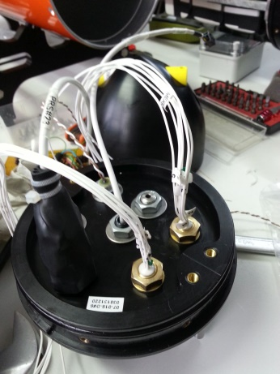
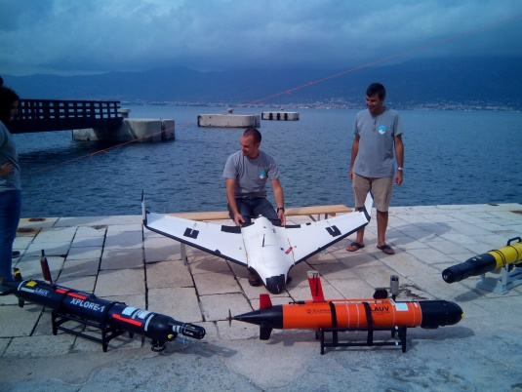
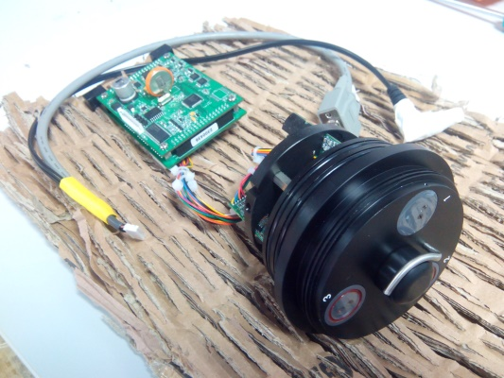
Action1. Probes
Action 1
● Increase the number of vehicles of the URready4OS fleet
Assets | Current | Expanded
AUV | 3 | 8
USV | 1 | 3
UAV | 1 | 2

Slide 7
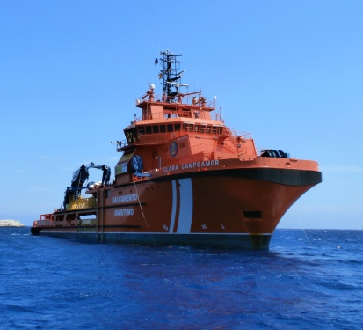
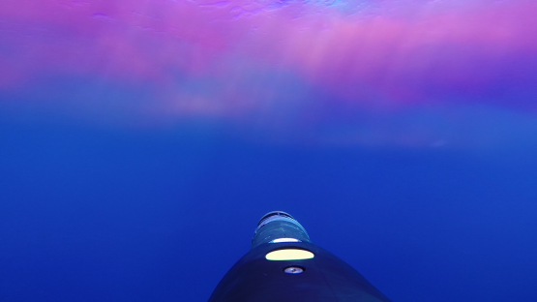
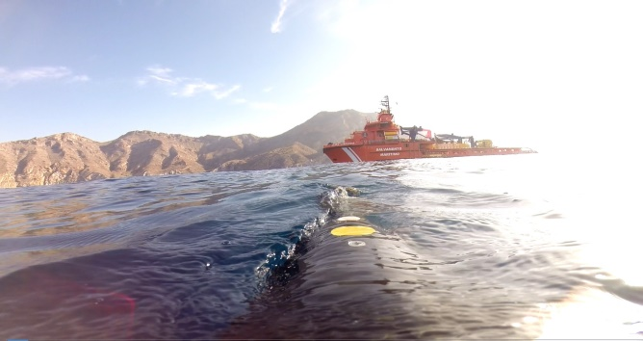
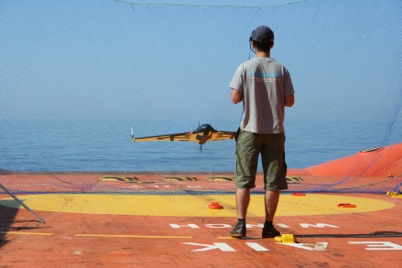
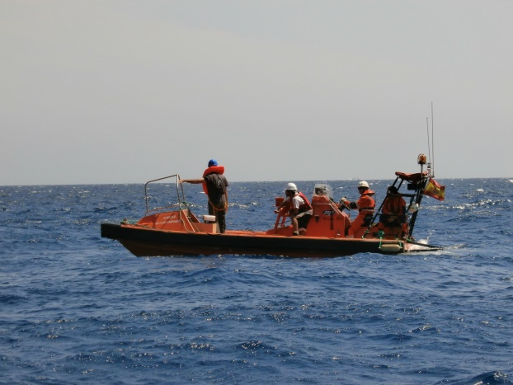
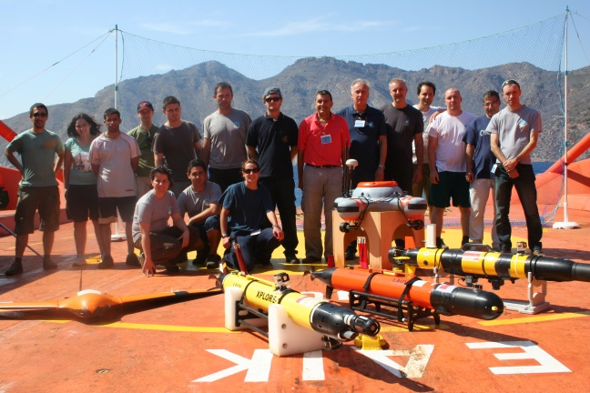
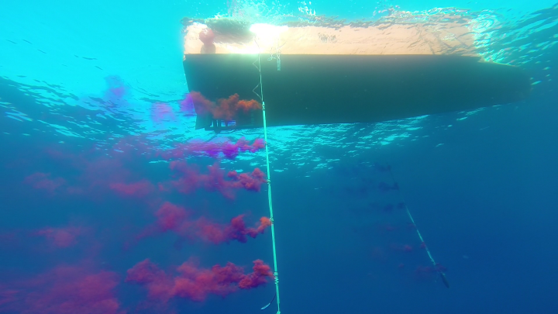
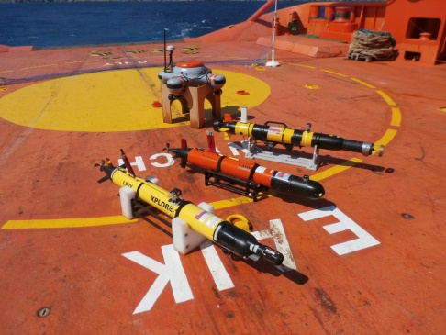
Action 2
● Training of the expanded and current fleet performing two exercises on board of:
● Clara Campoamor - SASEMAR, Cartagena (Spain), June 2017.
● Celtic Explorer – IRCG, Cork (Ireland), June 2018.

Slide 8
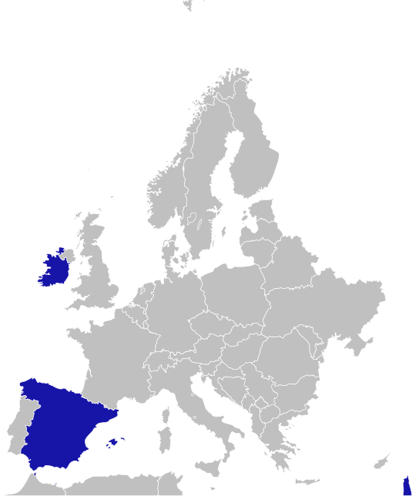
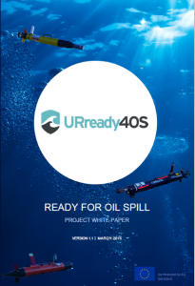
Action1. Probes
Action 3
● Transfer of Know-How to Maritime Safety Agencies
Short theoretical course on URready4OS system to:
Cyprus Civil Defense.
SASEMAR (Sociedad Estatal de Salvamento y Seguridad Marítima)
Irish Coast Guard

Slide 9
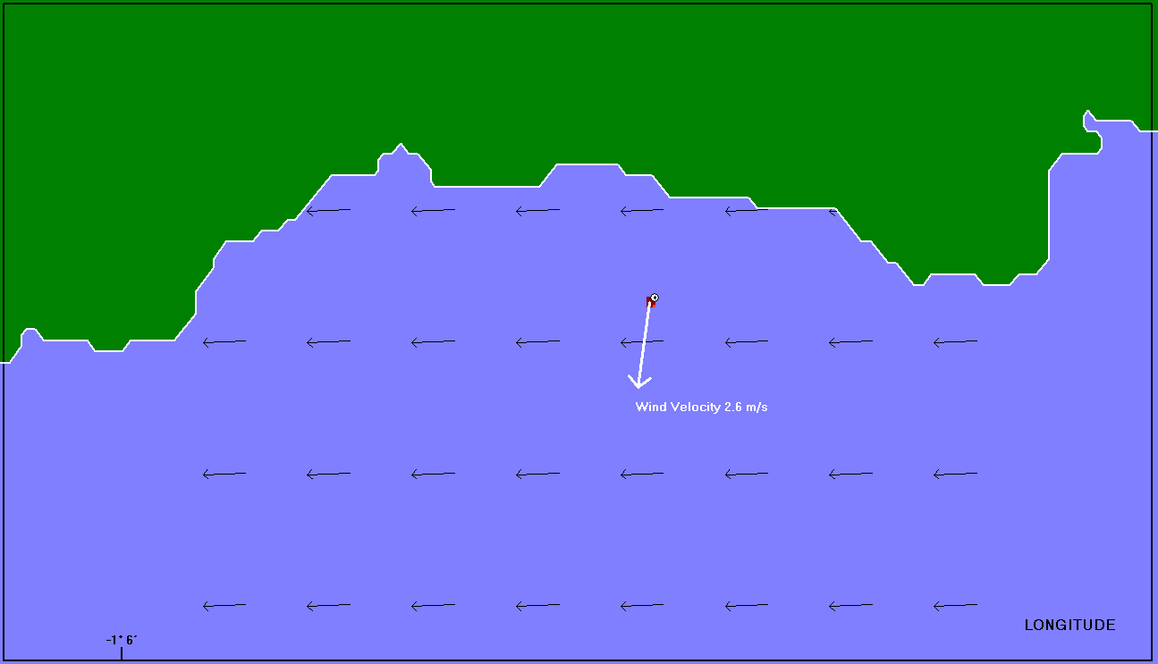
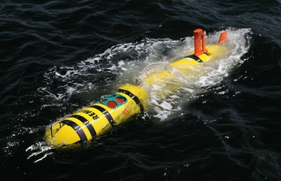
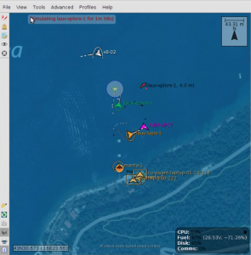
Action1. Probes
Action 4
● Improve the URready4OS system
● Explore the capability of the system for reaching deeper water.
● Upgrade Neptus with a specific version for the URready4OS system.
● Provide assistance for Neptus integration to new and current vehicles.
● Increase the capability of the MEDSLIK model to track small scale spills.
Remus-600

Slide 10
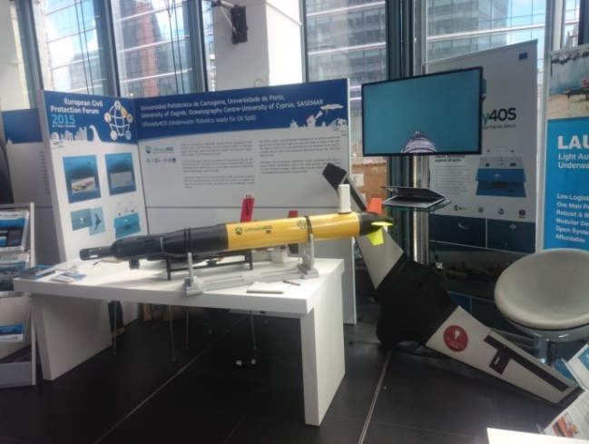
Action1. Probes
Action 5
● Communication and dissemination
The finished URready4OS project produced:
● 3 Bulletins, a brochure and 4 videos
● 2 international forums and 4 conferences
presentations.
● 1 white book
● More than 40 online media
appearances. Printed, radio and tv.
● More than 10.000 web site visit
All available at the web site
The e-URready4OS project will be shown at the National School of
Civil Protection in Madrid next 26/01/2017.

Slide 11
Deliverables and dates
1/07/2017 | News Bulletin uploaded to the web site for Cartagena training exercises. Upgrade project web site.
01/09/2017 | 1st progress report.
31/12/2017 | Upload the project web site with presentations given during the Cartagena and Cyprus courses.
01/06/2018 | 2nd progress report
1/07/2018 | News Bulletin uploaded to the web site for Cork training exercises. Upload the project web site with presentations given during the Cork´s course.
1/1/2018 | An adapted version of Neptus for the URready4OS fleet. An adapted version of Medslik for the URready4OS fleet. New vehicles integrated on the Urready4OS fleet
31/12/2018 | Provide with the participant countries with at least one AUV team trained to respond to oil spill.
31/12/2018 | Final report Layman’s report.

Slide 12
Expected results
Expected results
● Increasing the number of vehicles of the currently existing URready4OS fleet covering a larger geographical area of involved countries.
● Provide training to the expanded and current fleet.
● Improvement of the URready4OS system.
● Know-how transferred to Maritime Safety Agencies.

Slide 13
Follow up
Follow up
● The transfer of Know-how to Maritime Safety Agencies should be maintained
● Find new partners to join the fleet by integrating their vehicles and training the people in charge of them
● Introduce in the future new capabilities to the software allowing an optimal integration of them on the MSAs procedures
● The first step taken on the e-URready4OS project to explore the possibility of the fleet to be expanded to deeper waters will need to be supported in the future

Slide 14
Thank you for your attention

