Slide 1
Kick Off Meeting for the Action: “Single Country Grants for Disaster Risk Management (Track 1)” 13th November 2020
Ministry of Interior General Directorate of Fire Rescue Service
Population Protection Institute
Czech Republic
„Study of the applicability of VR/AR technologies in the area of civil protection in the Czech Republic “ ECHO/SUB/2020/TRACK1/831682

Slide 2
Basic project data: total eligible cost, EC co-financing, and duration
Estimated cost: eligible costs of the action - EUR 130’000,-
maximum amount of the EU contribution - EUR 123’500,-
95% EU reimbursement
5 % PPI contribution = EUR 6’500,-
Duration: 12 month - starting from 1st September 2020

Slide 3
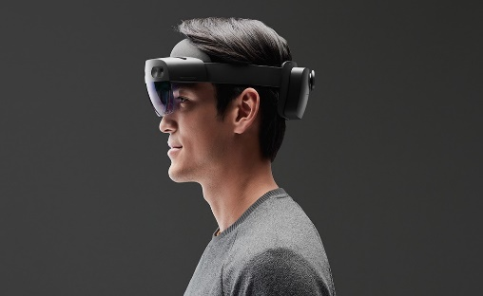
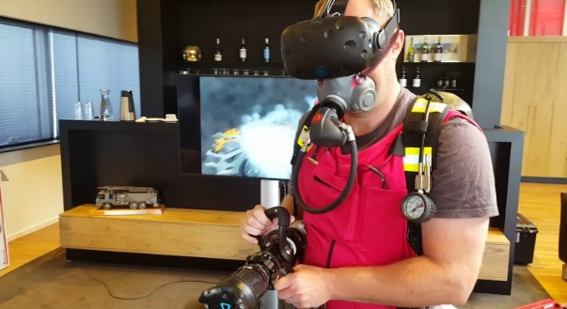
Short description, background information and reasons why the project is necessary
VR and AR reality technologies potential for use in the area of state and civil security.
their use in emergency situations is still very rare
essential for effective response to all types of emergencies and disasters
WHY?
Use of VR/AR could help increase proficiency of first responders’ preparedness.
VR/AR could be used to drill highly specific or high-risk activities or to provide a high-quality psychosocial support after major events as part of PTSD prevention.
NECESSITY TO IMPROVE

Slide 4
Expected outputs – how the outputs will help achieve the objectives of the project
Identification of commercially available VR/AR systems that are potentially applicable in the current civil protection conditions of the Czech Republic, and their evaluation.
Assessment of practical applicability of the identified VR/AR systems.
Drafting final implementation outputs based on the findings from previous activities.
Main output
Study of the applicability of VR/AR technologies in the area of civil protection in the Czech Republic.
Supporting outputs
Consultations with foreign partners.

Slide 5
Main milestones and follow up
TIMETABLE FOR EACH STAGE OF THE ACTION SHOWING MAIN DATES AND EXPECTED RESULTS FOR EACH STAGE
 | Semester 1 |  |  |  |  |  |  | Semester 2
Activity |  | Month 1 | 2 | 3 | 4 | 5 | 6 | 7 | 8 | 9 | 10 | 11 | 12
Preparation Activity 1 |  | x | x
Implementation Activity 1 |  |  | x | x | x | x | x
Preparation Activity 2 |  |  |  |  |  |  | x | x
Implementation Activity 2 |  |  |  |  |  |  |  | x | x | x
Preparation Activity 3 |  |  |  |  |  |  |  |  |  | x | x
Implementation Activity 3 |  |  |  |  |  |  |  |  |  |  | x | x | x
Activity 1: Identification of commercially available VR/AR systems that are potentially applicable in the current civil protection conditions of the Czech Republic, and their evaluation.
Activity 2: Assessment of practical applicability of the identified VR/AR systems.
Activity 3: Drafting final implementation outputs based on the findings from previous activities.

