Slide 1
Green Infrastructures for disaster risk reduction protection: evidence, policy instruments and marketability GREEN PREVENTION AND PREPAREDNESS PROJECTS IN CIVIL PROTECTION AND MARINE POLLUTION KICK OFF MEETING BRUXELLES 18-01-2017

Slide 2
Consortium
EUCENTRE
Promote and support research and education in the field of seismology, geology, geotechnical engineering, hazard and risk assessment, flooding vulnerability assessment, ecological approach and emergency management, Re-insurance market
DELTARES
Develop and apply expertise in Flood Risk, Availability of water and soil resources, Water and Subsoil Resources, Delta Infrastructures, Healthy water and soil systems
FEEM
Provides analysis and produces specialized research in Mitigation, Innovation and Transformation Pathways, Climate Change Economic Impacts and Adaptation, Energy Scenarios and Policy and Society and Sustainability
AUTH
Through the Environmental Engineering Laboratory (ENVE LAB), Develops research and design processes and products in the context of Environment and health, Advanced technology for monitoring environment pollution and waste management, Industrial ecology

Slide 3
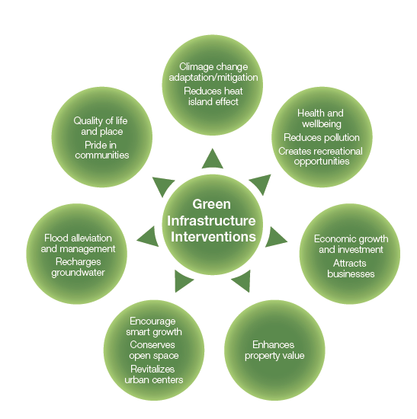
Benefits of Green Infrastructures
Image from Gray to Green: Jumpstarting Private Investment in Green Infrastructure.

Slide 4
Project structure
MANAGEMENT (EUC)
A
REVIEW OF GI SOLUTIONS, ANALYSIS OF COSTS AND BENEFITS (AUT)
B
CASE STUDIES (DELT)
GI DEPLOYMENT ON A LARGE SCALE (FEEM)
COMPARIZON BETWEEN THE PERFORMANCE OF GREEN AND GREY INFRASTRUCTURES, STAKEHOLDER ENGAGEMENT, BUSINESS PLANNING IN CASE STUDIES (FEEM)
C
E
F
DESIGN OPTIONS FOR THE MONITORING OF GI - COPERNICUS (EUC)
D
DISSEMINATION (EUC)
G
GI= Green Infrastructures

Slide 5
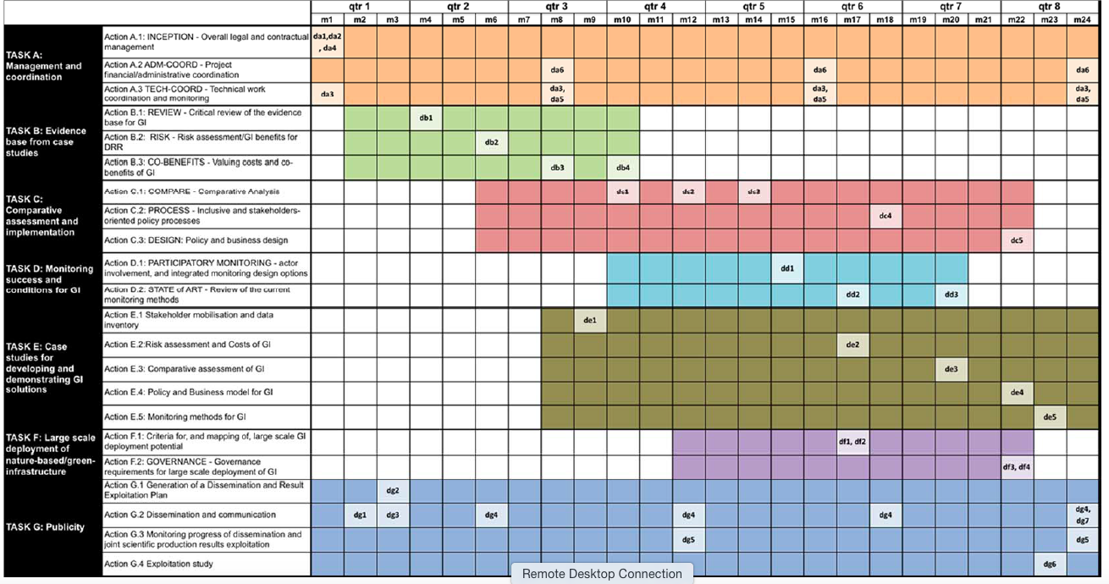
GANTT chart

Slide 6
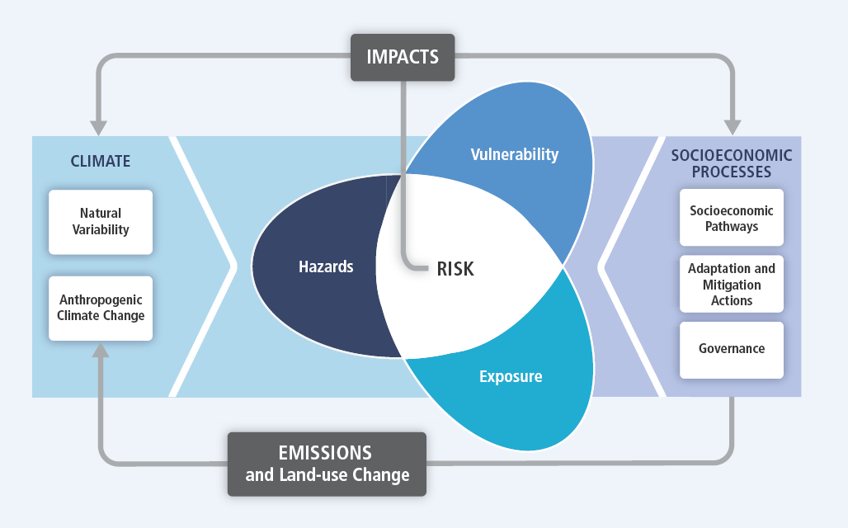
Risk assessment
Risk = Hazard × Exposure × Vulnerability
Increasing vulnerability, exposure, or severity and frequency of climate events increases disaster risks

Slide 7
Valuing costs and co-benefits of GI
Month 4: DB.1 Inventory/database of GI measures and their cost characteristics that are
included in the GREEN project
Month 6: DB.2 Report on GI measures and their characteristics and risk reducing effect
Month 8: DB.3: Document with guidelines for assessing GI costs and co-benefits
Scenario
development
Sector
modelling
Benefits
Costs
G.I. Performance
Direct Costs
Ecosystem Services
Ecosystem Disservices
Hard and Soft Infrastructure
Efficiency
Indirect costs
Avoided costs
Benefit costs comparison

Slide 8
Comparative assessment
Comparative Analysis
Comparison of the performance of GI based solutions for disaster risk reduction (DRR) and climate change adaptation with other traditional, engineering and non-engineering, solutions.
Policy and business design
Optimal policy design principles for implementing GI solutions in practice, and guide the case studies in devising appropriate implementation strategies.
Month 10: DC.1 Comparative assessment framework
Month 12: DC.2 Comparative assessment reports for selected case studies
Month 14: DC.3 Synthesis report of the comparative assessments conducted in all case
Studies
Month 18: DC.4 Peer review evaluation of the stakeholder engagement
processes in the case studies and recommendation for improvements
Month 22: DC.5 Policy and business model design report in case studies

Slide 9
Monitoring success and conditions for GI
Analyze and develop an integrated monitoring system for assessing and developing GI solutions, through COPERNICUS data and monitoring program
PARTECIPATORY MONITORING
Specification of GI monitoring design options based on end users prerogatives and needs
Make full use of citizens observation and participatory monitoring
Design guidelines for the development of Downstreaming service
PARTECIPATORY MONITORING
Analysis of data sources needed to assess and monitor GI performance
Inclusion of societal condition and phenomena to enable community and policy relevant monitoring
Analysis of data fusion needs, including temporal and spatial resolution
Identification of key GI indicators as minimum requirements for GI monitoring systems
STATE OF THE ART
Month 15: DD.1 Report: Inventory of user requirements for
monitoring GI
Month 17: DD.2 Data Analysis
Month 20: DD.3 Assessment of the performance of ecosystem services

Slide 10
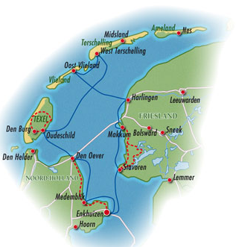
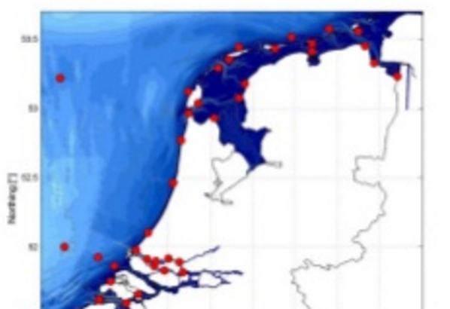
Case studies
Stakeholder mobilisation and data inventory
Inventory of stakeholder needs related to GI.
Provide an inventory of all available data on GI in the
- Observational data (Study case: Wadden Sea)
- Models (Study case: Wadden Sea)
Policy and Business model for GI
Identify best practices and lessons learnt and formulate recommendations on how to improve stakeholder involvement in the decision making
Risk assessment/GI benefits for DRR
Statistical models that show the relation between GI and its effect on risk reduction.
In order to identify future risk levels and future uncertainty, for each case scenarios will be developed that show how climate change and socio economic changes influence trends in hazard, exposure and vulnerability
Monitoring methods for GI
Monitoring design
Review of the current monitoring methods
Impact assessment vulnerability and resilience
Assessing the impacts of GI on ecosystem service and biodiversity conservation
Possible resilience measure
Month 9: DE.1 Stakeholder inventory report
Month17: DE.2 Report on Risk assessment and cost of GI
Month 20: DE.3 Report on Comparative assessment of GI
Month 22: DE.4 Report on Policy and Business models for GI
Month 23: DE.5 Report on Monitoring services

Slide 11
Large scale deployment of GI and follow up
Building upon the evidence, policy, business and monitoring models obtained the task
will provide the base for scale-up and multiply GI by:
Identifying GI potential according to hazard type and climate projections
Mapping GI potential at national and supra-national scale
ensuring the legitimacy and hence long term sustainability of the solutions through governance requirements
Month 17 DF.1 A report including maps, on the potential of deployment of different GIs
Month 17 DF.2 A guidance document including specifically targeted Copernicus
downstream applications
Month 22 DF.3 A report co-produced with funders and investors such as the EIB on current
and possible future funding mechanisms for GI
Month 22 D.F.4 A co-produced report on the governance requirements for large scale
deployment of GI

