Slide 1
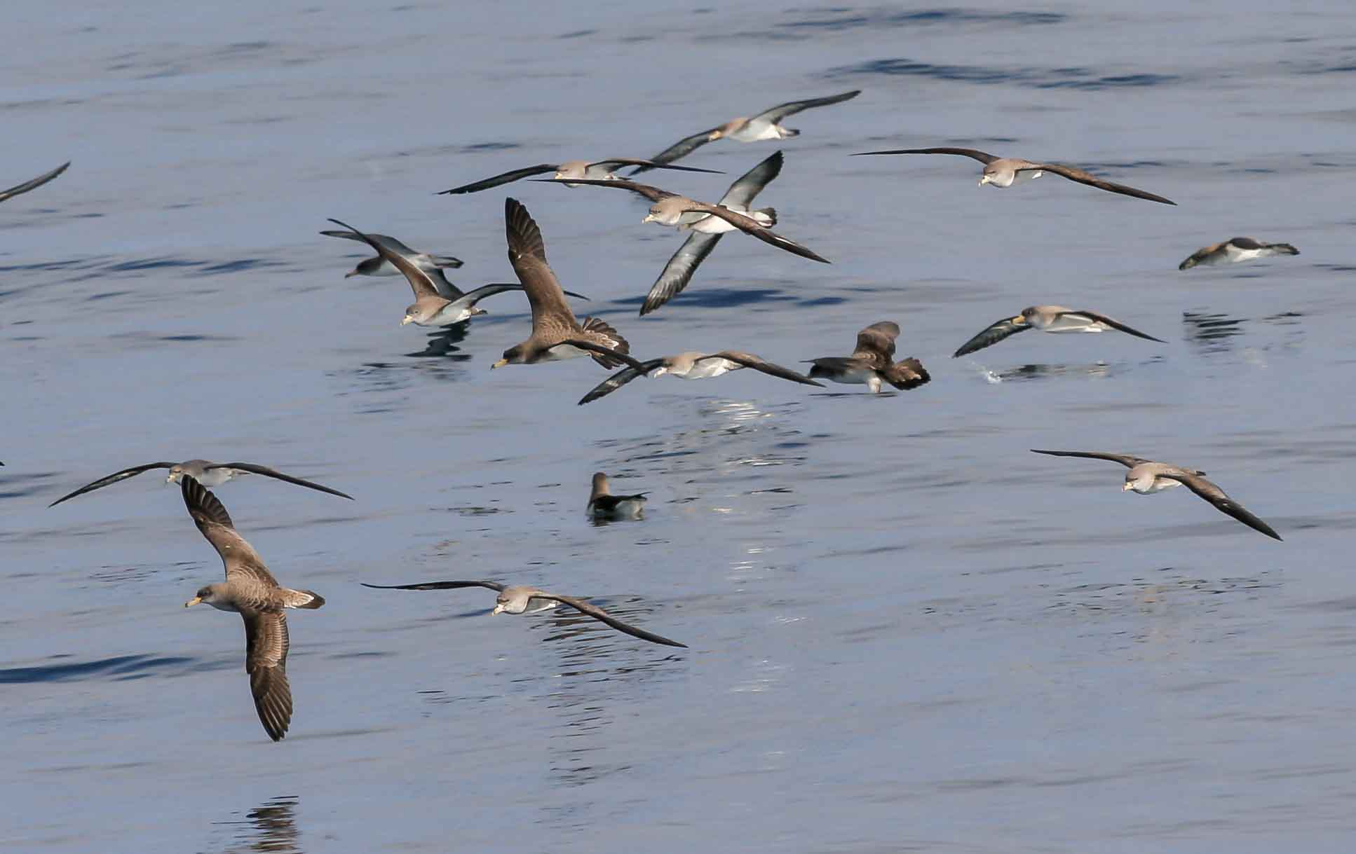
Mapping bird sensitivity to marine oil pollution
Kick off meeting, 18 January 2017, Brussels
Bruna Campos
BirdLife Europe and Central Asia

Slide 2
Notes:
We are the world’s largest nature conservation Partnership
120 Partners worldwide- 1 per country
13 million members & supporters

Slide 3
Seabirds are the most threatened group of birds. Overall threats:
Notes:
Oil spills at sea can kill large numbers of seabirds and have the potential to wipe out entire populations where these are small or localised.

Slide 4
Oil spills have direct (mortality) and indirect impacts on seabird populations, including:
Oiled plumage - Impairing flight, waterproofing and temperature regulation (eventual death)
- often mass mortality events (1000s)
Increased levels of pollutants
(toxic fumes, diet intake,…)
Scarcer food
Increased stress – waste of energy
Unbalanced populations (age, sex)
Notes:
Seabirds dive for fish, Wade on the surface, Preen their feathers
When oil sticks to a bird's feathers, it causes them to mat and separate, impairing waterproofing and exposing the animal's sensitive skin to extremes in temperature.
Every time it preens, it injests oil

Slide 5
What’s missing?
In several oil spill events, authorities were not prepared and failed to take appropriate emergency measures, particularly regarding seabirds and other wildlife, but also overall impacts on the marine environment and depending human activities. Recent cases include:
November 2002 – The “Prestige” environmental disaster; estimated >> 100,000 dead birds
April 2015 – “Oleg Naydenov” – still lack of appropriate response

Slide 6
The Project – in brief
Budget: 283,000€
Implementation period: 01-01-2017 / 31-12-2018
Coordinator: SEO/BirdLife (Spain)
Partners: LPO (France), SPEA (Portugal), BirdLife International (UK+), OP Puertos del Estado (Spain)
Aim: improving decision-making process regarding accidental oil spills at sea (or the risk of it), with focus on seabirds.
Main outputs: a seasonal seabird sensitivity map of the Atlantic and Mediterranean shores of Spain, France and Portugal.
Notes:
In close coordination with the competent authorities and based on the best available scientific information.
Extend methodology to all EU Member States and to other animal groups and habitats.

Slide 7
Objectives
Providing the competent authorities in maritime emergencies with the best available information to minimise impacts to seabirds.
Objective 1 – Developing a methodology and elaborating maps of seabird sensitivity areas to oil spills.
Objective 2 – Identifying the key institutions and professionals to contact in the eventuality of an oil spill and update procedure manuals.
Objective 3 – Integrating these outputs into the official systems of vessel distress management.
Objective 4 – Putting up a proposal for the extension of this methodology to other faunal groups and habitats.
Objective 5 – Disseminating the results of this project and advocating to have it implemented in other EU Member States.

Slide 8
Bird Sensitivity Index to oil
Notes:
Examples: Wadden sea & ESI tool

Slide 9
On the short term
Trigger better decisions when dealing with accidents that may cause oil spills, improving the selection of refuge ports and the routes towards them.
Enable a more effective and faster response to oil spills at sea whatever their causes may be.
On the long term
Aim to have a coordinated risk evaluation system for birds and eventually for other animal groups and habitats at a European scale.

Slide 10
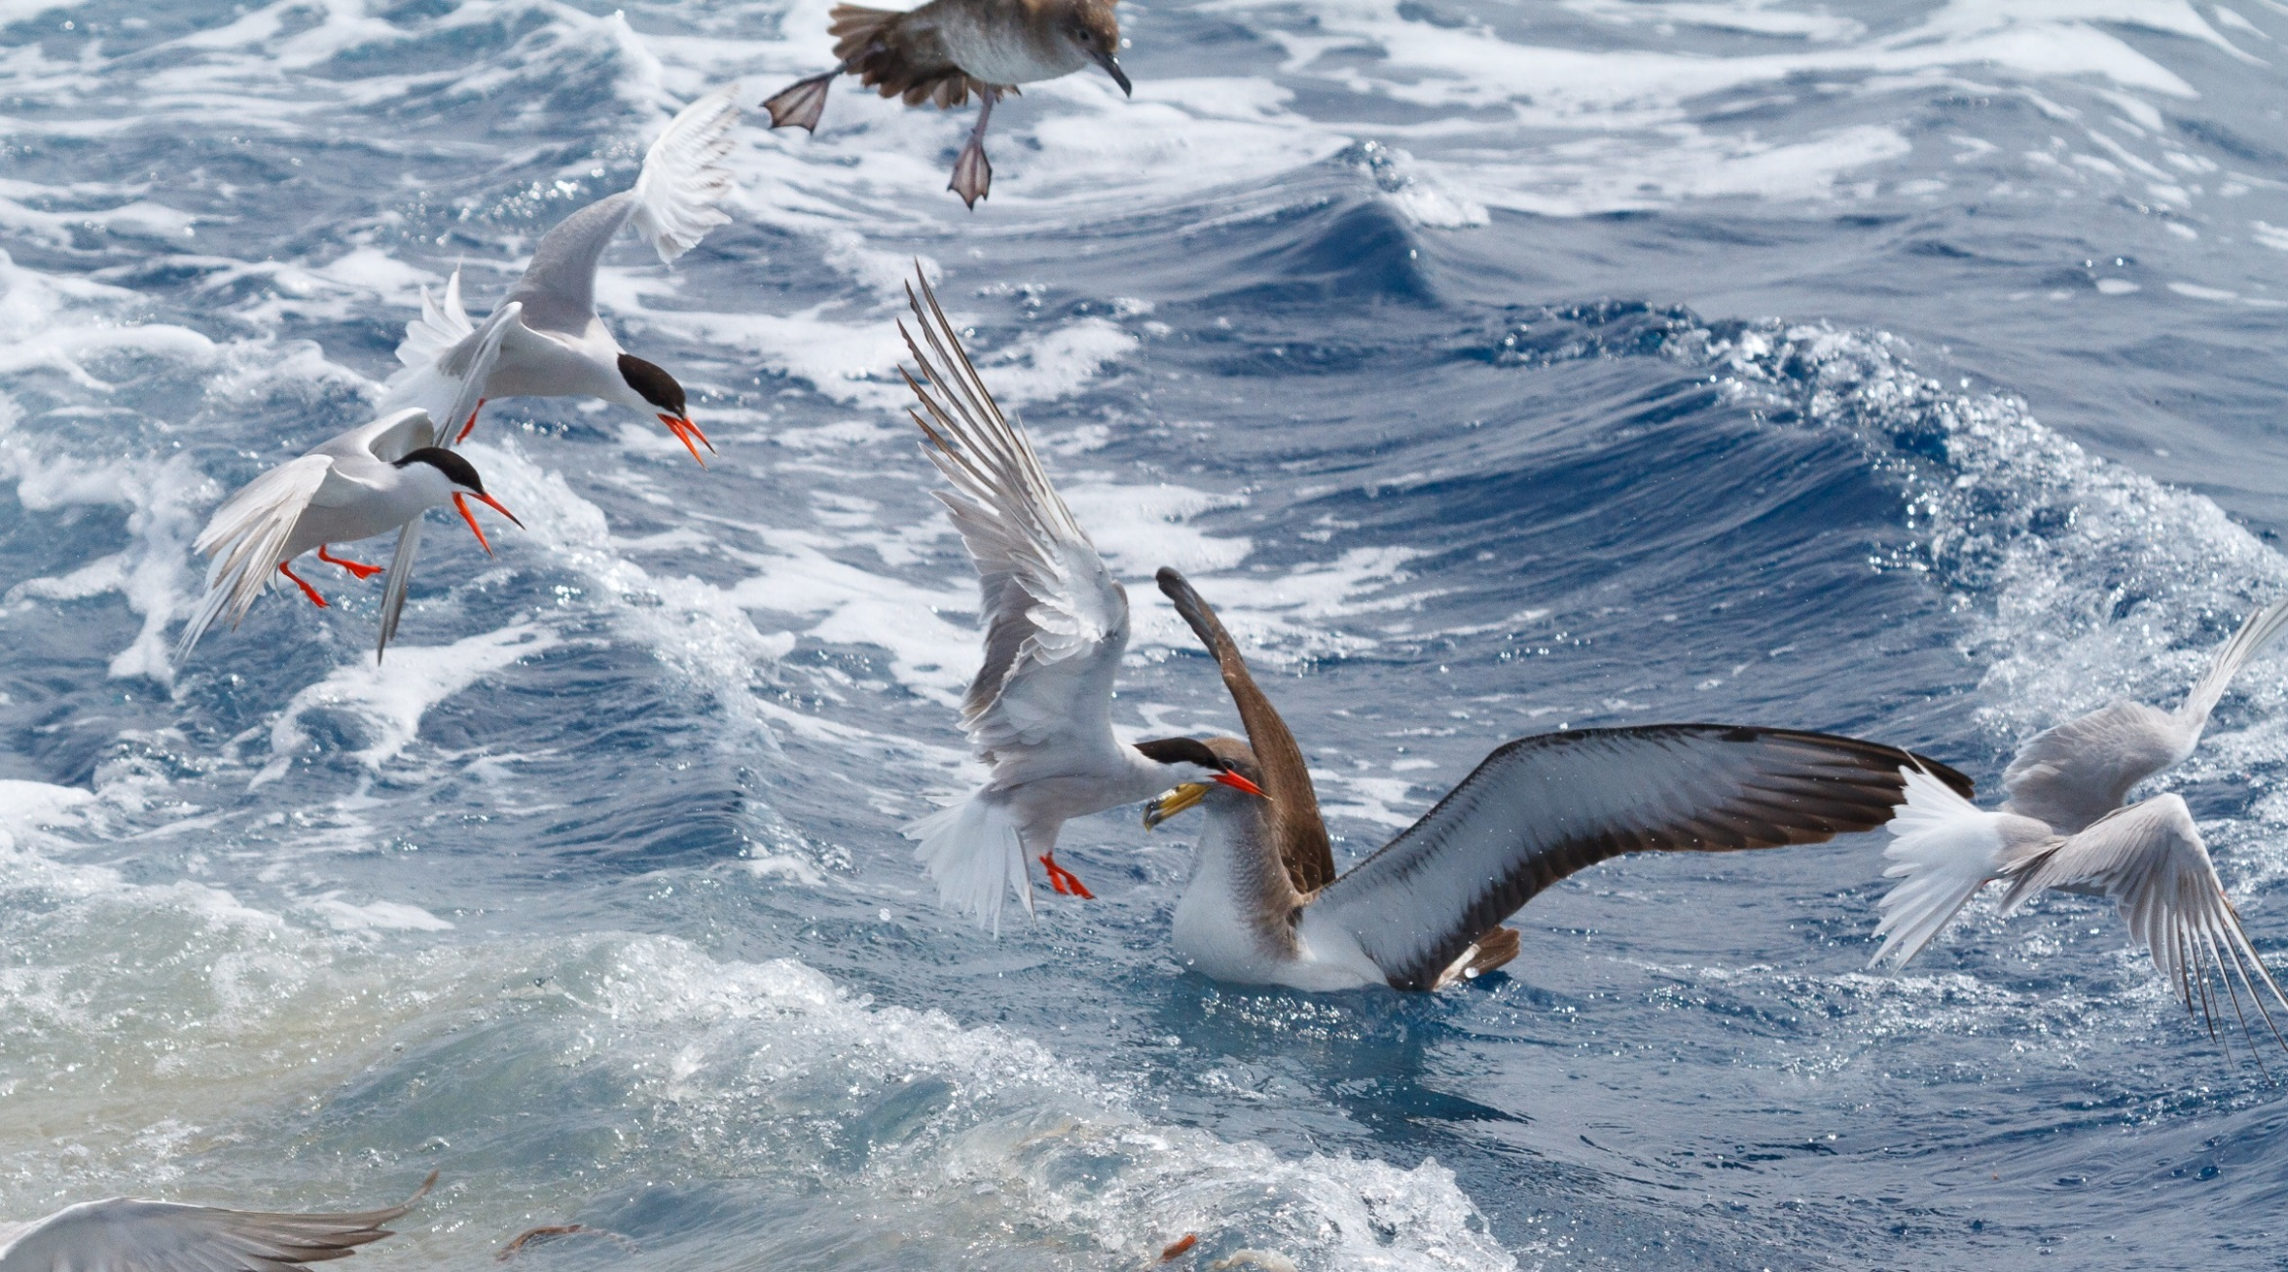
Thank you!
For further information contact: Pep Arcos - SEO/BirdLife - jmarcos@seo.org

