Slide 1
Turkish Goverment
Ministry of Interior
Disaster and Emergency Management Authority
The Effect of Climate Change on Critical Infrastructures Specifically for the Energy Sector in Pilot Region: İzmir – Aliağa
13.11.2020
T.C. İçişleri Bakanlığı Afet ve Acil Durum Yönetimi Başkanlığı
Notes:
Hello ı am … ı will talk about our echo Project that is The Effect of Climate Change on Critical Infrastructures Specifically for the Energy Sector in Pilot Region: İzmir – Aliağa

Slide 2
Content
Objectives of the Project
Project Overview
Pilot region :İzmir-Aliağa
Components of the Project
Afet ve Acil Durum Yönetimi Başkanlığı
Notes:
In this short presentation firstly ı will talk about objectives of the Project then a short overview of Project then ı will talk about pilot region izmir Aliağa lastly ı will finish with components of the Project.

Slide 3
Objectives of Project
INCREASE RESILIENCE OF CI
IDENTIFYING RISKS
MINIMIZE LOSSES
Afet ve Acil Durum Yönetimi Başkanlığı
Notes:
To begin with why we start this Project. we aim to increase resilience of CI, identifying risk of CI in Aliağa . When we succeed these objectives we will minimize life , property and economic losses. This Project also will help to develop capacity and increase awareness .
Before this Project we completed a Project called «Determination of Critical Infrastructures and Risk Assessments and Raising Awareness of Disaster Risk.s. The methodology and outputs of this Project will be used in this Project.

Slide 4
Project Overview
Project Duration
1 year
Budget
536.500 £
Funding Programme
European commission Directorate-general for European Civil Protection and Humanitarian Aid Operations (ECHO)
Priority Area
Capacity Building , Increasing resilience
Stakeholders
Public institutions, NGOs, Universities, Private Sector
Notes:
Now ı want to mention Project overview. It will take 1 year and ıt started 19 october. Project will funded by European commission Directorate-general for European Civil Protection and Humanitarian Aid Operations (ECHO).
In this Project our priorities are capacity building and increase reslience of cı . Our stakeholders are Public institutions, NGOs, Universities, Private Sector

Slide 5
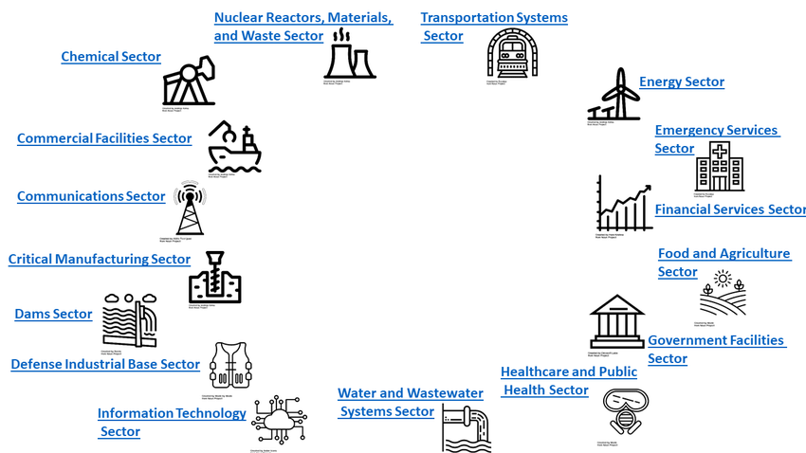
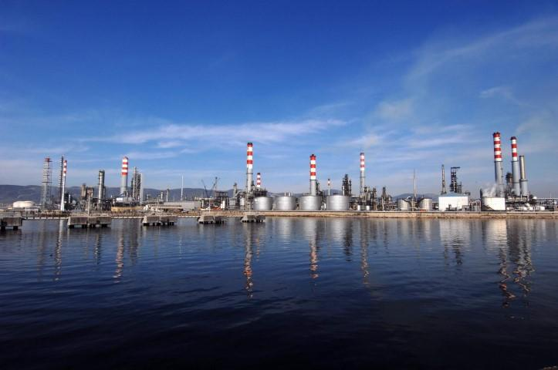
Pilot Region: İzmir-Aliağa
Afet ve Acil Durum Yönetimi Başkanlığı
Notes:
İzmir is an important city in Turkey's economy both in terms of industry and tourism sectors .İzmir has important investments the petroleum and petrochemical industry in our region, energy production and national energy capacity, pioneering in the iron and steel sector, organized industrial zone, LNG facilities, which is our country's natural gas insurance, ship dismantling, port and logistics and Entered the list of 100 largest industrial enterprises according to sales from production in 2017 with 16 companies,
It will be an important step for climate change adaptation studies in Izmir, which is the largest city in member of the covenant of mayors created against climate change.

Slide 6
Components of the Project
COMPONENT 2
Capacity building and awareness raising for the adaptation of critical assets to climate change in the pilot region
COMPONENT 1
Increasing the resilience of critical infrastructures by identifying risks against disasters caused by climate change
Afet ve Acil Durum Yönetimi Başkanlığı
Notes:
There are 2 basic components of this Project. The first one is Increasing the resilience of critical infrastructures by identifying risks against disasters caused by climate change and the second :Capacity building and awareness raising for the adaptation of critical assets to climate change in the pilot region
Up to now, we meet with experts who work critical infrastructures and climate change.

Slide 7
Thank You
Afet ve Acil Durum Yönetimi Başkanlığı

