Slide 1
DIRECT – DIsaster REsilient Communities and Towns
Brussels, 18 January 2017
Co-funded by the European Union
Ministry of Interior of Montenegro

Slide 2
DIRECT – DIsaster REsilient Communities and Towns
Project partners
Target area
FORS Montenegro – Coordinator
Directorate for Emergency Management of the Ministry of Interior of MNE
Fire & Rescue Service Kranj, Slovenia
Fire Rescue Brigade of Moravian Silesian Region, Czech Republic
Czech Association of Fire Officers
Montenegro
Slovenia - Gorenjska region
Czech Republic – Moravian Silesian Region
Ministry of Interior of Montenegro
Co-funded by the European Union

Slide 3
DIRECT – DIsaster REsilient Communities and Towns
Project value and duration
Total costs: € 736,257.34
EC Contribution: 552,131
100%
74.99%
Duration: 24 months
1 January 2017 – 31 December 2018
Co-funded by the European Union

Slide 4
DIRECT – DIsaster REsilient Communities and Towns
Area of activity: Disaster Risk Reduction - DRR
Increasing number of disasters faced by European countries each year;
Local communities are not adequately prepared for disasters;
Lack of effective systems for reacting during emergencies;
Need for capacity building of professional emergency units and international cooperation in this area.
Why?
Co-funded by the European Union

Slide 5
DIRECT – DIsaster REsilient Communities and Towns
How?
SO 1: To strengthen the capacity of professionals from target municipalities for Disaster Risk Reduction through trainings and exchange of experiences and best practices
SO 2: To contribute to improved level of preparedness of local communities through raising the awareness of population from target municipalities on Disaster Risk Reduction
To improve the level of preparedness of civil protection systems in Montenegro, Slovenia and the Czech Republic through capacity building, raising awareness of population and international cooperation

Slide 6
DIRECT – DIsaster REsilient Communities and Towns
How?
SO 1: To strengthen the capacity of professionals from target municipalities for Disaster Risk Reduction through trainings and exchange of experiences and best practices
SO 2: To contribute to improved level of preparedness of local communities through raising the awareness of population from target municipalities on Disaster Risk Reduction
Results:
R1 – Improved capacity of institutions and services dealing with protection and rescue in target municipalities;
R2 – Population in target municipalities familiarised with DRR;
R3 – Institutions and services in charge of protection and rescue in Montenegro familiarised with the best EU practice in DRR through cooperation with project partners from Slovenia and the Czech Republic and a joint study visit;
R4 – Contribution to more resilient communities and schools made through awareness campaign and evacuation plans.

Slide 7
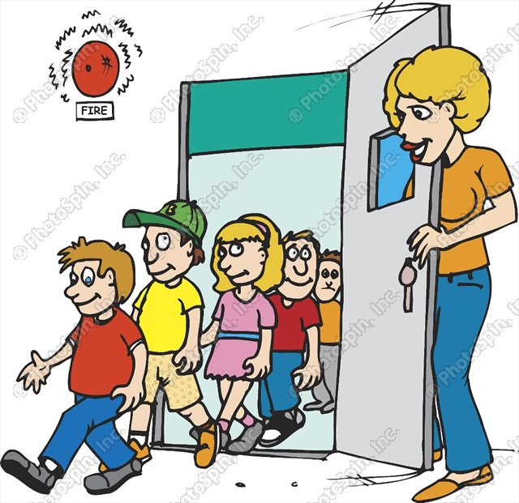
DIRECT – DIsaster REsilient Communities and Towns
Area of activity: Disaster Risk Reduction - DRR
Local population
Rescuers
Children and youth
Institutions: protection and rescue services, schools, kindergartens, local administrations and national administrations in charge of emergency management
For Whom?

Slide 8
DIRECT – DIsaster REsilient Communities and Towns
Deliverables
Task: Management and Reporting
Task: Capacity building of rescuers
Detailed implementation plan, 25 Jan 2017
At least 6 cross-border coordination meetings, 15 Jan 2017-31 Dec 2018
Reports, 1 Aug 2017-31 Dec 2018
Two evaluations, 1 Oct 2017-31 Dec 2018
Memorandum of Cooperation, 10 Mar 2017
6 cross-border trainings on Protection and Rescue in case of different emergencies, 1 Apr 2017-1 Jul 2018
3 cross-border field exercises, 1 Apr 2017-1 Jul 2018
At least 15 workshops for rescuers, 1 May 2017-1 Sep 2018
Task: Publicity
Task: Organise International Conferences on DRR
At least 6 press conferences, 30 TV and radio shows and features, 100 newspapers articles and website texts, 15 Jan 2017-31 Dec 2018
3 project videos published on the websites and social networks, 1 Sep 2018-31 Dec 2018
3 International conferences on DRR, 1 Sep -1 Dec 2018

Slide 9
DIRECT – DIsaster REsilient Communities and Towns
Deliverables
Task: Organise DRR trainings for school managements and local authorities
3 DRR trainings in Slovenia, Montenegro and the Czech Republic, 1 Feb-1 Apr 2018
Task: Organise a study visit to EU
Study visit to EU, October 2017
Tasks: Develop evacuation plans in local communities and schools and organise evacuation exercises
Task: Awareness raising campaign
At least 50 workshops in schools, 1 Mar-1 Jun 2018
3 literary competitions, 3 quizzes and an international drawing competition, 1 May-20 Oct 2018
At least 15 workshops in local communities, 20 Oct-25 Dec 2018
5 different publications, 1 Mar-1 Dec 2017
Promotional material, 1 Mar-1 Dec 2017
At least 20 evacuation plans developed for schools and local communities, 1 Apr-1 Sep 2018
At least 3 evacuation exercises in schools, 1 Sep-30 Nov 2018

Slide 10
DIRECT – DIsaster REsilient Communities and Towns
Follow-up
Major events
Dissemination and updating of publications on DRR developed through the project
Dissemination of project videos
Training of trainers on DRR
Workshops - trained rescuers will pass the knowledge and skills on their colleagues
Organisation of workshops in schools and communities after the end of the project
Dissemination of evacuation plans
Websites
Kick off meeting, Montenegro, February 2017
International conferences, October 2017, April 2018 and October 2018
Trainings
Field exercises
Study visit

Slide 11
DIRECT – DIsaster REsilient Communities and Towns
Thank you for your attention!
Ministry of Interior of Montenegro
Co-funded by the European Union

